Slide 1
Otkriće NBPF 3mer HOR genomske simetrije za razvoj kognitivnih sposobnosti čovjeka, neandertalca i čimpanze
Hrvatska akademija znanosti i umjetnosti
Odbor za biološku fiziku i bioinformatiku Razreda za matematičke, fizičke i kemijske znanosti
Zagreb 18. svibnja 2023.

Slide 2
Interdisciplinarity of molecular biology
Albert Einstein, physicist - symmetries underlying natural laws
Gregor Mendel, physicist – “father” of genetics
Erwin Schrӧdinger, physicist – DNA molecule as “aperiodic crystal” in “What is life”
Erwin Chargaff, biochemist – binary relations between bases
Rosalind Franklin, physicist – spiral structure of DNA
James Watson, biologist – DNA structure
Francis Crick, physicist – DNA structure
Marshall Nirenberg, biochemist – phenomenological genetic code
Francis Crick, physicist – standard genetic code table & frozen accident hypothesis

Slide 3
D.J. Gross, Proceedings of the National Academy of Sciences U.S.A.93, 14256-14259, 1996:
“Einstein՚s great advance was to put symmetries as a dominant concept in the fundamental laws of physics, to regard the symmetry principle as the primary feature of nature.
The symmetry principles dictate the form of the laws of nature.”

Slide 4
Otkriće GRM metode
GRM - Global Repeat Map
Originalna hrvatska bioinformatička metoda GRM najprije je u svjetskoj znanosti razvijena još 2007. za jedinstvenu preciznu identifikaciju i istraživanje simetrijskih korelacija u genomskoj sekvenci. Ta metoda je našla punu primjenu 2022. s otkrićem vrhunske T2T metode za kompletno sekvencioniranje ljudskog genoma (T2T Konzorcij) koja je po prvi put omogućila da se u potpunosti odredi kompletni humani genom, koji je do tada bio samo djelomično poznat.
Razvoj te bioinformatičke metode u Hrvatskoj prethodio je 15 godina razvoju T2T preciznog sekvencionranja genoma u SAD.

Slide 5
GRM - Global Repeat Map
M. Rosandić, V. Paar, I. Basar, Key-string segmentation algorithm and higher-order repeat 16mer (54 copies) in human alpha satellite DNA in chromosome 7, J. Theor. Biology (Cambridge) 221 (2003) 29-37.
M. Rosandić, V. Paar, I. Basar, M. Glunčić, N. Pavin, I. Pilaš, CENP-B box and pJα sequence distribution in human alpha satellite higher-order repeats (HOR), Chromosome Res. 14 (2006) 735-753.
V. Paar, I. Basar, M. Rosandić, M. Glunčić, Consensus Higher Order Repeats and Frequency of String Distributions in Human Genome, Curr. Genomics 8 (2007) 93-111.
M. Rosandić, M. Glunčić, V. Paar, I. Basar, The role of alphoid higher order repeats (HORs) in the centromere folding, J. Theor. Biol. 254 (2008) 555-560.
V. Paar, N. Pavin, I. Basar, M. Rosandić, M. Glunčić, N. Paar, Hierarchical structure of cascade of primary and secondary periodicities in Fourier power spectrum of alphoid higher order repeats, BMC Bioinformatics 9 (2008) 466.

Slide 6
GRM - Global Repeat Map
V. Paar, M. Glunčić, I. Basar, M. Rosandić, P. Paar, M. Cvitković, Large tandem, higher order repeats and regularly dispersed repeat units contribute substantially to divergence between human and chimpanzee Y chromosomes, J. Mol. Evol. 72 (2011) 34-55.
V. Paar, M. Glunčić, M. Rosandić, I. Basar, I. Vlahović, Intragene higher order repeats in neuroblastoma breakpoint family genes distinguish humans from chimpanzees, Mol. Biol. Evol. 28 (2011) 1877-1892.
M. Glunčić, V. Paar, Direct mapping of symbolic DNA sequence into frequency domain in global repeat map algorithm, Nucleic Acids Res. 41 (2013) e17.
Ines Vlahović, Matko Glunčić, Marija Rosandić, Đurđica Ugarković, Vladimir Paar, Regular Higher Order Repeat Structures in Beetle Tribolium Castaneum Genome, Genome Biol. Evol. 9, 10 (2017) 2668-2680.
Matko Glunčić, Ines Vlahović, Vladimir Paar, Discovery of 33mer in chromosome 21 – the largest alpha satellite higher order repeat unit among all human somatic chromosomes, Scientific Reports Nature Research 9 (2019) 12629 1-8.

Slide 7
GRM - Global Repeat Map
I. Vlahović, M. Glunčić, K. Dekanić, I. Mršić, H. Jerković, I. Martinjak, V. Paar, Global repeat map algorithm (GRM) reveals differences in alpha satellite number of tandem and higher order repeats (HORs) in human, Neanderthal and chimpanzee genomes – novel tandem repeat database, in: 2020 43rd International Convention on Information, Communication and Electronic Technology (MIPRO), DOI: 10.23919MIPRO 48935.2020.9245278, IEEE (Institute of Electrical and Electronic Engineers), ISSN: 2623-8764.
V. Paar, I. Vlahović, M. Rosandić, M. Glunčić, Global Repeat Map (GRM): Advantageous Method for Discovery of Largest Higher–Order Repeats (HORs) in Neuroblastoma Breakpoint Family (NBPF) Genes, in Hornerin Exon and in Chromosome 21, Satellite DNAs in Physiology and Evolution, Progress in Molecular Biology, Vol. 60, 203-234, 2021, Ed. Đ. Ugaković, Springer (978-3-030-74888-3, 634_1_En).
Matko Glunčić, Ines Vlahović, Leo Mršić, Vladimir Paar, Global Repeat Map (GRM) application: finding all DNA tandem repeat units, Algorithms 15, 458, 2022.
Matko Glunčić, Ines Vlahović, Marija Rosandić, Vladimir Paar, Tandemly repeated NBPF HOR copies (Olduvai triplets): Possible impact on human brain evolution, Life Science Allience 6, 1, e202101306 (2022).

Slide 8
S.S. Lower, M.P. McGurk, A.G. Clark, A. Barbash (Department of Molecular Biology and Genetics, Cornell University, Ithaca, USA), Satellite DNA evolution: old ideas, new approaches, Curr. Opin. Genet. Dev. 49, 70 (2018):
“A substantial portion of the genomes of most multicellular eukaryotes consists of large arrays of tandemly repeated sequence, collectively called satellite DNA. Satellites have been linked to chromosome mis-segregation, disease phenotypes, and reproductive isolation between species. Advances in computational tools and sequencing technologies now enable identification and quantification of satellite sequences genome-wide. Here, we describe some of these tools and how their applications are to our knowledge of satellite evolution and function.”

Slide 9
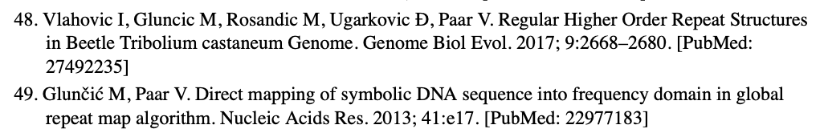
S.S. Lower, M.P. McGurk, A.G. Clark, A. Barbash (Department of Molecular Biology and Genetics, Cornell University, Ithaca, USA), Satellite DNA evolution: old ideas, new approaches, Curr. Opin. Genet. Dev. 49, 70 (2018):

Slide 10
N. Altemose, G.A. Logsdon, A.V. Bzikadze, P. Sidhwani, S.A. Langley, G.V. Caldas, S.K. Hoyt, L. Uralsky, F.D. Ryabov, C.J. Shew, M.E.G. Sauria, M. Borchers. A. Gershman, A. A. Mikheenko, V.A. Shepelev, T. Dvorkina, O. Kunyavskaya, M.R. Vollger, A. Rhie, A.M. McCartney, M. Asri, R. Lorig-Roach, K. Shafin, J.K. Lucas, S. Aganezov, D. Olson, L.G. de Lima, T. Potapova, G.A. Hartley, M. Haukness, P.Kerpedjiev, F. Gusev, K. Tigyi, S. Brooks, A. Young, S. Nurk, S. Koren, S.R. Salama, B. Paten, E.I. Rogaev, A. Streets, G.H. Karpen, A.F. Dernburg, B.A. Sullivan, A.F. Straight, T.J. Wheeler, J.L. Gerton, E.E. Eichler, A.M. Phillippy, W. Timp, M.Y. Dennis, R.E. O՚Neill, J.M. Zook, M.C. Schatz, P.A. Pevzner, M. Diekhans, C.H. Langley, I.A. Alexandrov, K.H. Miga (Department of Molecular and Cell Biology, University of California, Berkley, California, USA; Department of Genome Science, University of Washington School of Medicine, Seattle, Washington, USA; Graduate Program in Bioinformatics and System Biology, University of California San Diego, La Jolla, California, USA; Department of Biochemistry, Stanford University, Stanford, California, USA; Institute of Systems Genomics, University of Connecticut, Storrs, Connecticut, USA; MIND Institute and Department of Biochemistry and Molecular Medicine, University of California, Davis, California, USA; Department of Biology, Johns Hopkins University, Baltimore, Maryland, USA; Stowers Institute for Medical Research, Kansas City, Missouri, USA; Department of Molecular Biology and Genetics, Johns Hopkins University, Baltimore, Maryland, USA; Center for Algorithmic Biotechnology, Saint Petersburg State University, Saint Petersburg, Russia; Genome Informatics Section, Human Genome Research Institute, National Institutes of Health, Bethesda Maryland, USA; Santa Cruz Genomics Institute, University of California Santa Cruz, Santa Cruz, California, Santa Cruz, California, USA; Department of Computer Science, Johns Hopkins University, Baltimore, Maryland, USA; Department of Computer Science, University of Montana, Missoula, Montana, USA; Reservoir Genomics, Oakland, California, USA; Howard Hughes Medical Institute, Chevy Chase, Maryland, USA; NIH Intramural Sequencing Center, National Institutes of Health, Bethesda, Maryland, USA; Department of Biomolecular Engineering, University of California Santa Cruz, California, USA; Department of Psychiatry, University of Massachusetts Medical School, Worcester, Maine, USA; Faculty of Biology, Lomonosov Moscow State University, Moscow, Russia; Department of Bioengineering, University of California, Berkeley, California, USA; Chan Zuckerberg Biohub, San Francisco, USA; Institute for Quantitative Biosciences, University of California, Berkeley, California, USA; Department of Molecular Genetics and Microbiology, Duke University, Durham, North Carolina, USA; University of Kansas Medical School, Department of Biochemistry and Molecular Biology and Cancer Center, Kansas City, Kansas, USA; Department of Biomedical Engineering, Johns Hopkins University, Baltimore, Maryland, USA; Biosystems and Biomaterials Division, National Institute of Standards and Technology, Gaithersburg, Maryland, USA; Department of Computer Science and Engineering, University of California at San Diego, California, USA) - T2T Consortium
Complete Genomic and epigenetic maps of human centromeres, Science 376, eabl4178 (2022):
“Whereas some chromosomes, such as chr7, are composed almost entirely of canonical HOR units, others, such as chr 10, contain many structural variant types, with high variation in the relative frequency of these structural variants across individuals. Unlike alphaSat, some families such as HSat2 and HSat3 have inconsistent or unknown repeat unit lengths and often contain an irregular hierarchy or smaller repeat units. We refer to these repeat units as nested tandem repeats (NTRs), a more general term than HORs, which are composed of discrete numbers of monomers of similar lengths. To expand our ability to annotate repeat structure within assembled satellite DNA arrays, we developed NTRprism, an algorithm to discover and visualize satellite repeat periodicity, similar to (V. Paar, I. Basar, M. Rosandić, M. Glunčić, Consensus Higher Order Repeats and Frequency of String Distributions in Human Genome, Curr. Genomics 8 (2007) 93-111). Using this tool, we discovered HORs in HSat1 and beta Sat arrays, as well as NTRs in multiple HSat2,3 arrays. We also applied this tool in smaller windows across individual arrays, showing that repeat periodicity can vary across an array, which is consistent with NTRs evolving and expanding hyper-locally in some cases (fig. S11).”

Slide 11
Otkriće NBPF 3mer HORs
Vladimir Paar, Matko Glunčić, Marija Rosandić, Ivan Basar, Ines Vlahović:
Intragene higher order repeats in neuroblastoma breakpoint family genes distinguish human from chimpanzees
Molecular Biology and Evolution28, 1877-1892 (2011)
Matko Glunčić, Ines Vlahović, Marija Rosandić, Vladimir Paar:
Tandemly repeated NBPF HOR copies (Olduvai triplets): Possible impact on human brain evolution
Life Science Alliance 6, e202101306 (2022)
Matko Glunčić, Ines Vlahović, Marija Rosandić, Vladimir Paar
Tandemly repeated NBPF 3mer HOR copies (Olduvai triplets) in Neanderthal AltaiNea.hg19 assembly and novel tandem arrays of NBPF 3mer HOR repeats in complete T2T-CHM13 assemblies of human and chimpanzee chromosome 1
Submitted for publication (2023)

Slide 12
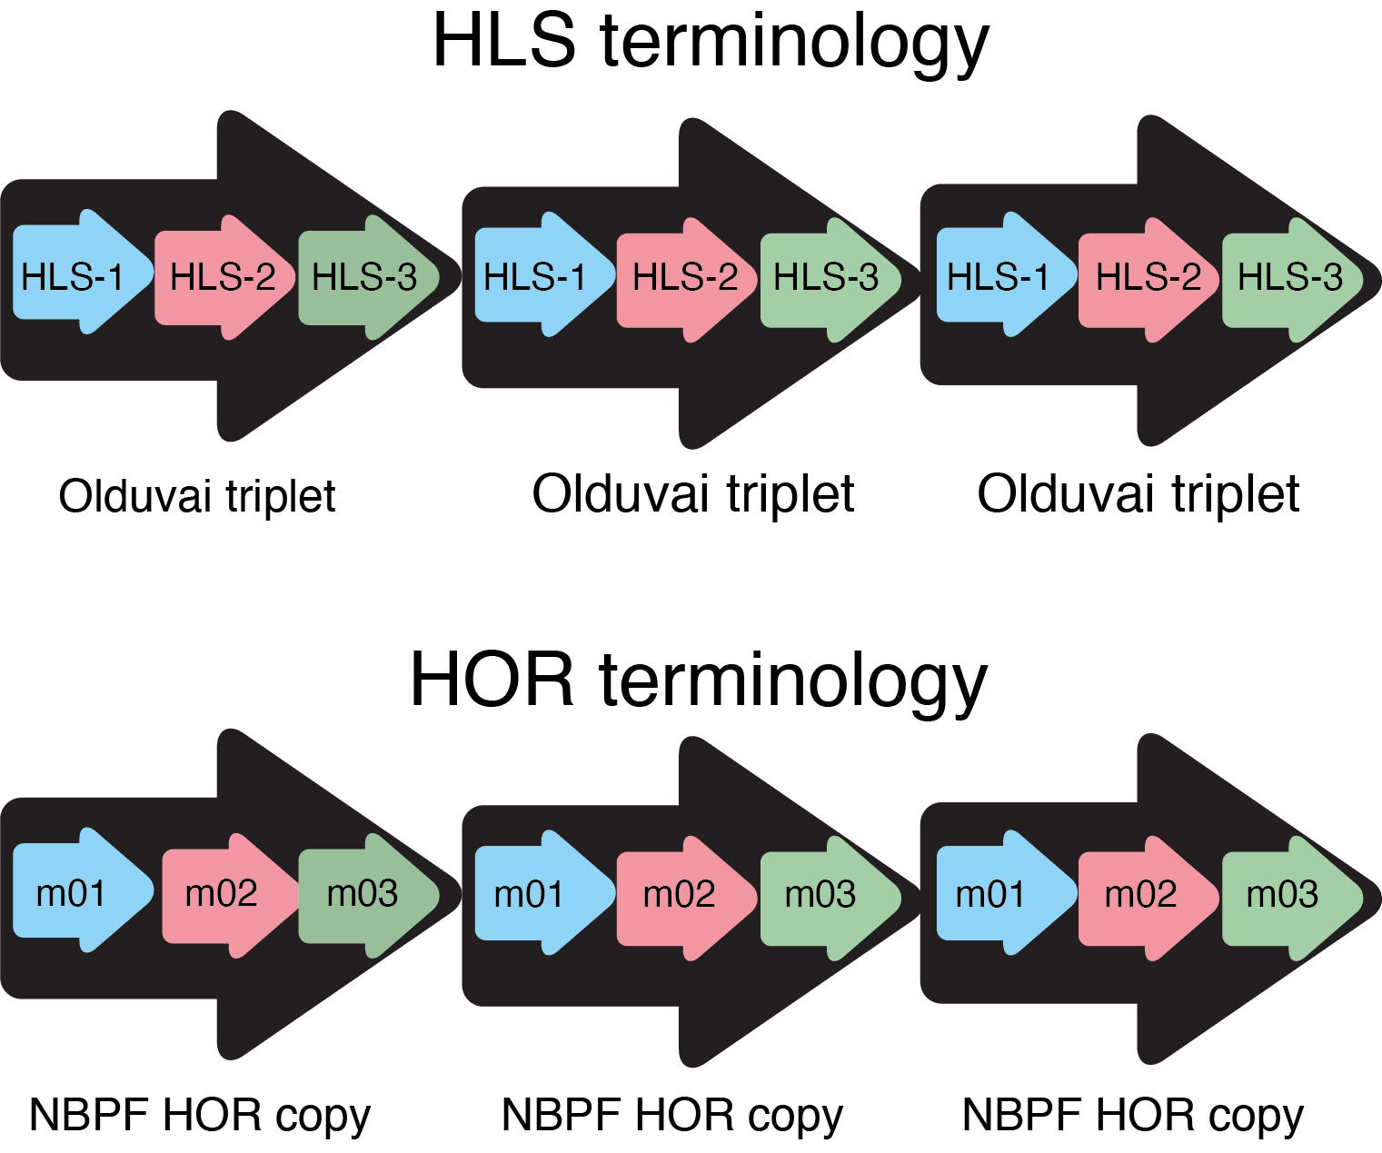
HLS vs. HOR terminologija
Glunčić, Vlahović, Rosandić, Paar
Life Science Alliance 6, e202101306

Slide 13
GRM diagram za 140 Mb – 150 Mb segment kromosoma 1
Glunčić, Vlahović, Rosandić, Paar
Submitted for publication (2023)

Slide 14
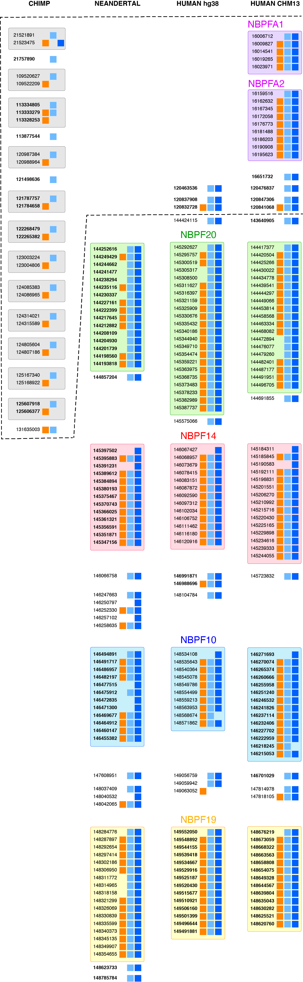
Usporedba sheme poravnanja NBPF monomera za NBPF 3mer HOR kopije kromosoma 1

Slide 15
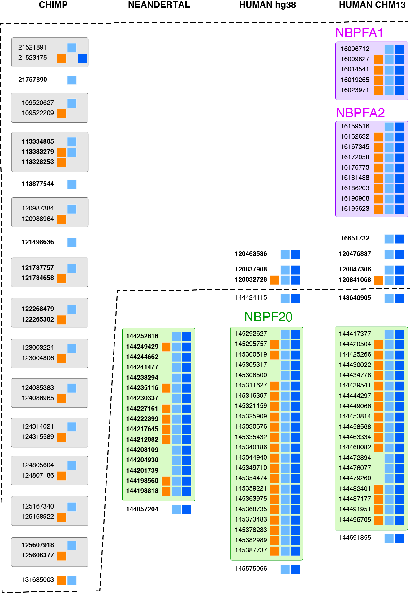

Slide 16
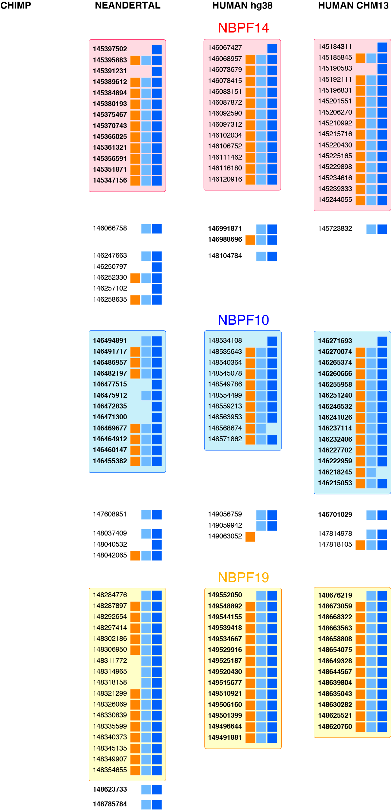

Slide 17
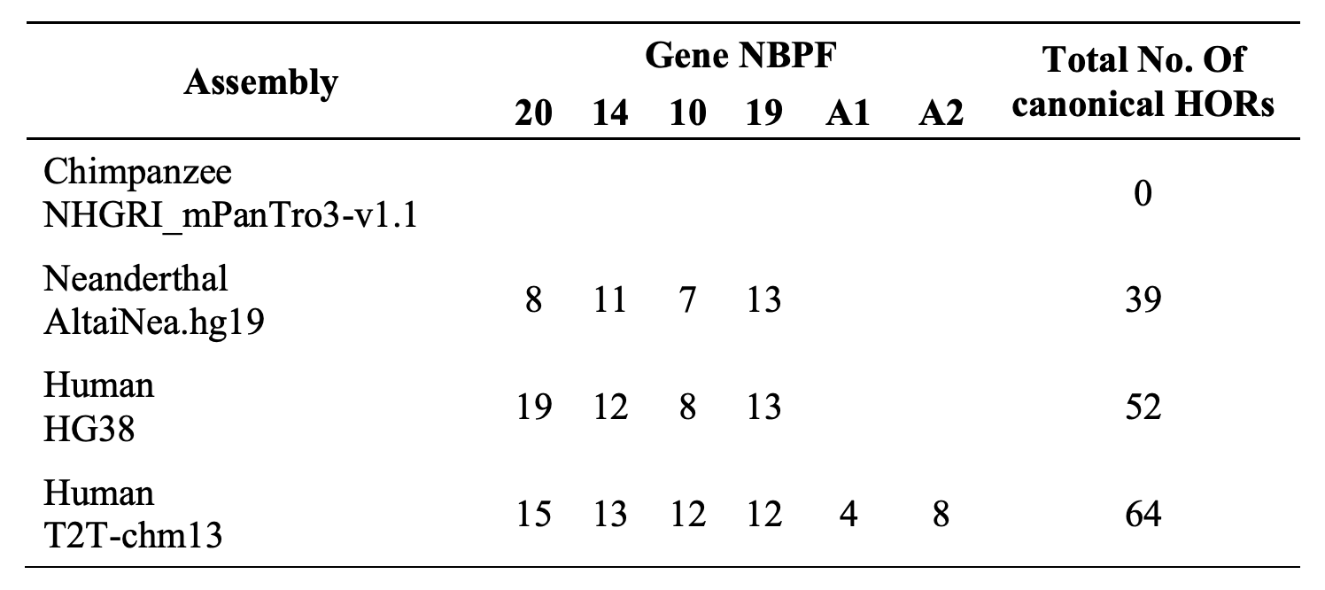
It is known that the ~1.6 kb NBPF repeats from NBPF genes are also contributing to human cognitive capabilities. Using our original GRM (Global Repeat Map) algorithm we have discovered a discontinuous jump of tandemly organized 3mer HORs (Olduvai triplets) from 0 in chimpanzee to ~50 in modern human genome. This is the exclusively human specific organized pattern of ~50 × 3 × 1.6 kb ~ 240 kb (240 000) nucleotides!
Could one hypothesize about particular “long range correlations”?
Related to quantum-physical wave function as Einstein՚s “ghost”?
Related to deterministic chaos in human brain?
“Quantum world is smoke and windows.” Tri Nobelovca

Slide 18
OTKRIĆE U HRVATSKOJ!
Here we investigate the NBPF 3mer HOR structure in Neanderthal genome assembly of Pääbo and collaborators, in comparison to results for human hg38 chromosome 1. We compute the human NBPF 3mer HOR pattern for complete T2T-CHM13 human assembly by Miga and collaborators (T2T- Consortium). We discover in T2T-CHM13 assembly the two novel tandem arrays of NBPF 3mer HOR repeats with 5 and 9 NBPF 3mer HOR copies. We hypothesize that they correspond to the novel human specific NBPF genes (here named NBPFA1 and NBPFA2), positioned at large distance of 100 Mbp from the known NBPF genes.
For understanding human evolution it is important to improve the quality of sequenced Neanderthal genome using T2T-CHM13 as a reference, to determine whether the counterparts of distant human novel NBPF genes exist in Neanderthal genome.

Slide 19
In addition to investigate human reference genome, we have also determined the 3mer tandems of canonical 3mer HOR copies in 20 randomly chosen human genomes (10 male and 10 female).
In all cases we found the same 3mer HOR copy numbers as in the case of the reference human genome, with no mutation.
On the contrary, we found point mutations with respect to the reference genome for some NBPF monomers which are not tandemly organized in canonical HORs.
One more case for Einstein՚s paradigm: Symmetries are underlying the natural laws

Slide 20
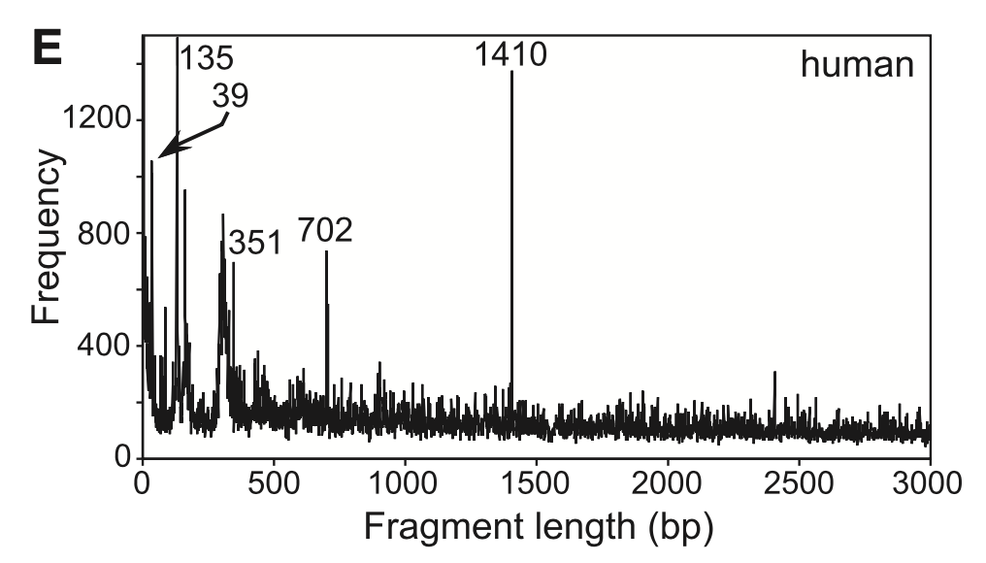
Discovery of the first case of quartic HOR in human genome

Slide 21
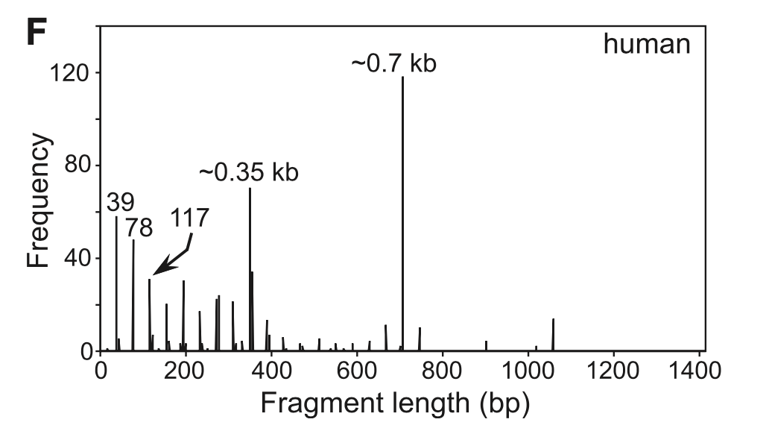
Discovery of the first case of quartic HOR in human genome

Slide 22
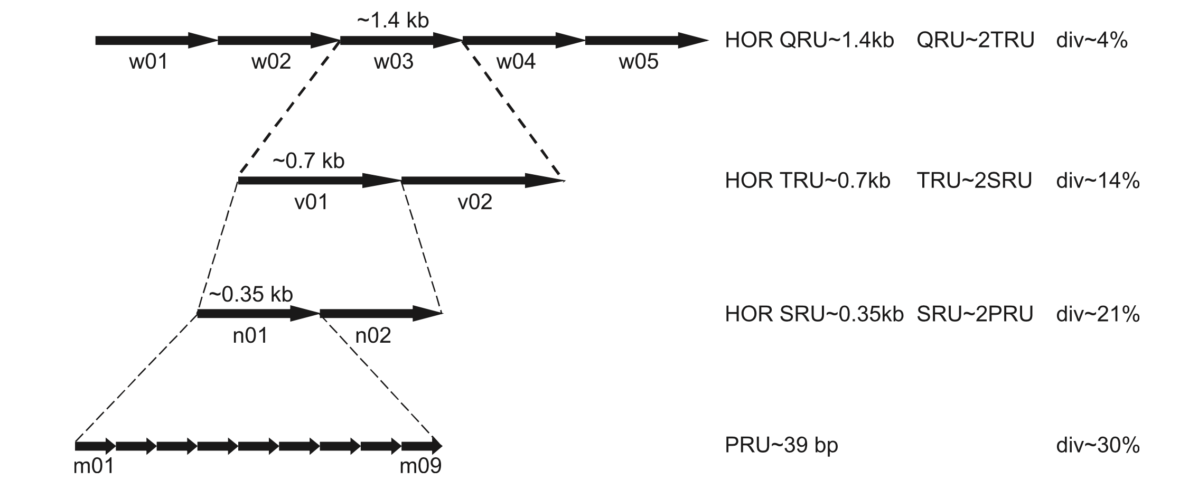
Discovery of the first case of quartic HOR in human genome

Slide 23
V. Romero, H. Nakaoka, I. Inoue, K. Hosomichi (Department of Genetics School of Life Sciences, SOKENDAI Graduate University of Advanced Studies, Japan; National Institute of Genetics, Mishima, Japan; Department of Bioinformatics and Genetics, Gradual School of Medical Sciences, Kanezawa University, Japan), High order formation and evolution of hornerin in primates, Genome Biology and Evolution 10, 3167-3175 (2018):
"Paar et al. (Paar, Glunčić, Rosandić , Basar, Vlahović, 2011) and Takaishi et al. (2005) have different theories as to the formation of the repeated region of HRNR; both groups share the longest repeat length of 1,404 bp (longest unit), but they differed in the process. We identified the formation described by Paar et al. (2011): {[(39bp(primary)×9"×2(secondary) ×2(tertiary)]×5(quartic)}, to be conserved in all primate species except the crab-eating macaque. Introduction: Paar et al. (2011) described HRNR formation using the Global Repeat map algorithm as follows: a primary repeat unit sequence (39 bp) was amplified by nine to form a secondary repeat unit (351 bp), duplication of the secondary repeat unit forms a tertiary repeat unit of 0.70 kb, and finally two tertiary repeat units form a 1.4 kb quartic repeat unit. Notably, Paar et al. (2011) detected the higher order repeat structure only in human HRNR but not in chimpanzee, which could be a driving force for the evolutionary process. Paar et al. (2011) description starts with 39 bp to form the primary repeat unit, which amplified 9 times to form the secondary unit (type n01 and n02), the secondary unit duplicated to form the tertiary unit (type v01 and v02) and finally the tertiary unit duplicated again to form the quartic unit (w01). Fig.2. Longest, second–longest, quartic, tertiary, and secondary units of hornerin in primates by Takaishi et al. and Paar et al. formation. By Paar et al. formation, the number of quartic units was six for human, chimpanzee, orangutan, and crab-eating macaque and four for gorilla and ranged from 936 to 1,410 bp. The length of the longest repeat formed was 1,404 bp and shared both formations proposed by Paar et al. and Takaishi. Primary units (39 bp) described by Paar et al. (2011). The proposed formation by Takaishi et al. (2005) was [(117 bp×4) ×3(subunits)] × 6(units)} (fig. 1A), whereas the formation by Paar et al. (2011) was {[("39bp(primary)×9"×2(secondary)) ×2(tertiary)]×5(quartic)}. We examined both possibilities and clarified which structure was detectable in primates. The phylogeny of the primary units divided primary units into nine clusters (order, 1-9) in each species tree by Paar et al. (2011). This pattern was observed for human, chimpanzee, gorilla, and orangutan... We next focused on tertiary units proposed by Paar et al. (2011). We used the secondary units to reconstruct the tertiary units (fig. 2). Paar et al. divided tertiary units into "v01" and "v02" types. Fig. 5. representation. The cluster pattern follows, "Group-1st," "Group-2nd," "Group-3rd," which fits the length of the secondary unit described by Paar et al. Hornerin has a unique and complex duplicate formation that is different from other SFPTs. The hornerin repeat formations proposed by Takaishi et al. (2005) {[(117 bp×4) ×3(subunits)]×6(units)} (fig. 1A), and by Paar et al. (2011) {[("39bp(primary)×9"×2(secondary))×2(tertiary)]×5(quartic)}. were examined and compared among several primates (fig. 1). In the repeat organization by Paar et al. (2011), 39bp of the primary unit was detected in chimpanzee, gorilla, orangutan, and crab-eating macaque (fig. 2). We confirmed that in all primates except crab-eating macaque the formation model started with the primary units which duplicated to make the secondary units, and the secondary units duplicated twice again to form the tertiary structure as described by Paar et al. (2011) (fig. 1B). The biological importance of tandem repeats was mentioned by Paar et al. (2011) as a rapidly evolving type of DNA that could contribute to phenotypic differences, even between closely related species such as humans and chimpanzees. The Global Repeat Map of Paar et al. (2011). Neuroblastoma break-point family (NBPF) copy number variability is a dramatic example of high order repeat in human and chimpanzees (Paar et al. 2011). The NBPF repeat is related to the evolutionary level of higher primates and the high order repeat pattern shows a discontinuous jump in the evolutionary step from 48 monomers in chimpanzee to 165 monomers in human, possibly related to a regulatory function of high order repeats (Paar et al. 2011).
Paar et al. 2011: Paar V, Glunčić M, Rosandić M, Basar I, Vlahović I, 2011, Intragene higher order repeats in neuroblastoma breakpoint family genes distinguish humans from chimpanzees. Molecular Biology and Evolution 28(6):1877-1892. (Oxford University Press)."

Slide 24
Discovery of fundamental supersymmetry giving rise to genetic code
E. Koonin and A.S. Novozhilov, U.S. National Institute of Health, Origin and evolution of genetic code: the universal enigma, IUBMB Life 61, 99-111, 2009:
“Why is the genetic code the way it is and how did it come to be, that was asked over fifty years ago at the dawn of molecular biology and might remain pertinent even in another fifty years.”
Marija Rosandić, Vladimir Paar, Standard Genetic Code vs. Supersymmetry Genetic Code – Alphabetical table vs. Physicochemical table, BioSystems 218 (2022) 104695
“We solved this problem forty years earlier than expected.”

Slide 25
Supersymmetry genetic Code (SSyGC) Table
The National Institutes of Health, National Library of Medicine:
“The fundamental role of symmetry in the genetic code is to decrease disorder (information entropy) between codons and to preserve the integrity of system during evolution.”
Rosandić, Paar, Standard Genetic Code vs. Supersymmetry Genetic Code – Alphabetical table vs. Physicochemical table, BioSystems 218 (2022) 104695
Rosandić, Vlahović, Pilaš, Glunčić, Paar, An explanation of exceptions from Chargaff՚s second parity rule/strand symmetry of DNA molecules, Genes 13 (2022) 1929
Rosandić, Paar, The novel Ideal Symmetry Genetic code table – common purine-pyrimidine symmetry net for all RNA and DNA species. Journal of Theoretical Biology 524, 110748 (2021).
Rosandić, Vlahović, Paar, Novel look at DNA and life – symmetry as evolutionary forcing, Journal of Theoretical Biology 483, 109985 (2019). Marija Rosandić, Ines Vlahović, Vladimir Paar, Novel look at DNA and life – Symmetry as evolutionary forcing, Journal of Theoretical Biology, 483 (2019) 109985
Rosandić, Vlahović, Glunčić, Paar, Trinucleodide´s quadruplet symmetries and natural symmetry law of DNA creation ensuing Chargaff´s second parity rule, Journal of Biomolecular Structure and Dynamics 34 (2016) 1383-1394.
Rosandić, Paar, Codon sextets with leading role of serine creates “ideal” symmetry classification scheme of the genetic code, Gene (2014); Marija Rosandić, Vladimir Paar, Codon sextets with leading role of serine create "ideal" symmetry classification scheme of the genetic code, Gene 543 (2014) 45-52.
Rosandić, Paar, Glunčić, Fundamental role of start/stop regulators in whole DNA and new trinucleotide classification, Gene 531, 2 (2013) 184-190.

Slide 26
M. Rosandić (Croatian Academy of Sciences and Arts), RYUGU amino acid samples support genetic code supersymmetry, Science (2022) 10.1126/science.abn7850 eLetters:
“The recently published fascinating results from material directly brought to Earth from asteroid Ryugu, old 4.6 billion years, are showing for the first time extraterrestrial amino acids essential to make proteins (Yokoyama et al., 2022; Nakamura et al., 2022). In May 2022 our published article “Standard Genetic code vs. supersymmetry Genetic code – Alphabetical table vs. physicochemical table “, presents a new view on the origin of life and evolution based on physicochemical genetic code symmetries (Rosandić and Paar, 2022). Ever since Nirenberg՚s discovery in 1961 (Nirenberg and Matthaei, 1961) in which codons code individual amino acids, scientists searched for genetic code symmetries which are decreasing disorder (entropy) during evolution and preserve integrity of biological systems. Already Einstein put symmetries as the primary feature of nature. But the standard Genetic Code (SGC) table is only an alphabetical construct. Our novel Supersymmetry Genetic Code (SSyGC) table is based on the unique physicochemical purine-pyrimidine symmetry net as “the golden rule” which is universal and unchanged during the whole evolution of all RNA and DNA living species on Earth. The position of codons is strictly determined in the symmetry net. In more than 30 slightly alternative variants of nuclear and mitochondrial genetic codes, the symmetry net is also present. The laboratory constructed Escherichia coli synthetic genetic code (Fredens et al., 2019) excluding two out of six codons encoding serine and TAG signal, has not a different but mutilated SSyGC with abnormal E. coli (Rosandić and Paar, 2022). We concluded that there exist arguments against the random, gradual, and individual development of amino acids during the early evolution. Life was born when all members of the genetic code had been generated. Our hypothesis received scientific support a month later from asteroid Ryugu samples. Life on Earth was born with the initial inclusion of all 20 natural amino acids already present in the Solar System and with symmetries to shed new light on evolution.
REFERENCES
Yokoyama et al., Science 10.1126/science.abn7850 (2022)
Nakamura et al., Proc. Jpn. Acad. 10.2183/pjab.98.015 (2022)
Rosandić, V. Paar, BioSystems 10.1016/j.biosystems.2022.104695 (2022)
W. Nirenberg, J.H. Matthaei, Proc.Nat.Acad.Sci.USA 10.1073/pnas.47.10.1588 (1961)
Fredens et al., Nature 10.1038/s41986-019-1192-5 (2019).”

Slide 27
OUR HYPOTHESIS:
REALIZATION OF SSyGC SUPERSYMMETRY instead of Crick՚s Frozen Accident Hypothesis

