Slide 1
Molekularni mehanizmi cijepljenja protiv COVID-19
Luka Čičin-Šain, HZI
Research group: Immune Aging and Chronic Infections
HZI Braunschweig, 26.4.2021
E-mail: luka.cicin-sain@helmholtz-hzi.de

Slide 2
Osnovni mehanizam imunološke memorije
Imunost je adaptacija jedinke na mikrobiološki okoliš
Limfociti
  B-stanice
  T-stanice
Raznovrsnot repertoara
  Imunološu memoriju definiraju
  kontakti s mikroorganizmima
  S godinama se prilagođavamo
  na mikrobiom iz okoliša
Notes:
The immune system of all vertebrates is able to adapt to its environment and form immunological memories. <CLICK> Therefore, our immune system “remembers” previously encountered germs, and is able to counter them efficiently if we get reinfected by them. The cells that perform this function are called lymphocytes <CLICK>, which are divided into B-lymphocytes <CLICK>, which make antibodies, and the T-lymphocytes <CLICK>, which are able to recognize and kill the infected cells, while sparing the uninfected bystanders.
When we are born, our lymphocytes have a very broad repertoire <CLICK>, which allows them to recognize literally billions of potential pathogens. However, as we age, <CLICK> the cumulative history of previous encounters with germs shapes our personal repertoire, selecting for the cell clones that were specific for encountered virus or bacteria.
At the same time <CLICK>, our repertoire diversity diminishes, making it increasingly more difficult to control novel pathogens.

Slide 3
Što može biti antigen?
B-stanice: svaka molekula koja nije prisutna u našem tijelu i koju B-stanice mogu susresti tijekom sazrijevanja u koštanoj srži. Na primjer:
    Proteini
    Saharidi
    Lipopolisaharidi, itd...
T stanice: Isključivo oligopeptidi
    Derivati bjelančevina
    Produkti proteolitičkog cijepljenja
    Locirani u stanicama

Slide 4
Ag prepoznavanje B-limfocitima
SOLUBILNI Ag IZ
EKSTRACELULARNOG PROSTORA
PROTUTIJELA
BCR

Slide 5
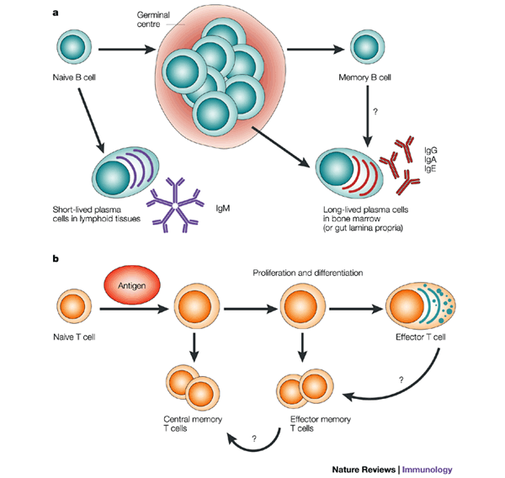
Mehanizam humoralne memorije
Pomoć CD4 T-stanica
Germ
centar
Naivna B stanica
Memorijski B limfocit
Kratkotrajna
plazma stanica
IgM
Dugoročna
plazma stanica u k. srži

Slide 6
T-stanični antigeni
MHC I
TCR
CD8
SVAKA STANICA
MHC II
PROFESIONALNA
Ag PREZENTIRAJUĆA
STANICA
CD4

Slide 7
Mehanizmi protuvirusnog djelovanja limfocita
citokini
citotoksičnost
MHC I
TCR
SVAKA STANICA
CD8
Citosol
citokini
MHC II
PROFESIONALNA
Ag PREZENTIRAJUĆA
STANICA
CD4
Endosom

Slide 8
MHC-II prikazuje peptide nastale proteaznom razgradnjom proteina iz endosoma
ER
Golgi
Endosome
T cell
MHC II
+li
MHC II
+CLIP
H2-DM
Lysosome
Endolysosome
Cytokines
(IFNg,
IL6,
IL17, etc…)
nucleus

Slide 9
MHC-I Prikazuje peptide nastale proteasomalnom razgradnjom
viral
ER
proteins
proteasome
Golgi
Virus
1/2
viral
T cell
proteins
TAP
MHC I
MHC I
nucleus

Slide 10
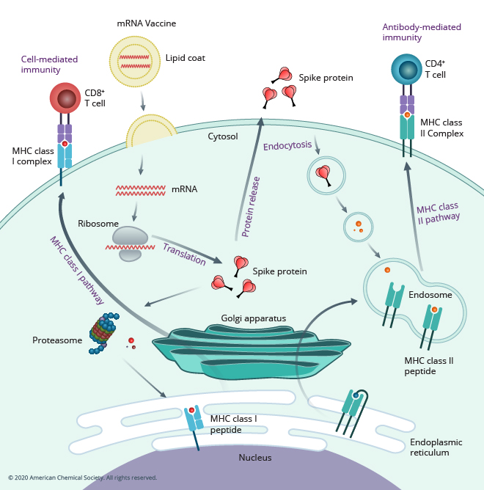
mRNA cjepiva

Slide 11
Koje formulacije cjepiva aktiviraju koje stanice?
Živo atenuirano
Živo atenuirano
Živo atenuirano
Inaktivirano
Inaktivirano
Subunit
(podjedinično)
Subunit
(podjedinično)
mRNA
Nanočestice
mRNA
Nanočestice
mRNA
Nanočestice
TCR
BCR
TCR
CD4
B-cell
CD8

Slide 12
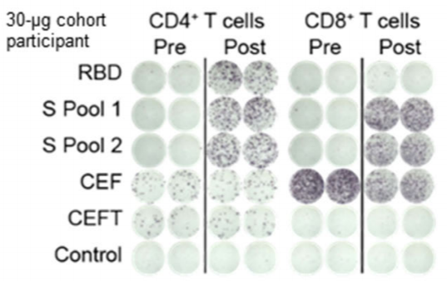
Stanična Imunost po Biontech cjepivu
https://doi.org/10.1038/s41586-020-2814-7

Slide 13
COVID cjepiva
Odobrena u EU: Biontech, Moderna, AstraZeneca, J&J
Odobrena u drugim zemljama ili pred odobrenjem: Sputnik-V, Curevac, Sinovac, Novavax, CanSino...
mRNA cjepiva: Biontech, Moderna, Curevac
Adenovirusni vektori: AstraZeneca, J&J, Sputnik-V, CanSino
Inaktivirani virus: Sinovac
Subunit: Novavax

Slide 14
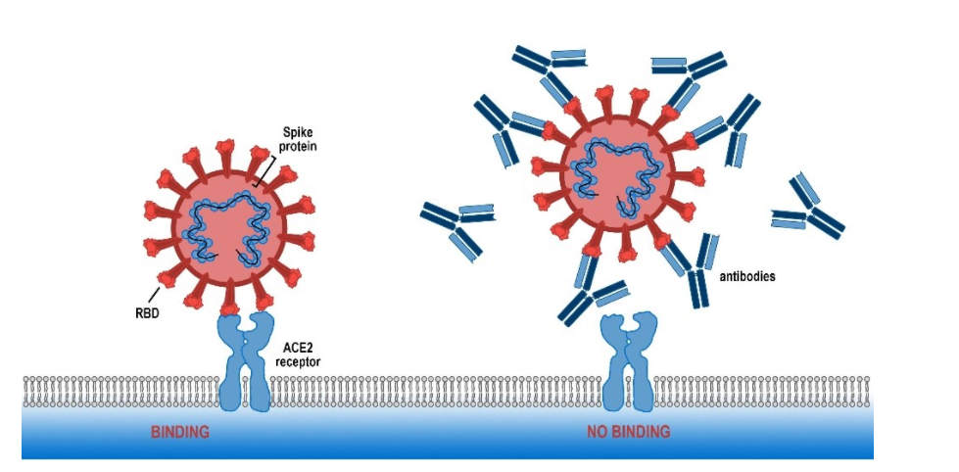
Mehanizam djelovanja COVID cjepiva
https://www.fluidic.com/resources/solution-phase-affinity-profiling-of-a-SARS-CoV-2/

Slide 15
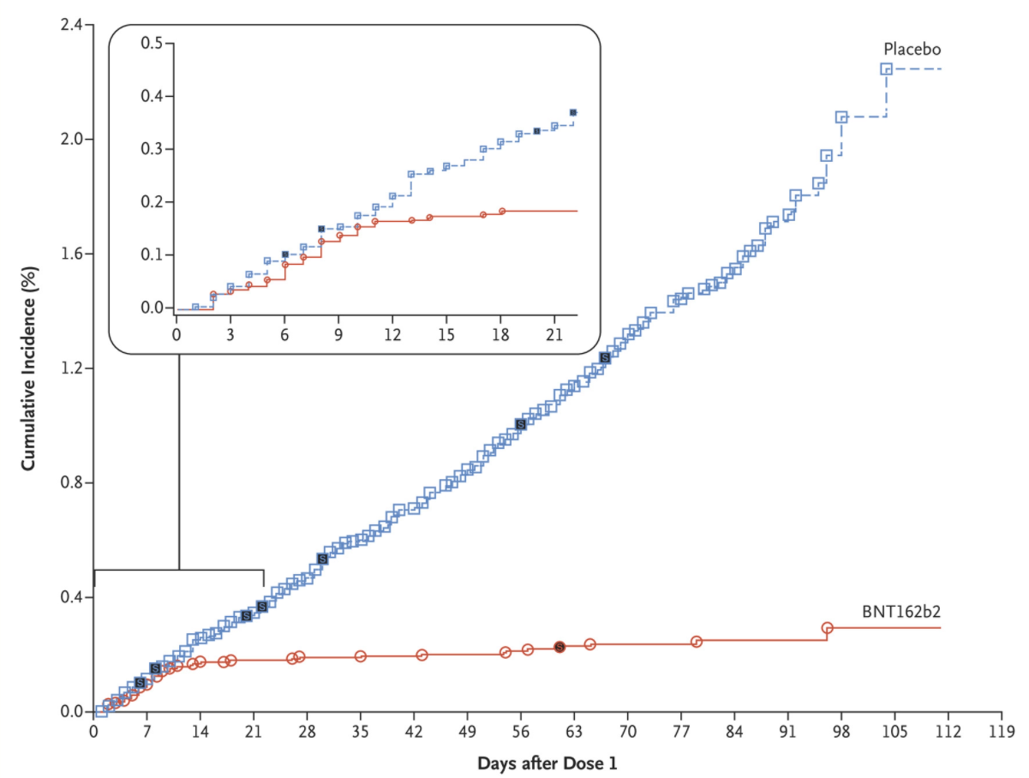
Rezultati 3. faze kliničkog testiranja: Biontech/Pfizer

Slide 16
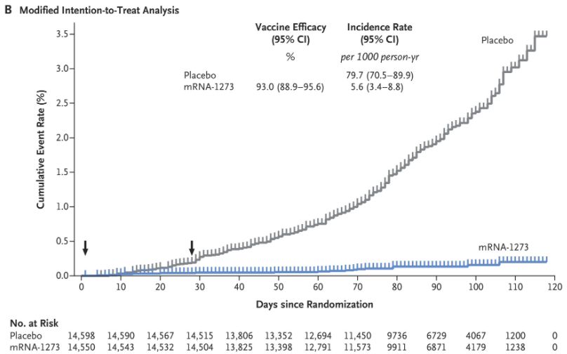
Rezultati 3. faze kliničkog testiranja: Moderna

Slide 17
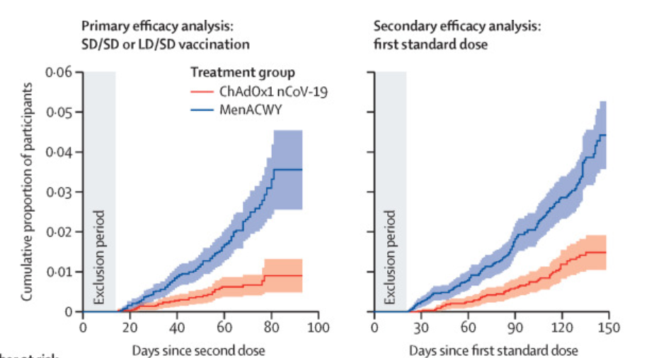
Rezultati 3. faze kliničkog testiranja: Astrazeneca
DOI:https://doi.org/10.1016/S0140-6736(20)32661-1

Slide 18
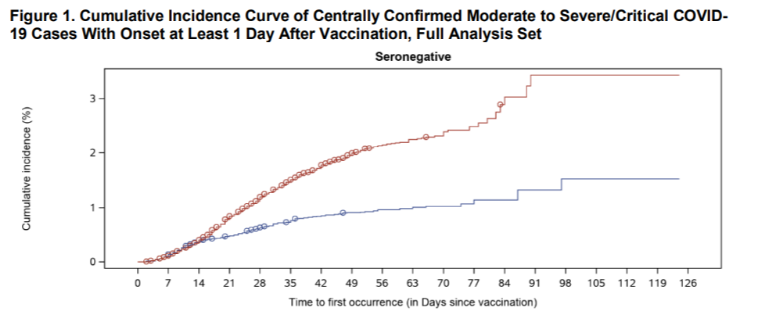
Rezultati 3. faze kliničkog testiranja: Johnson&Johnson
https://www.fda.gov/media/146217/download

Slide 19
Zaključak:
Sva cjepiva štite protiv COVID-19 infekcije
mRNA cjepiva djeluju jače od Adenovirusnih
Sva cjepiva štite protiv teških oblika bolesti

Slide 20
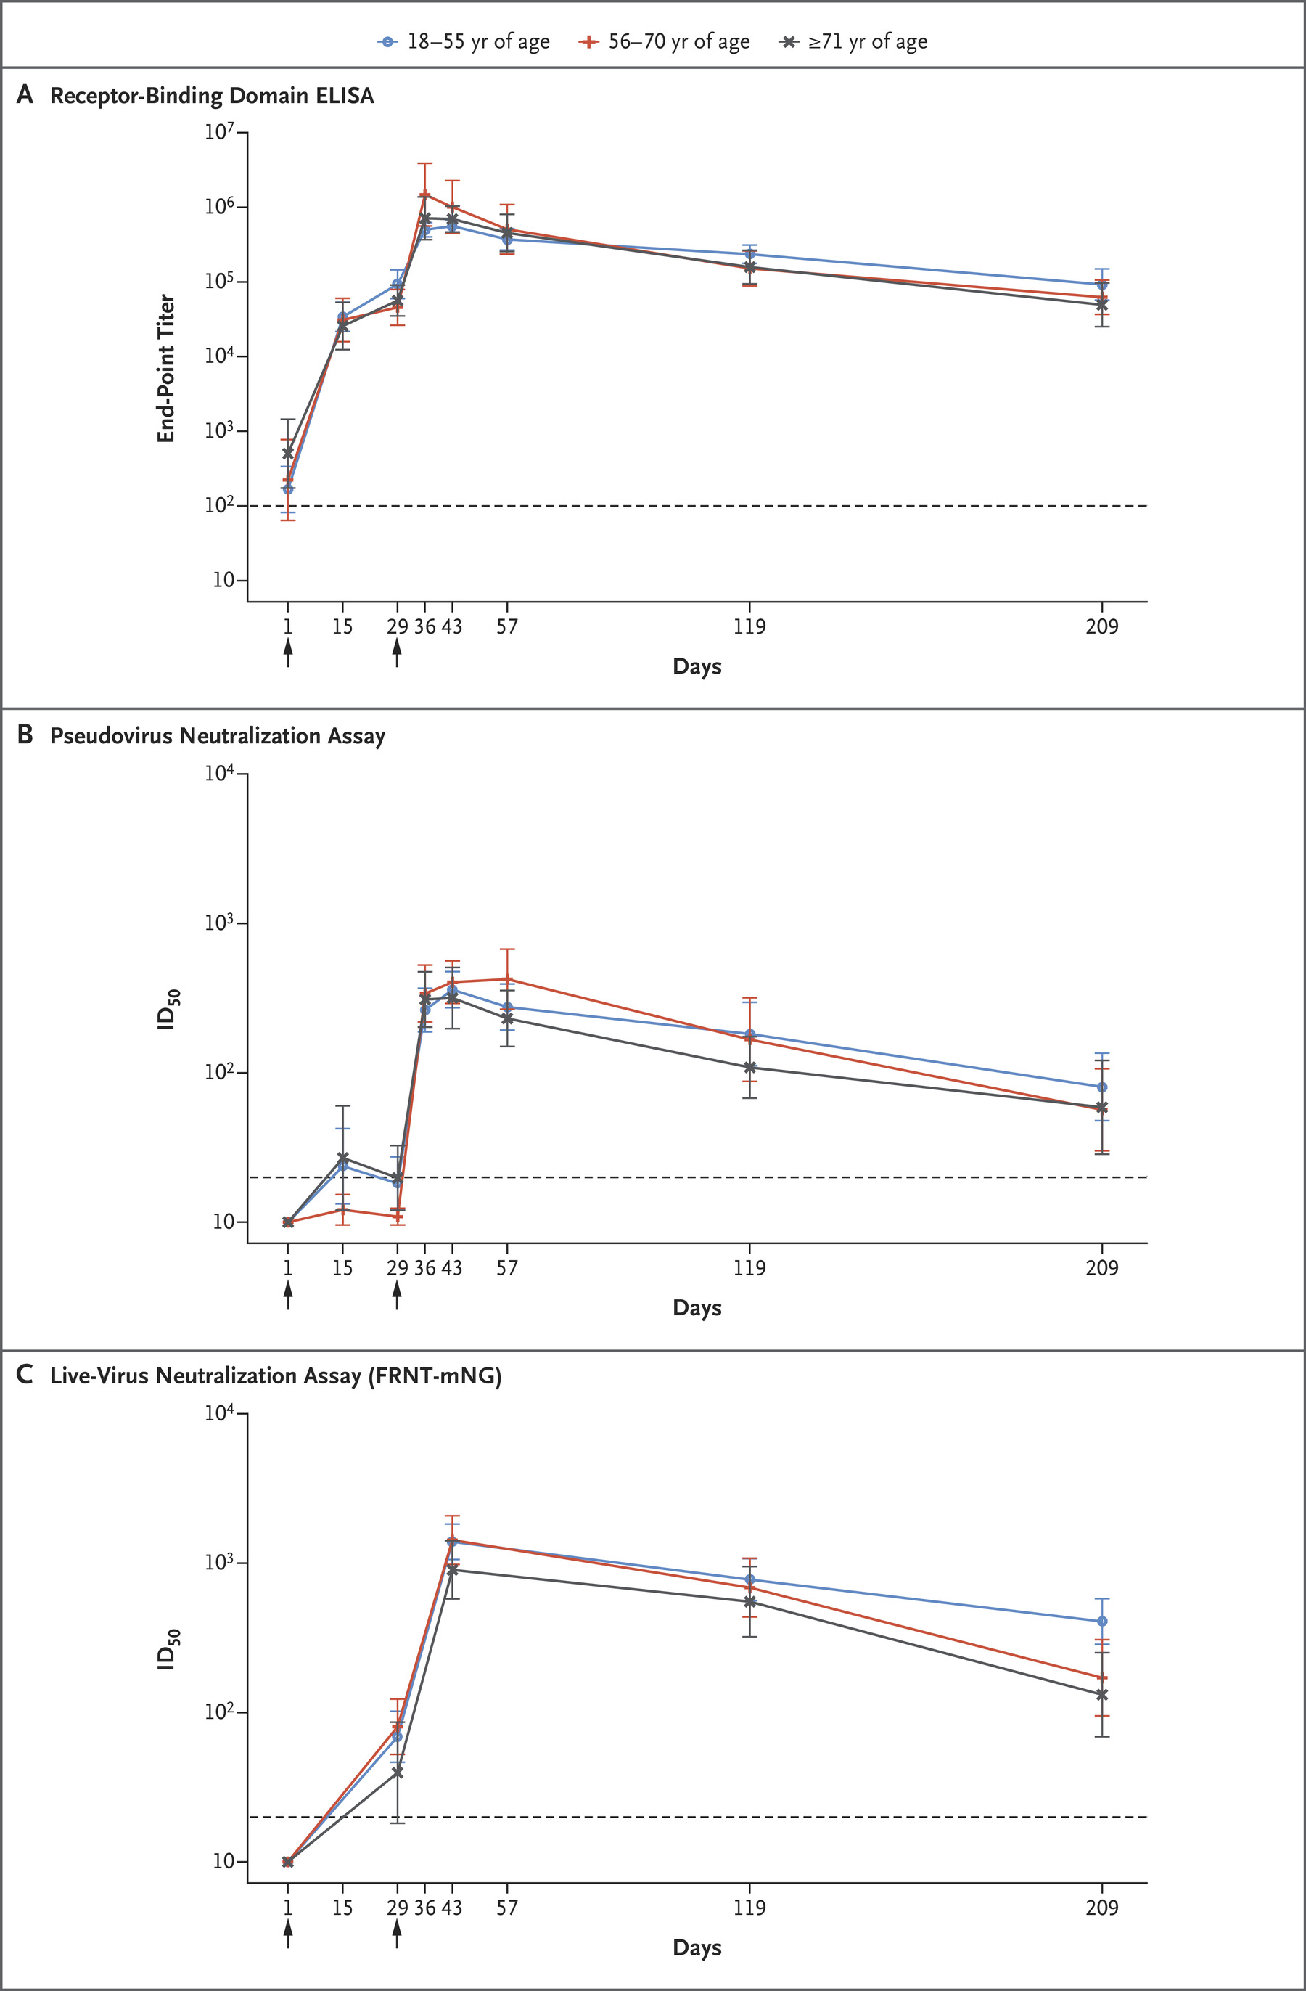
Trajnost imunosti (Moderna):
doi/full/10.1056/NEJMc2103916

Slide 21
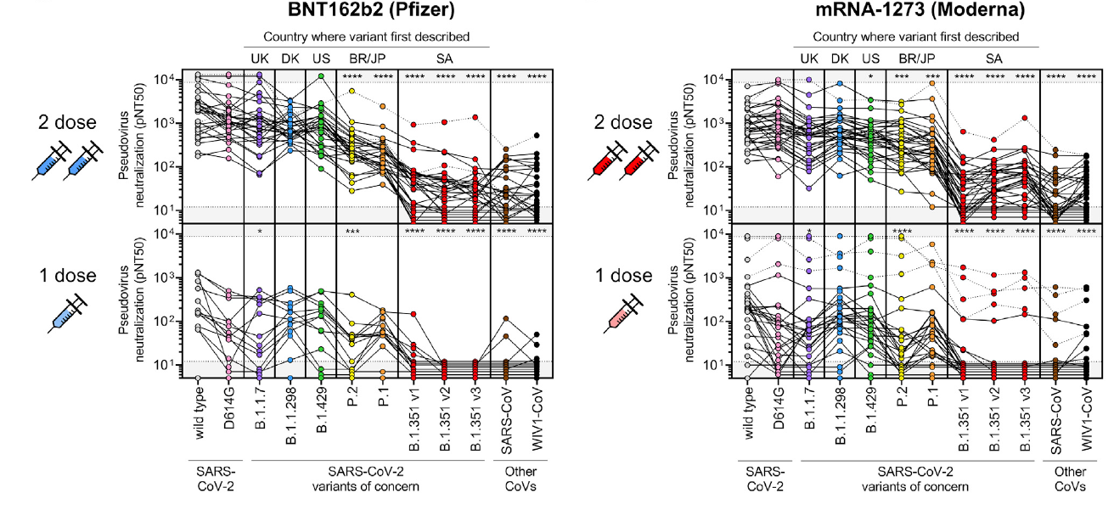
Imuna zaštita cijepljenjem protiv novih varijanti
(Biontech i Moderna)
doi.org/10.1016/j.cell.2021.03.013

Slide 22
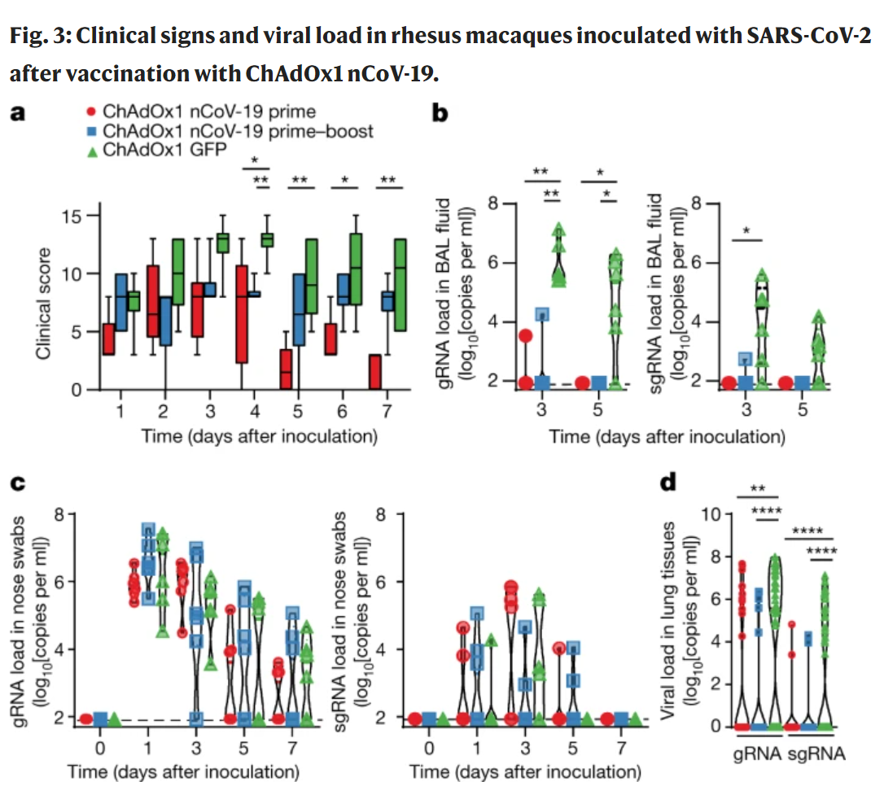
Neutralizacija virusa u gornjim i donjim dišnim putevima (AstraZeneca)
Lavaža bronha i pluća
Bris nosa
https://doi.org/10.1038/s41586-020-2608-y

Slide 23
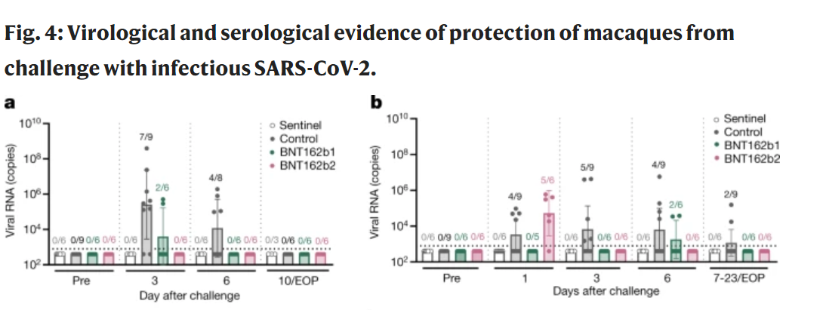
Neutralizacija virusa u gornjim i donjim dišnim putevima (Biontech)
Lavaža bronha i pluća
Bris nosa
https://doi.org/10.1038/s41586-021-03275-y

Slide 24
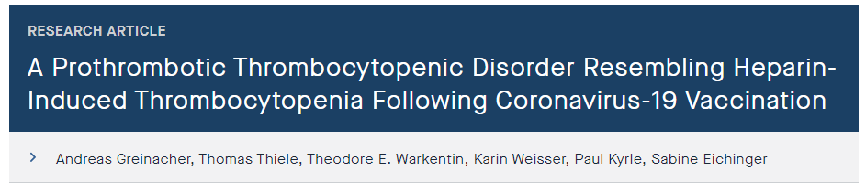
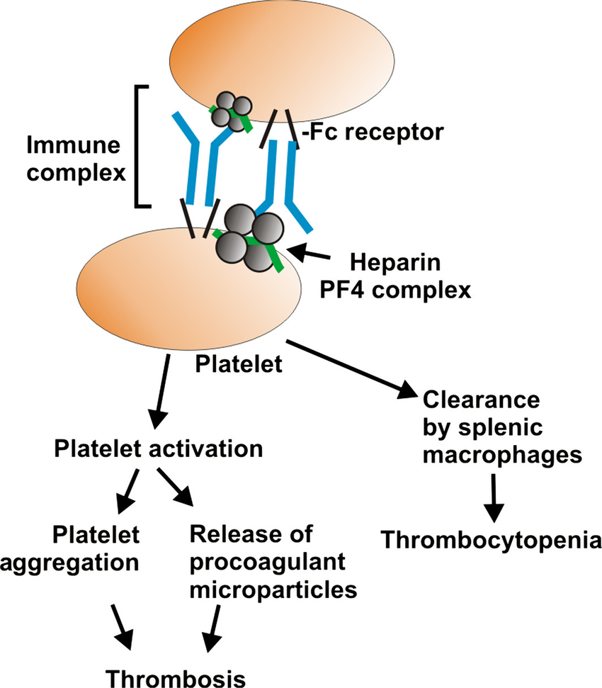
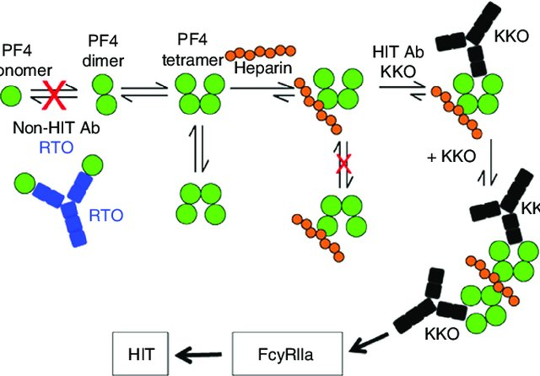
AstraZeneca cjepivo i trombocitna reakcija
mo

Slide 25
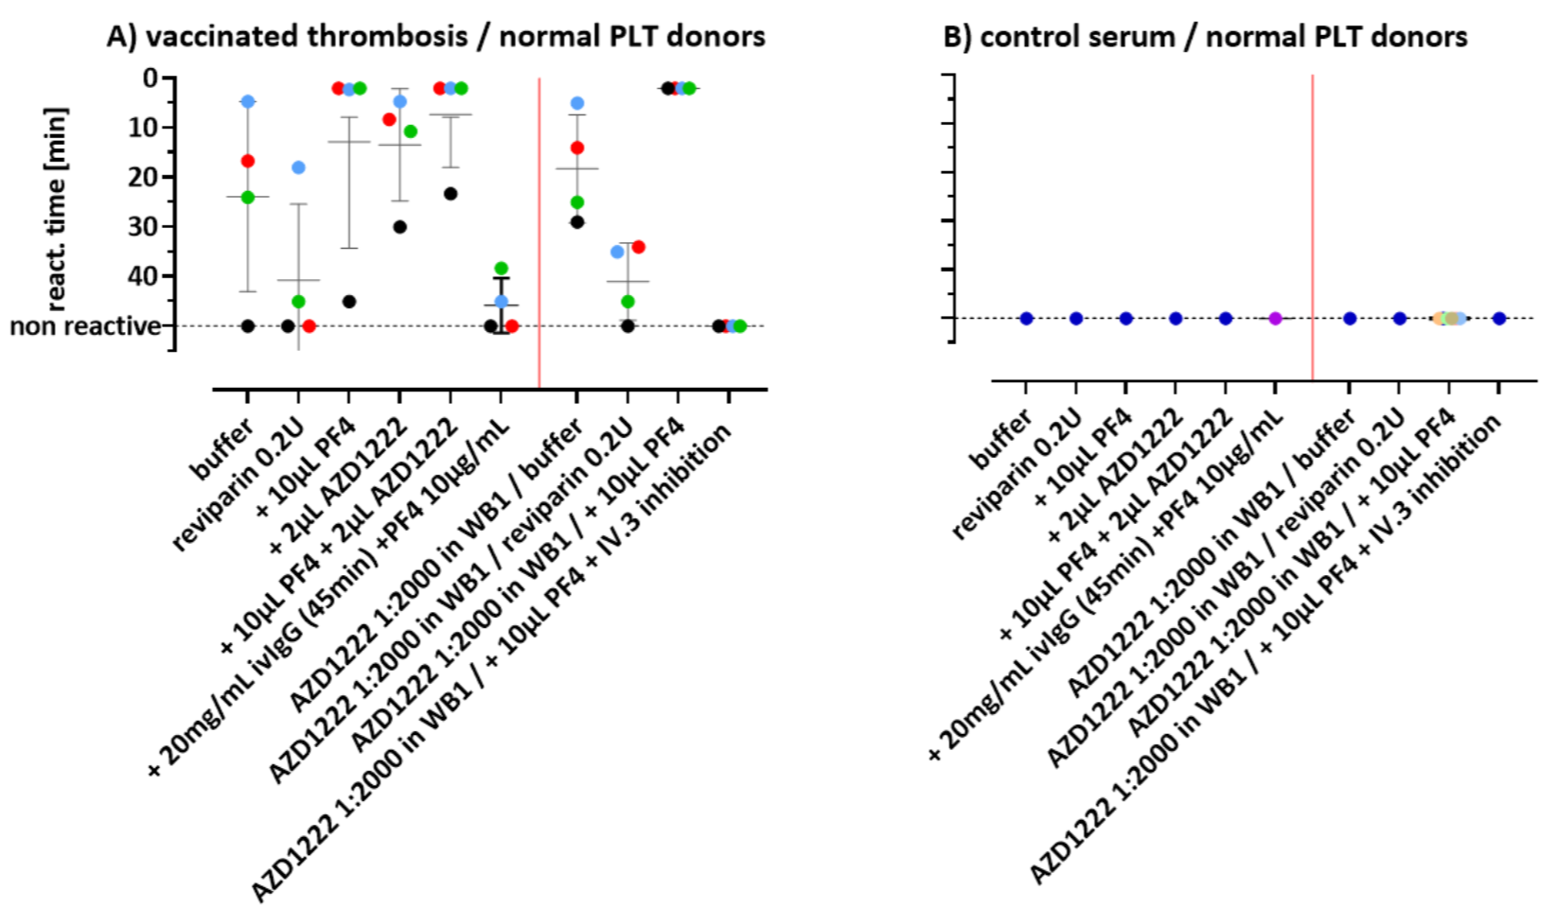
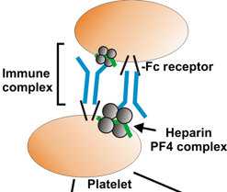
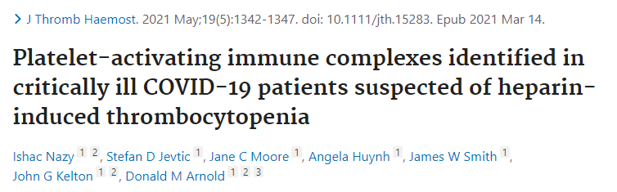
AstraZeneca cjepivo i trombocitna reakcija
DOI: 10.21203/rs.3.rs-362354/v2

Slide 26
Vaccine-Related Thrombosis following AstraZeneca COVID-19 Vaccination: Guidance Statement from the GTH
Izvadak iz preporuka Njemačke udruge za istraživane tromboze i hemostaze :
On a population basis, the positive effects of vaccination with the AstraZeneca COVID-19 vaccine outweigh the negative effects; so, the resumption of vaccinations in Germany with this vaccine is to be welcomed.
No evidence that thromboses at typical locations (i.e., leg vein thrombosis, pulmonary embolism) are more common after vaccination with the AstraZeneca COVID-19 vaccine
https://doi.org/ 10.1055-a/1469-7481.

Slide 27
Zaključci
COVID cjepiva izazivaju snažnu i dugotrajnu imunost
Druga doza mRNA cjepiva pruža imunost i protiv P1, P2 i B1.351 sojeva, ali slabiju nego li protiv uvriježenih EU sojeva
mRNA cjepiva snižavaju virusni titar i u gornjim dišnim putevima u eksperimentalnim uvjetima
Grušanje krvi po AstraZeneca cjepivu je rijetko, ali vezano za reakciju proteina iz seruma
Protutijela koja blokiraju Fc receptor na trombocitima blokiraju ovu reakciju, što upućuje na stvaranje imunih kompleksa
Otvoreno je pitanje – što prepoznaju protutijela koja izazivaju grušanje krvi kao komplikaciju cijepljenja?

Slide 28
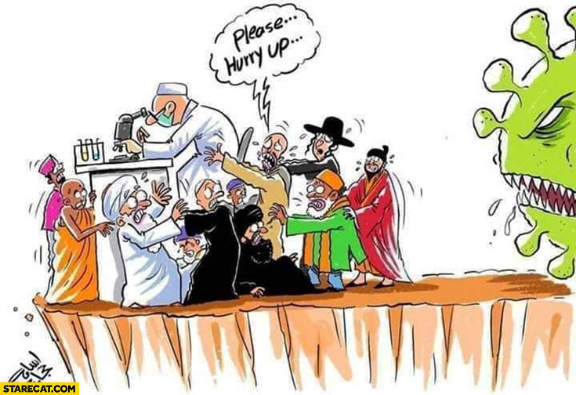
Hvala na Pažnji

Slide 29
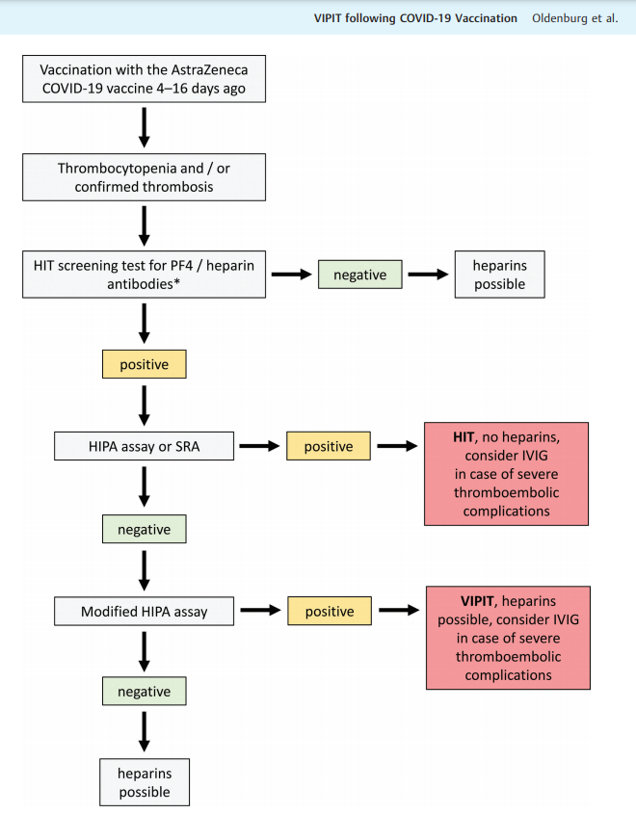
Preporuka kliničkog protokola
HIPA, heparin-induced platelet activation;
HIT, heparin-induced thrombocytopenia; IVIG, intravenous immunoglobulins; PF4, platelet factor 4;
SRA, serotonin-release assay;
VIPIT, vaccine-induced prothrombotic immune thrombocytopenia.
https://doi.org/ 10.1055-a/1469-7481.

Slide 30
Vaccine formulations Pros and cons:
Žive atenuirane virusne vakcine:
    Potiču sve ogranke immunog sustava
    Jak imuni odgovor
    Najviši rizik od nuspojava
mRNA vakcine:
    Jak imuni odgovor
    Oskudno isustvo o dugoročnim nuspojavama
Inaktivirani virusi
    Sigurnija cjepiva – manji rizik
    Lošija imunost – potreba za docijepljenjem
Subunit vakcine
    Najsigurnija
    Najslabija imunost
    Potreba za adjuvansima

Slide 31
BONUS FOLIEN
Ergebnisse aus Phase I/II zur Sicherheit von Impfstoffen und Nebenwirkungen.

Slide 32
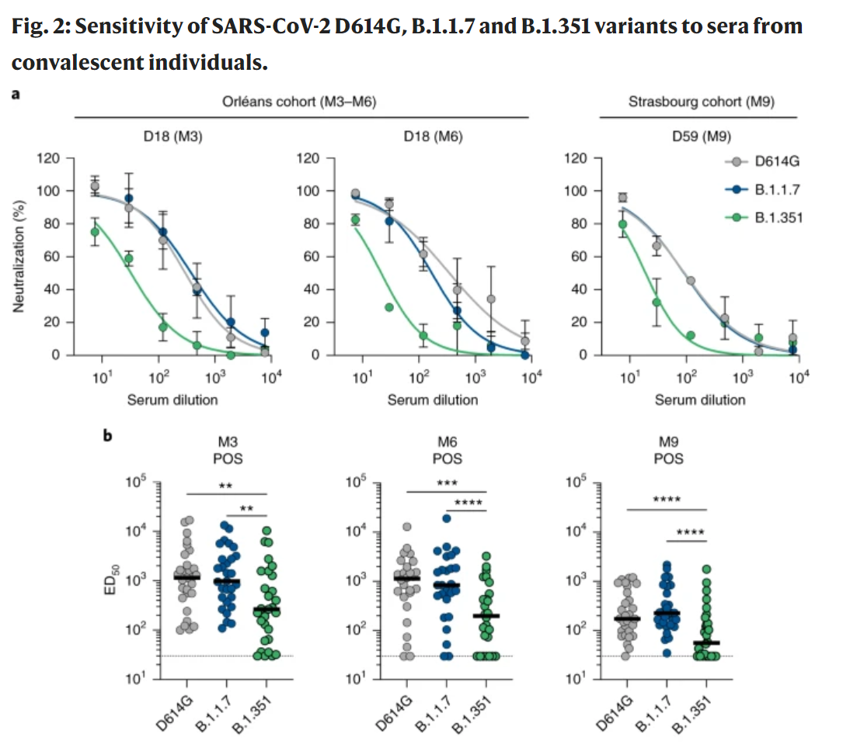
Imuna zaštita protiv novih varijanti po preboljeloj infekciji (Kent i J. Afrika)
https://doi.org/10.1038/s41591-021-01318-5

Slide 33
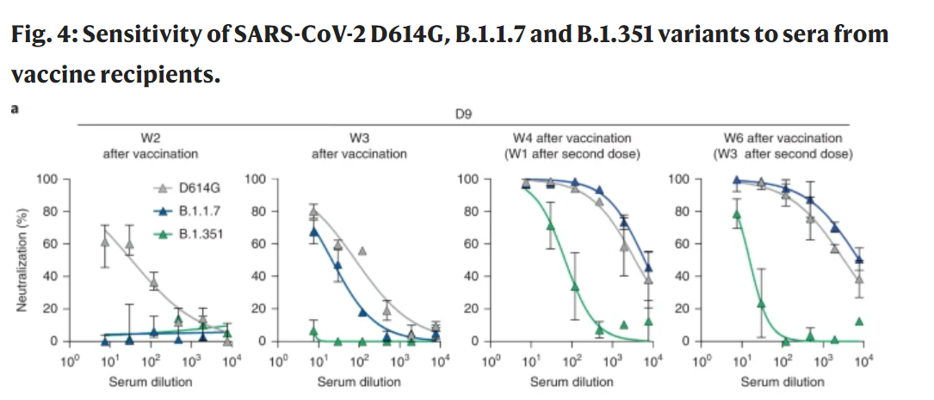
Imuna zaštita protiv novih varijanti po Biontech cjepivu (Kent i J. Afrika)
https://doi.org/10.1038/s41591-021-01318-5

Slide 34

COVID-19 Impfstoffkandidaten
Daten aus klinischen Studien der Impfstoffe, die sich zurzeit immer noch in „rolling review“ befinden oder bereits zugelassen sind
Zu beachten:
Wenn ca. 3% der geimpften Individuen z.B. ein hohes Fieber mit Temperaturen von über 39°C entwickeln, werden z.B. bei 10 Millionen Geimpften ca. 300.000 eine solche Nebenwirkung entwickeln
Notes:
34

Slide 35


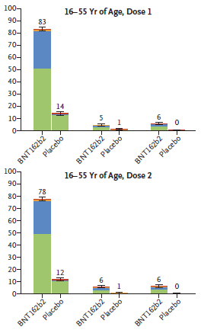
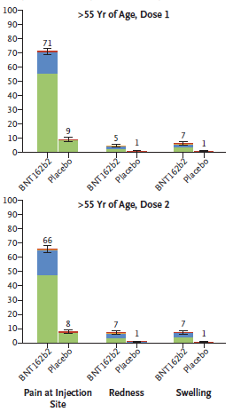

Comirnaty - BioNTech/Pfizer
- Lokale Reaktionen (AE) - 30 µg/Dose in Phase 3
N = 18,860
16 to 55 57.7%; >55 42.3%
Obesity 34.8%
DOI: 10.1056/NEJMoa2034577

Slide 36
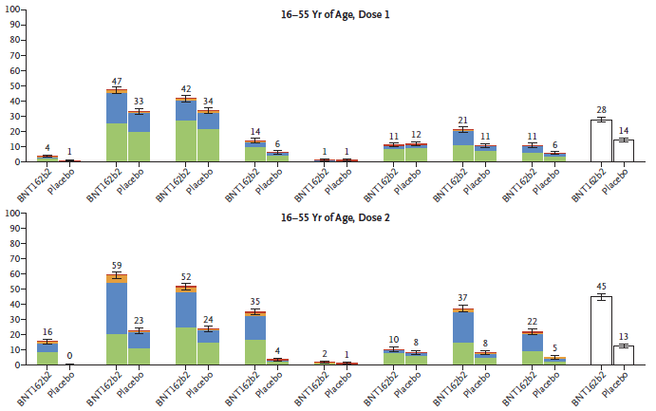
Comirnaty - BioNTech/Pfizer
- Systemische Reaktionen (AE) - 30 µg/Dosis in Phase 3 (1-3 Tage)
N = 18,860
16 to 55 57.7%; >55 42.3%
Obesity 34.8%
DOI: 10.1056/NEJMoa2034577

Slide 37
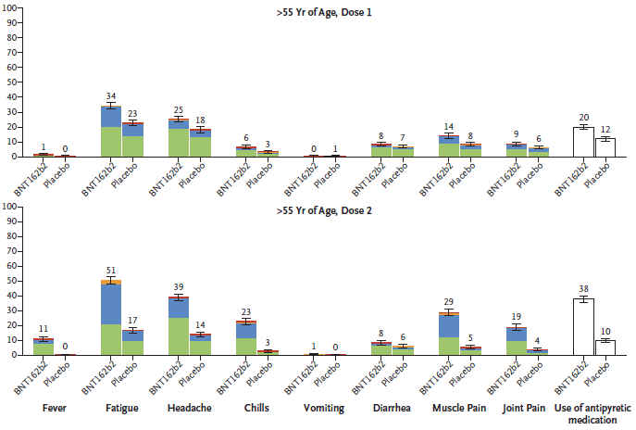
Comirnaty - BioNTech/Pfizer
- Systemische Reaktionen (AE) - 30 µg/Dose in Phase 3
N = 18,860
16 to 55 57.7%; >55 42.3%
Obesity 34.8%
DOI: 10.1056/NEJMoa2034577

Slide 38
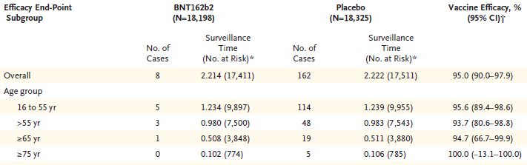
Comirnaty - BioNTech/Pfizer
- Wirksamkeit - 30 µg (2 Dose, 21 Tagen Abstand) in Phase 3
Wirksamkeit des Impfstoffs bei Teilnehmern ohne Anzeichen einer Infektion (7 Tage vor Dosis 2)
N = 18,860
16 to 55 57.7%; >55 42.3%
Obesity 34.8%
~ 50% nach 1 Dosis / vor 2 Dosis
DOI: 10.1056/NEJMoa2034577

Slide 39

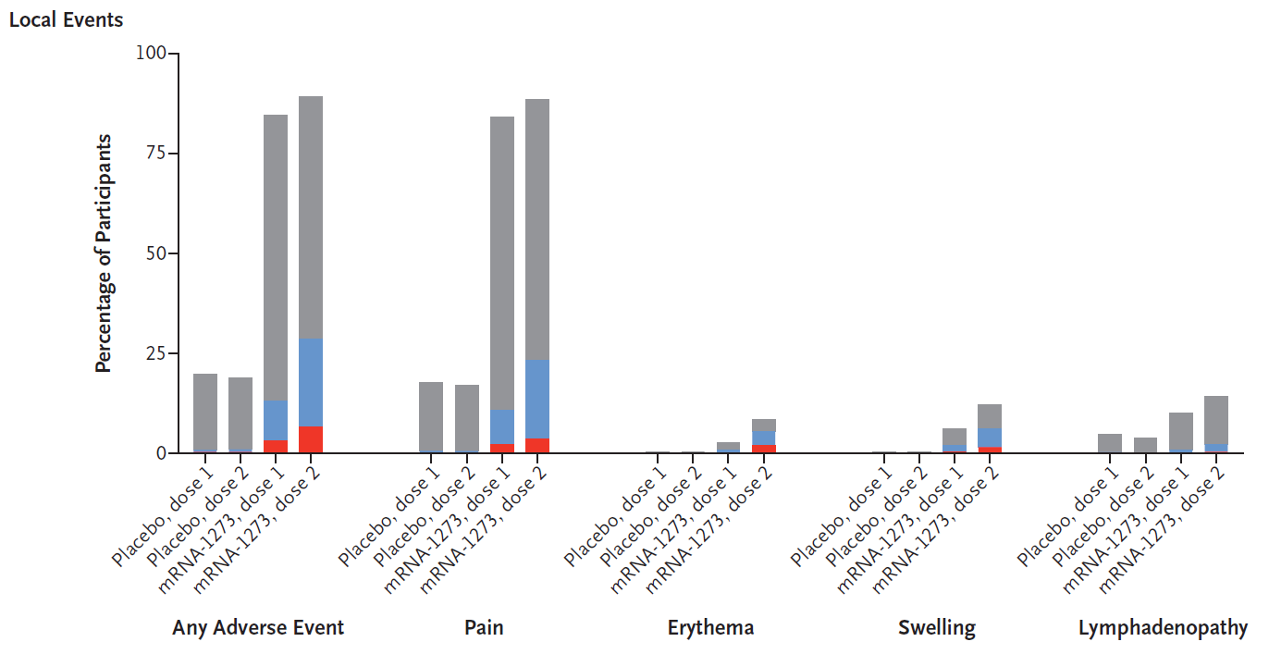

mRNA-1273 - Moderna – Phase 3 Studie – 100 µg
- Bisher bekannte lokale Impfstoffwirkungen (AE) -
N = 15,181
18 to <65 non risk 58%; 18 to <65 risk 16.7%; ≥65 24.8%
COPD 4.7%, CVD 5%, obesity 6.8%, diabetes 9.5%, CLD 0.7%, HIV 0.6%
DOI: 10.1056/NEJMoa2035389

Slide 40
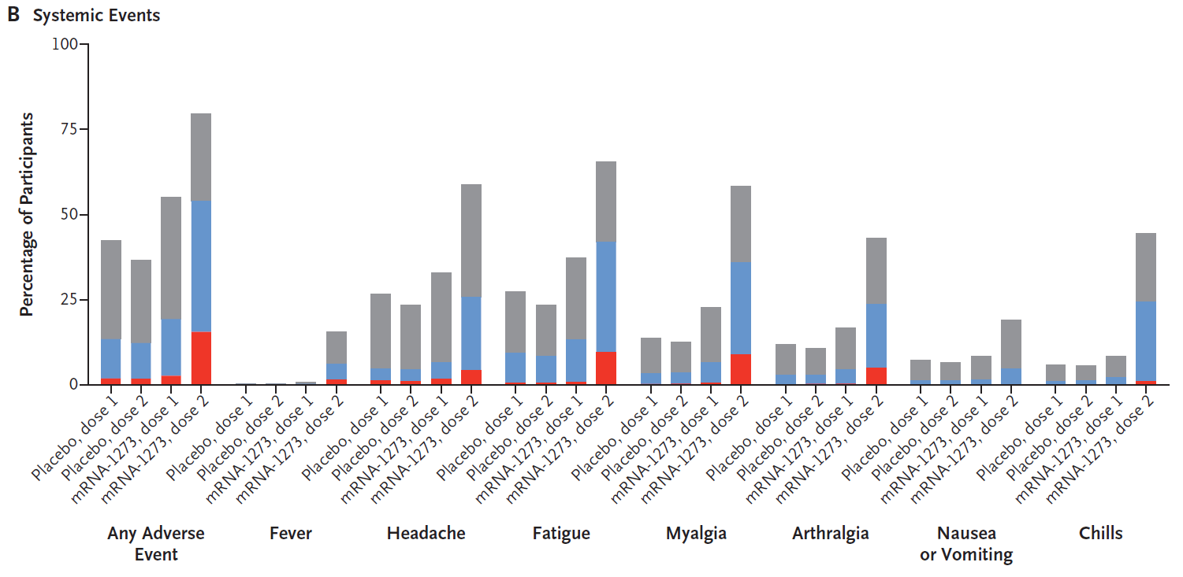
mRNA-1273 - Moderna – Phase 3 Studie – 100 µg
- Systemischen Impfstoffwirkungen 1 Dose (AE) -
N = 15,181
18 to <65 non risk 58%; 18 to <65 risk 16.7%; ≥65 24.8%
COPD 4.7%, CVD 5%, obesity 6.8%, diabetes 9.5%, CLD 0.7%, HIV 0.6%
DOI: 10.1056/NEJMoa2035389

Slide 41
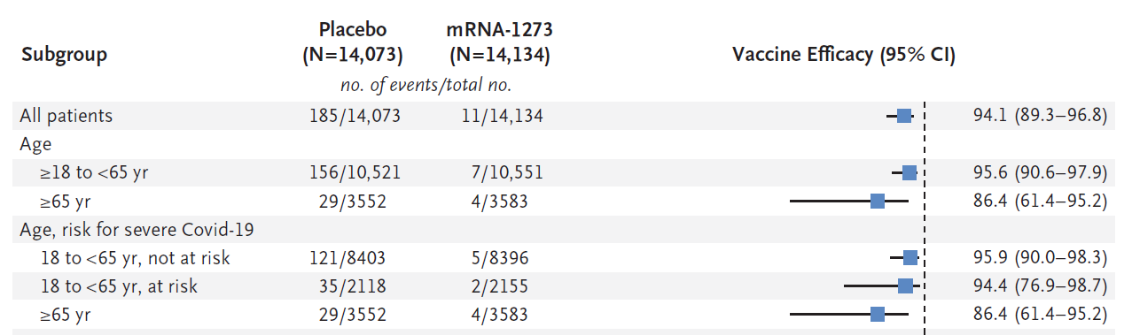
mRNA-1273 - Moderna – Phase 3 Studie – 100 µg
Wirksamkeit (2 Dosis, 28 Tage Abstand) –
(14 Tage nach letzter Injektion)
N = 15,181
18 to <65 non risk 58%; 18 to <65 risk 16.7%; ≥65 24.8%
COPD 4.7%, CVD 5%, obesity 6.8%, diabetes 9.5%, CLD 0.7%, HIV 0.6%
65 bis <75 yr – 82.4%
DOI: 10.1056/NEJMoa2035389

Slide 42


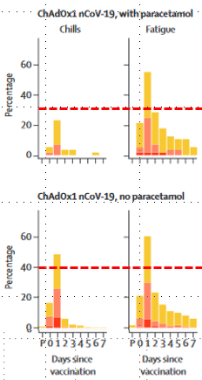
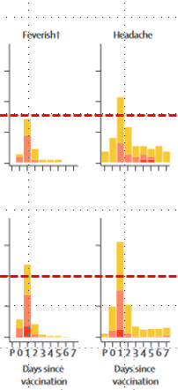
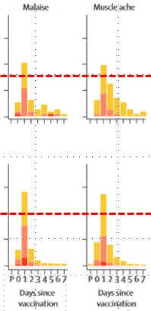




AZD1222 - Oxford/AstraZeneca
- bisher bekannte Impfstoffwirkungen (AE) -
Systemische AE
Lokale AE
www.thelancet.com Published online July 20, 2020 https://doi.org/10.1016/S0140-6736(20)31604-4

Slide 43
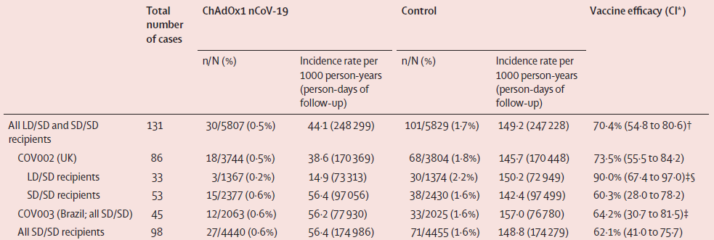
AZD1222 - Oxford/AstraZeneca
- Wirksamkeit -
Wirksamkeit gegen SARS-CoV-2 nach 2 Impfdosen
(14 Tage nach letzter Injektion)
Trial | UK - LD/SD | UK SD/SD | BZ SD/SD
N | 1367 | 2377 | 2063
18-55 | 100% | 79% | 89.3%
56-69 | - | 12% | 10.1%
>70 | - | 9% | 0.5%
Cardio. Dis. | 7.6% | 11.1% | 13.1%
Resp. Dis. | 11.6% | 12% | 10.4%
Diabetes | 1.3% | 2.4% | 2.9%
SD/SD – 5x10¹⁰ - 4440 - 27 vs 71 - 62.1%
LD/SD - 2.5x10¹⁰ 5x10¹⁰ - 1367 - 3 vs 30 - 90%
SD/SD + LD/SD - 5829 - 30 vs 101 - 70.4%
Lancet 2021; 397: 99–111

Slide 44
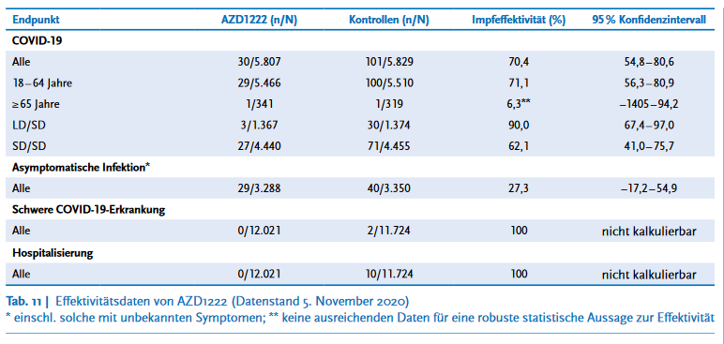
AZD1222 - Oxford/AstraZeneca
- Wirksamkeit -
Quelle: https://www.rki.de/DE/Content/Infekt/EpidBull/Archiv/2021/Ausgaben/05_21.pdf?__blob=publicationFile

Slide 45


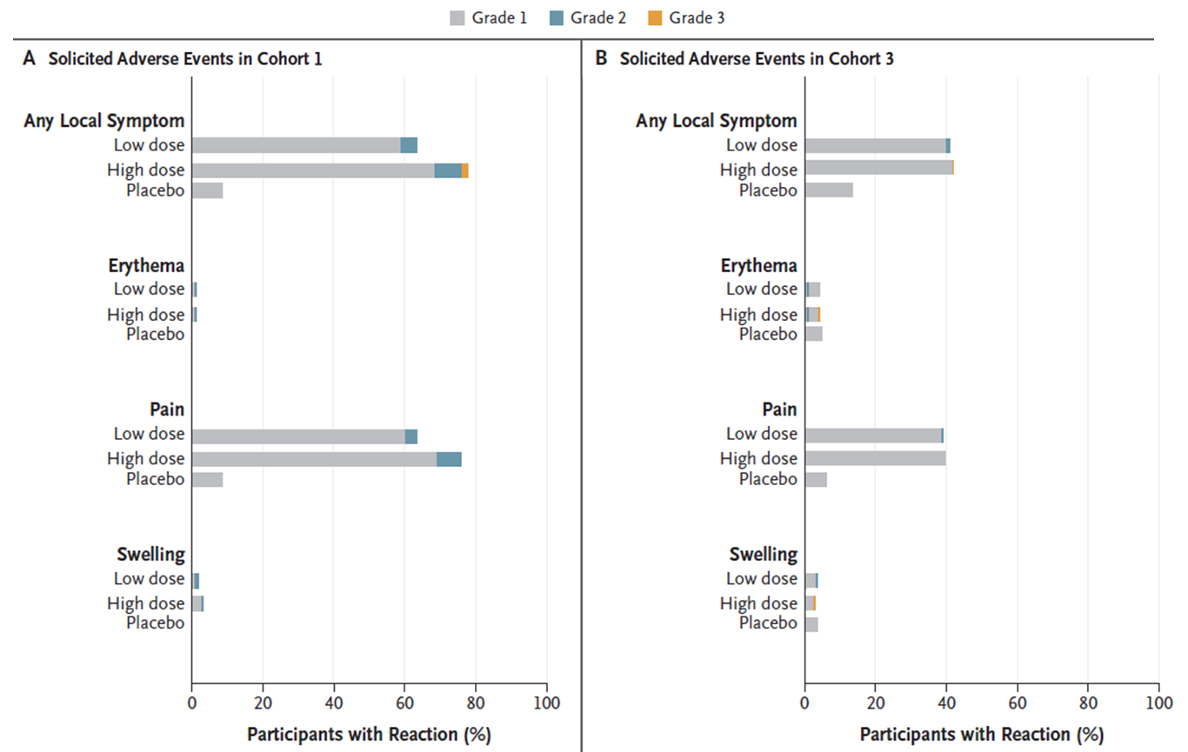
Ad26.COV2.S - Phase 1-2a
- bisher bekannte lokale Impfstoffwirkungen (AE) -
Alter 18-55
Alter >65
Low dose: 5 x 10¹⁰
High dose: 1 x 10¹¹
DOI: 10.1056/NEJMoa2034201

Slide 46
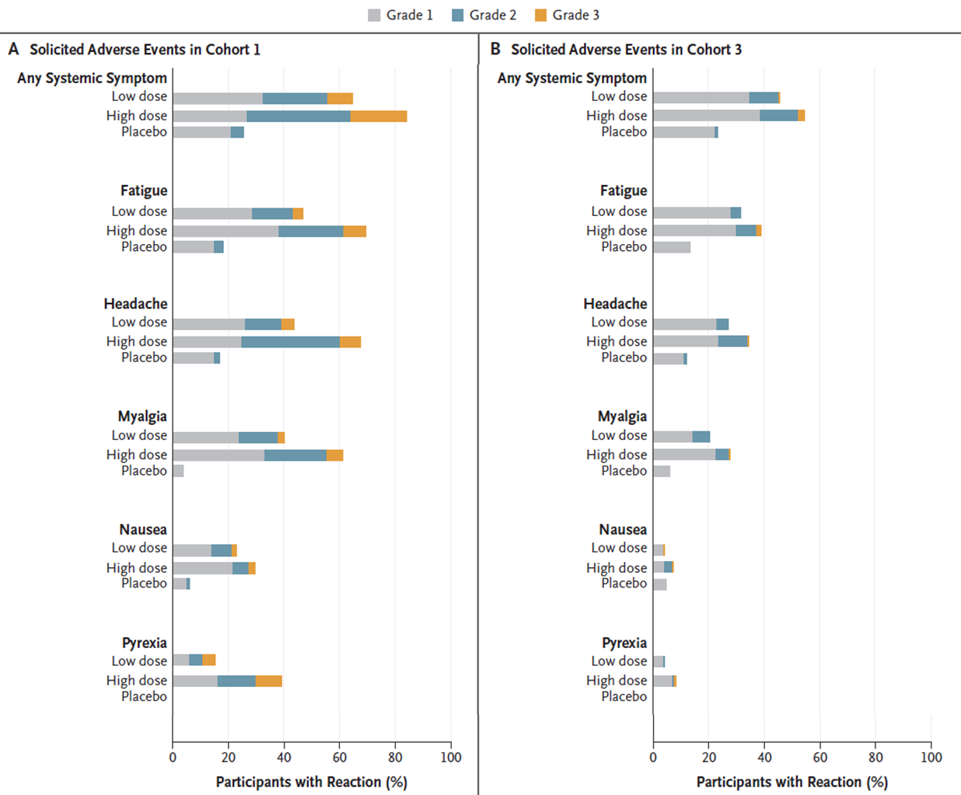
Ad26.COV2.S - Phase 1-2a
- bisher bekannte systemischen Impfstoffwirkungen (AE) -
Alter 18-55
Alter >65
Low dose: 5 x 10¹⁰
High dose: 1 x 10¹¹
DOI: 10.1056/NEJMoa2034201

Slide 47
In Bau…
- Einige Punkte -
Wirksamkeit in spezifischen Gruppen: Älteren, Kleinkindern, Immunsupprimierten, Autoimmunerkrankten, Schwangerschaft, chronischen Entzündungserkrankungen…
Impfung Wirksamkeit bei schwer COVID-19 Erkrankung, Reduktion Hospitalisierung / IST-Pflichtig / Beatmung-Pflichtig / Todesfälle, Reduktion Infektion / Transmission, neue Virusvarianten
Schutzdauer, wann musst eine weitere Auffrischung der Impfung erfolgen
Kompatibilität / Austausch / Kombination von verschieden Impfstoffe
Impfstoffe Wirksamkeit bei VOCs „Variants of Concern“
„Upgrade“ von Impfstoffe – Es ist Zeit/Kosten/Logistisch/Platform realistisch?
Notes:
47

Slide 48
Variants of Concern
- Phase 3 / Einige Fakten –
Novavax
      UK ~89% - Original: ~95%
                - B.1.1.7: ~85%
      Sudafrika (90% B1.3.5.1) ~60% (HIV-); ~49% (HIV+ & HIV-)
Johnson & Johnson
      USA 72%, Lateinamerika 66%, Sudafrika ~57%
AstraZeneca
      UK/Brazil ~70%
      Sudafrika ~22%
Notes:
48

