Slide 1
XXIII. Limes Congress 2015
1st century AD small finds from Burgenae:
Chronological clues for the establishment of the fort
Ivan Radman-Livaja, Archaeological Museum, Zagreb

Slide 2
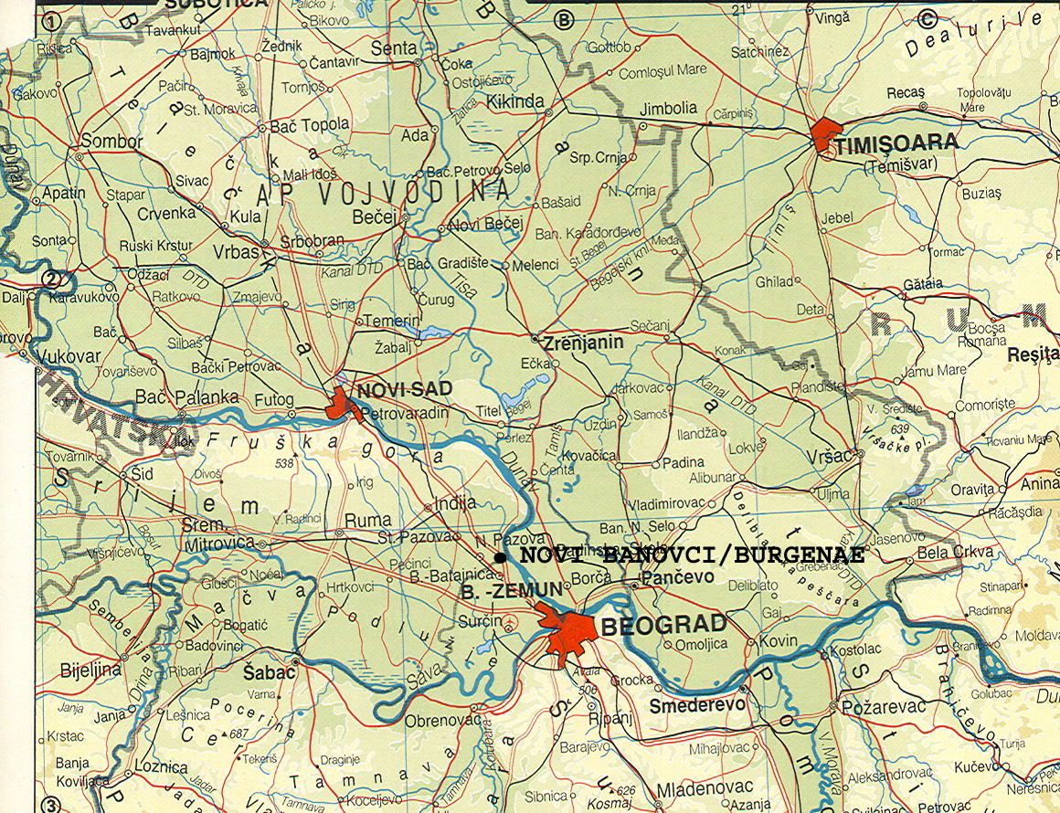

Slide 3
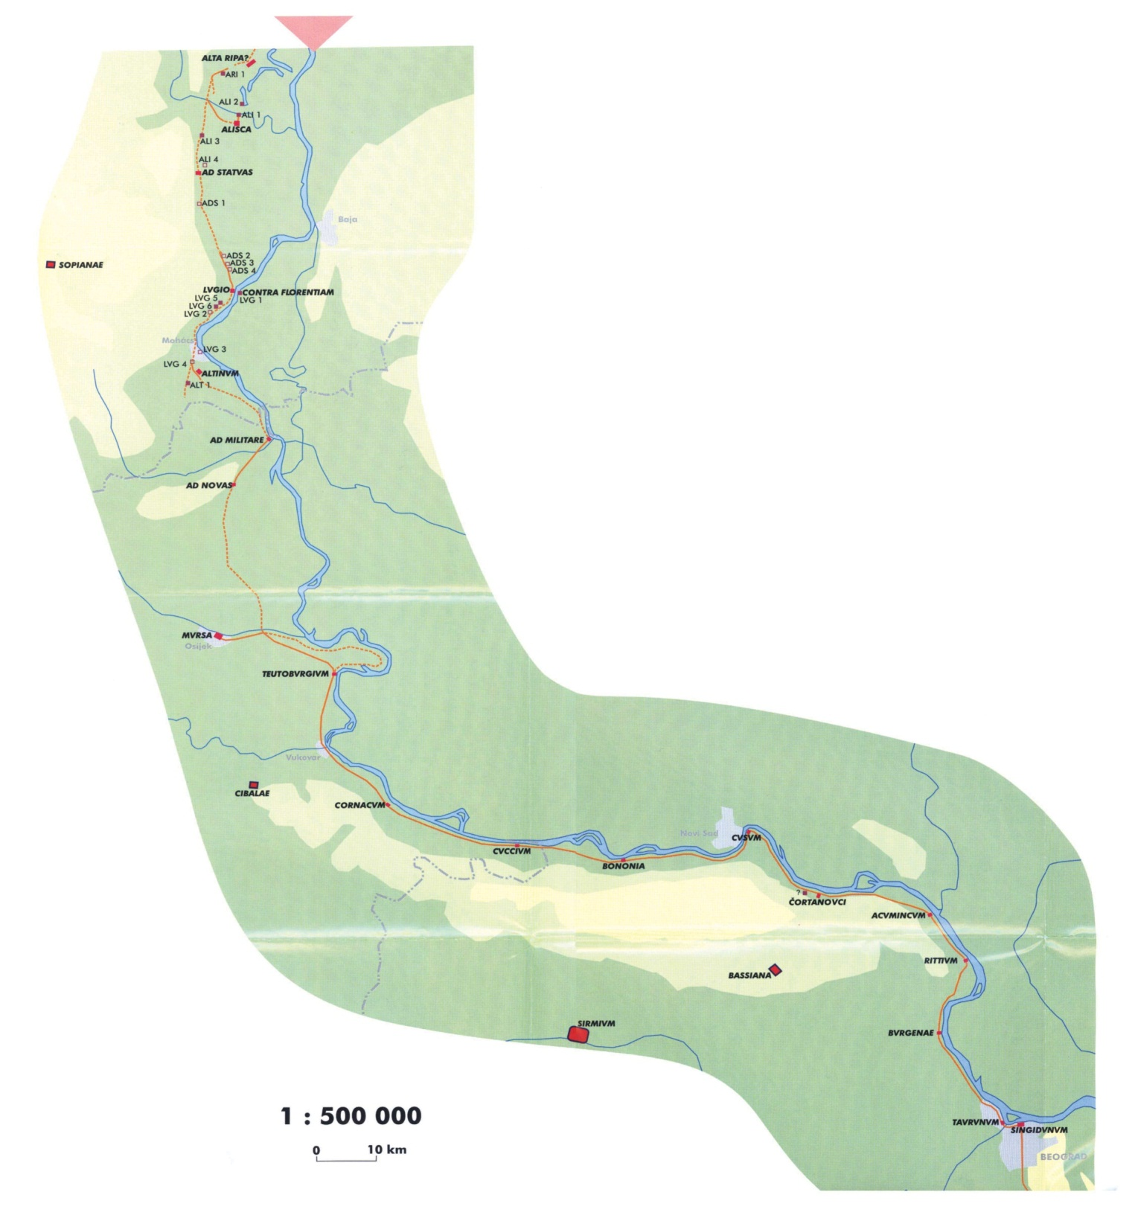

Slide 4
The site of Novi Banovci on the Danube river, in the south-western part of the Serbian province of Vojvodina, has yielded a large number of Roman finds since the 19th century, which is hardly surprising since the village occupies the spot of a Roman frontier fort called Burgenae.
Before the collapse of the Austro-Hungarian Empire the archaeological finds from that area were usually dispatched to the Archaeological department of the Croatian National Museum and due to that fact, a fairly large collection of Roman finds from Novi Banovci is kept today in the Archaeological Museum in Zagreb, numbering several thousand objects.

Slide 5
Some of those finds have been published since, but the majority still awaits a thorough analysis and publication.
This should not be a matter of distant future since a catalogue of Roman small finds from Burgenae is currently under preparation by the staff of the AMZ, due to be published by 2018, within the framework of the project no. 1549, „Cultural, economic, monetary and social transformations in view of the archaeological heritage of the Middle Danubian region 279 B.C. – A.D. 582”, entirely funded by the Croatian Science Foundation.

Slide 6
There is no need to present in great detail the history of the site and the military units that garrisoned Burgenae since this topic has been extensively discussed in several publications. It will therefore be sufficient just to give a short overview.
Although there is no much doubt that the fort was built during the Flavian period at the latest, nothing is known for sure about its garrison in the first decades of its existence. Some authors presume that the cohors II Asturum et Callaecorum might have been the first unit stationed there, but this assumption is far from being certain.
The same could be said about the cohors V Gallorum, which might have been in Burgenae during Trajan’s reign. The ala I civium Romanorum is thought to have garrisoned Burgenae between 118 or 119 and 138 AD, which is not entirely unlikely.
Nevertheless, most authors agree that the cohors I Thracum civium Romanorum pia fidelis was stationed in Burgenae after 138 AD. It seems that it remained there for a very long time, probably until the second half of the 3rd century AD, when it was moved to Bassiana. The names of some units are recorded for the 4th century AD as well: one detachment of the legio V Iovia, the equites Dalmatae and the cuneus equitum Constantianorum.
As one can see, the history of that site is still far from being well understood due to lack of reliable evidence, especially for the earliest period.

Slide 7
SELECTED BIBLIOGRAPHY
BRUNŠMID 1895: Josip Brunšmid, Arheološke bilješke iz Dalmacije i Panonije, Viestnik Hrvatskog Arheološkoga Društva, Nova Serija, I, 1895, 148-183
BRUNŠMID 1901: Josip Brunšmid, Arheološke bilješke iz Dalmacije i Panonije IV, Viestnik Hrvatskog Arheološkoga Društva, Nova Serija, V, 1901, 87-168
DIMITRIJEVIĆ 1956-1957: Danica Dimitrijević, Rad zemunskog Narodnog muzeja na rimskom limesu u Sremu, Starinar, Nova serija, VII-VIII, 1956-1957, 299-308
DIMITRIJEVIĆ 1961: Danica Dimitrijević, Nekoliko podataka o rimskom limesu u Istočnom Sremu, Limes u Jugoslaviji I, Zbornik radova sa simposiuma o Limesu 1960. godine, Beograd, 1961, 93-107
DUŠANIĆ 1968: Slobodan Dušanić, Rimska vojska u istočnom Sremu, Beogradski Univerzitet, Zbornik Filozofskog Fakulteta, X-1, 1968, 87-113
EADIE 1977: John W. Eadie, The Development of the Pannonian Frontier south of the Drave, Akten des XI. Internationalen Limeskongresses (Székesfehérvár, 30.8.-6.9.1976), Budapest, 1977,
FRÖHLICH 1892: Róbert Fröhlich, Emlékek és leletek. Acumincum vidéke és a régi Pannoniai Limes, Archaeologiai Értesitő XII, 1892, 34-44
KLEMENC 1961: Josip Klemenc, Limes u Donjoj Panoniji, Limes u Jugoslaviji I, Zbornik radova sa simposiuma o Limesu 1960. godine, Beograd, 1961, 5-34
KLEMENC 1963: Josip Klemenc, Der pannonische Limes in Jugoslawien, Arheološki radovi i rasprave 3, 1963, 55-68
LJUBIĆ 1889: Šime Ljubić, Rimske starine u Novih Banovcih, Viestnik Hrvatskoga Arhelogičkoga Družtva, XI/2, 1889, 62-63
LŐRINCZ 2001: Barnabás Lőrincz, Die römischen Hilfstruppen in Pannonien während der Prinzipatszeit, Teil I: Die Inschriften, Wien, 2001
PATSCH 1899: Carl Patsch, s.v. Burgenae, RE, III, 1062
PILETIĆ&RAŠIĆ 1961: Dragoslav Piletić & Bogdan Rašić, Pregled radova Vojnog muzeja na Limesu od Novih Banovaca do Sremskih Karlovaca, Limes u Jugoslaviji I, Zbornik radova sa simposiuma o Limesu 1960. godine, Beograd, 1961., 87-92
PILETIĆ 1972: Dragoslav Piletić, Preliminarni rezultati istraživanja rimskog kastruma Burgenae u Novim Banovcima 1971. godine, Vesnik Vojnog muzeja 18, 1972, 7-26
PILETIĆ 1986: Dragoslav Piletić, Acumincum i Burgenae - dva važna uporišta na donjopanonskom limesu, Odbrambeni sistemi u praistoriji i antici na tlu Jugoslavije, Materijali XXII, Referati XII Kongresa arheologa Jugoslavije (Novi Sad, 1984.), Novi Sad, 1986, 137-144
PILETIĆ 1989: Dragoslav Piletić, Rimske fortifikacije na teritoriji SR Srbije, Vesnik Vojnog muzeja 33, 1989, 79-104
VISY 2003: Zsolt Visy ed., The Roman Army in Pannonia, An Archaeological Guide of the Ripa Pannonica, Pécs, 2003.
WAGNER 1938: Walter Wagner, Die Dislokation der römischen Auxiliarformationen in den Provinzen Noricum, Pannonien, Moesien und Dakien von Augustus bis Gallienus, Berlin, 1938

Slide 8
For this occasion, a selection of finds will be presented, namely finds which can securely be dated to the 1st century AD. Of particular importance are finds which may be dated to an even narrower timeframe since they can give us significant clues about the foundation of the fort, i.e a more precise dating of its establishment.
As a matter of fact, there is no much doubt that the fort was built during the Flavian period at the latest (with the cohors II Asturum et Callaecorum as the first unit presumed to have been stationed there), but epigraphical data and sources do not point to a more precise dating. The analysis of early finds does not necessarily contradict a Flavian dating, but preliminary research has shown that an earlier foundation is not to be excluded.
Obviously, only field research may answer more precisely the question when the fort of Burgenae was actually built and garrisoned for the first time, but in the meantime the analysis of numerous old stray finds collected on the site may provide a plausible answer, albeit not a definite one.

Slide 9
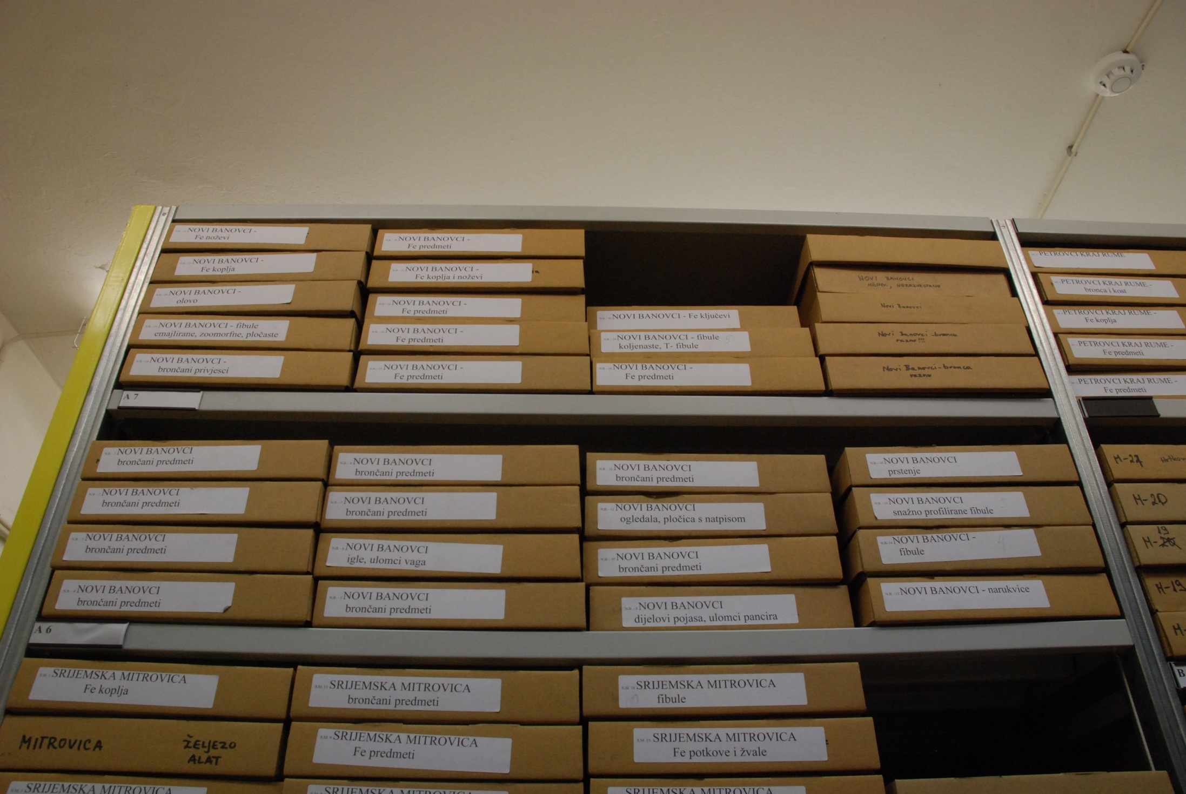

Slide 10
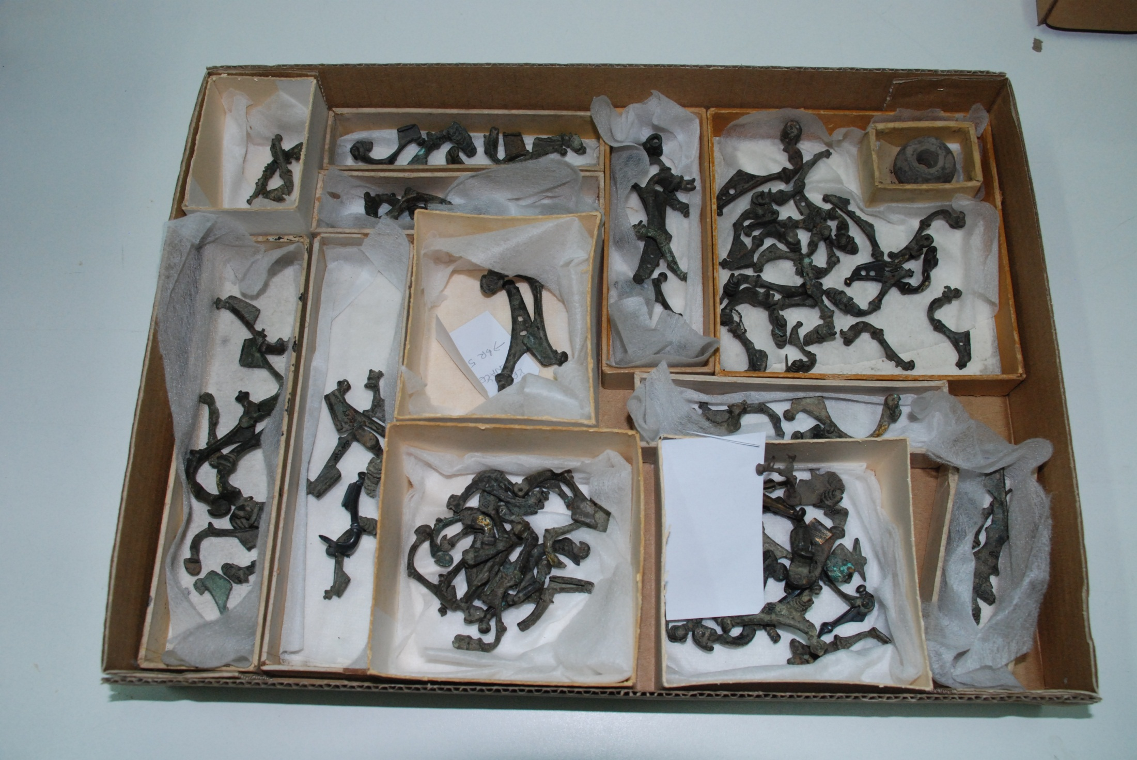

Slide 11
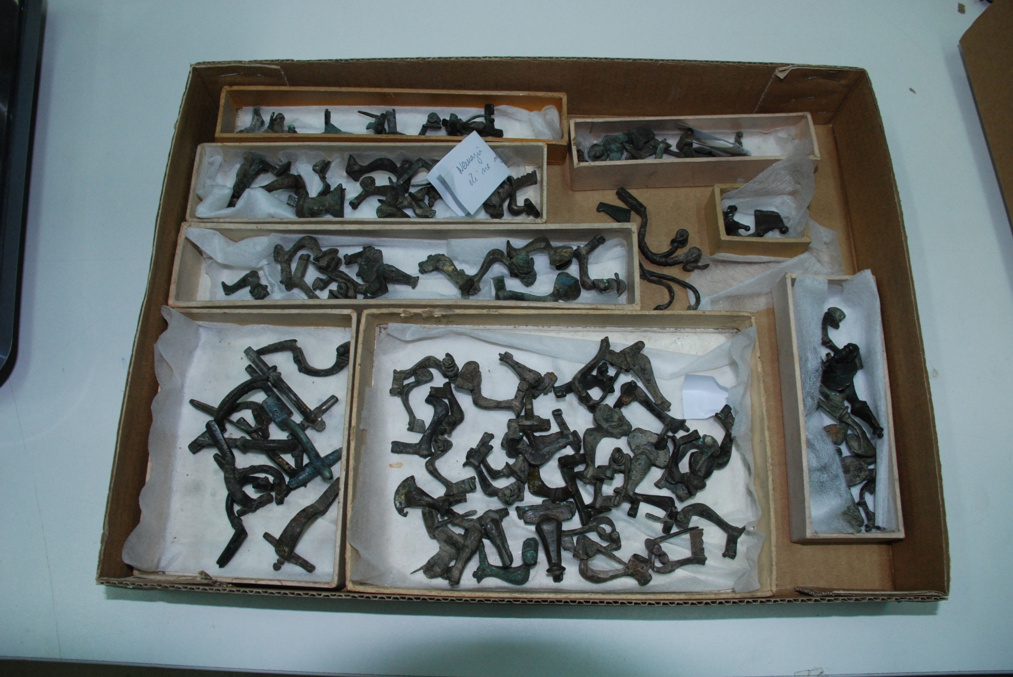

Slide 12
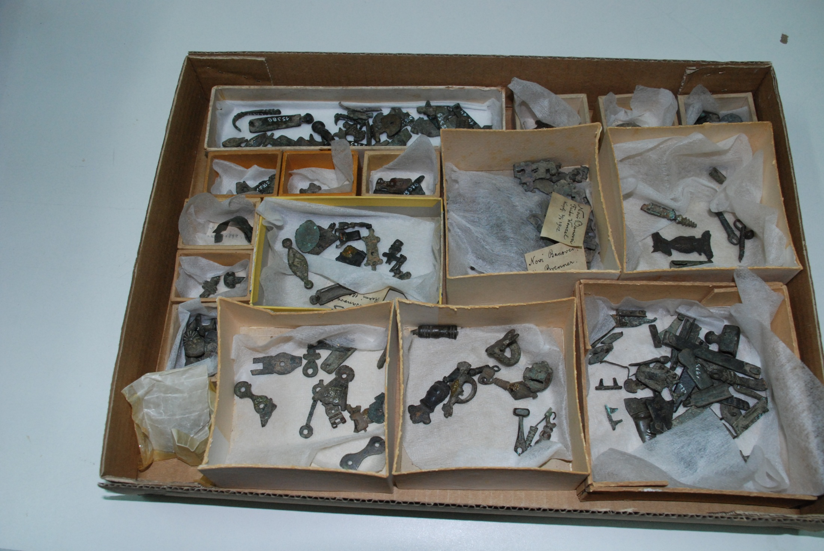

Slide 13
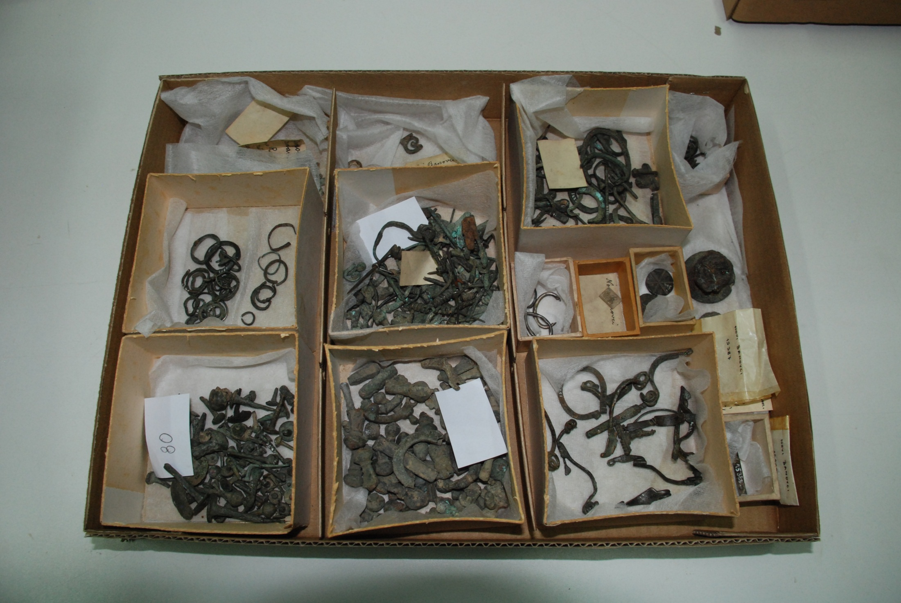

Slide 14
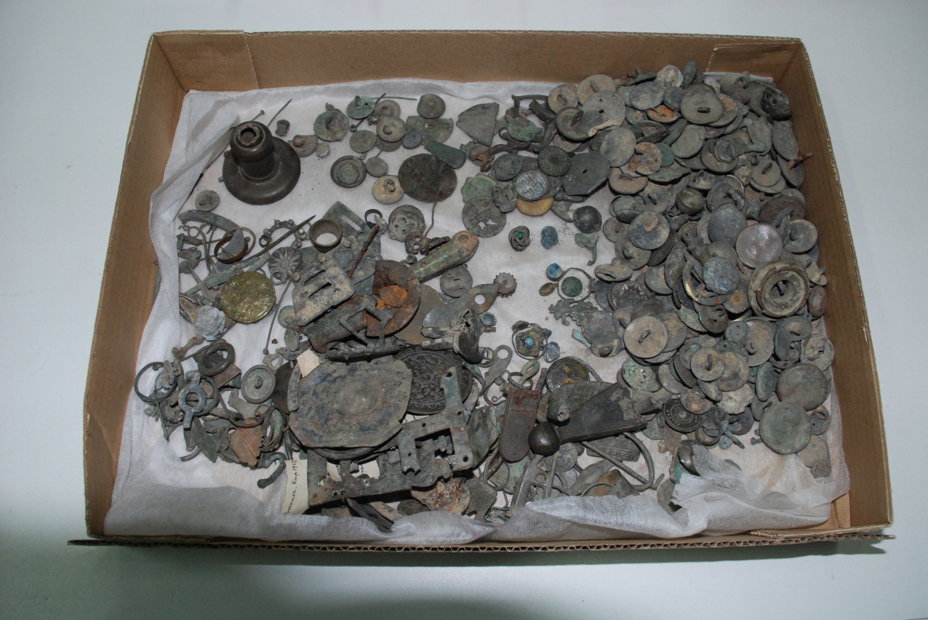

Slide 15
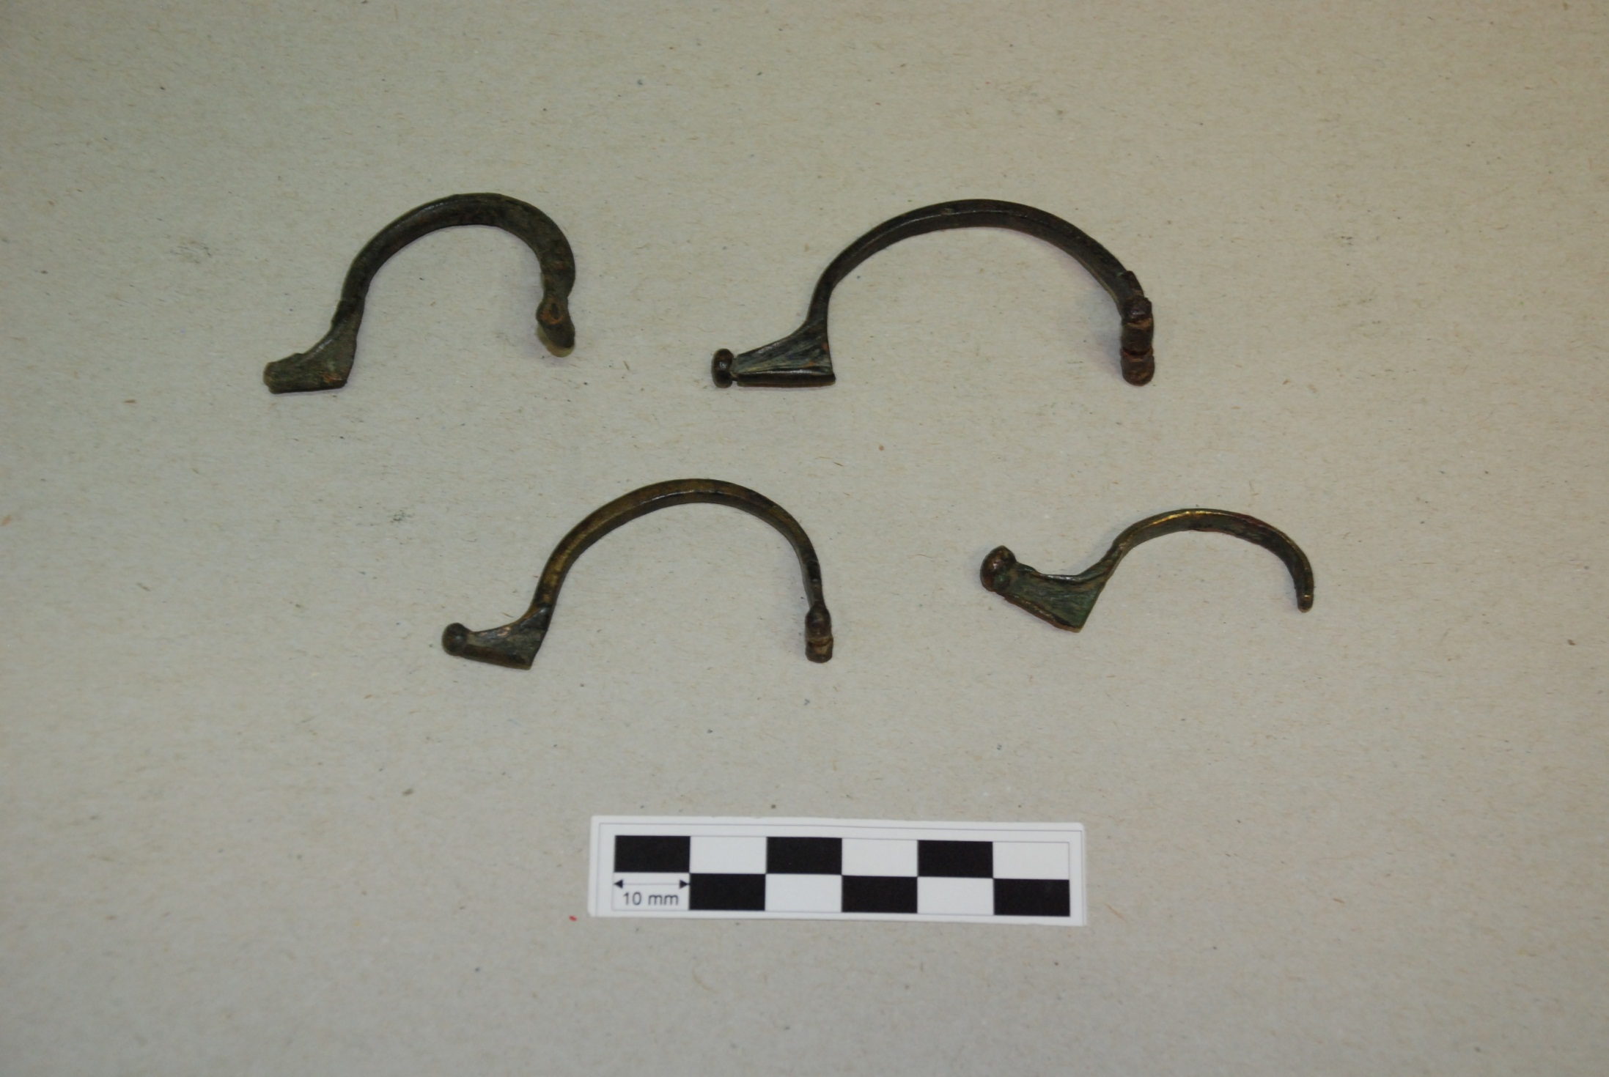
Aucissa type brooches

Slide 16
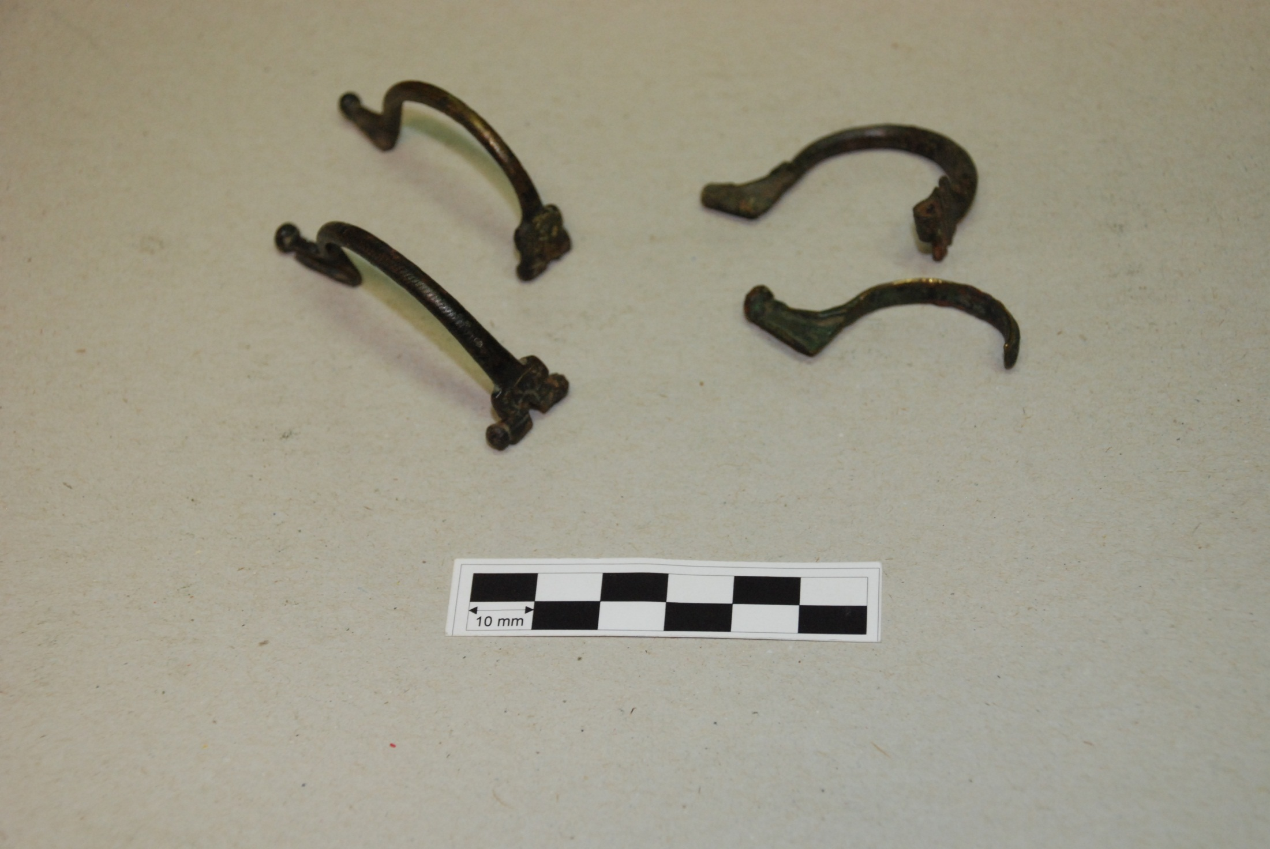

Slide 17
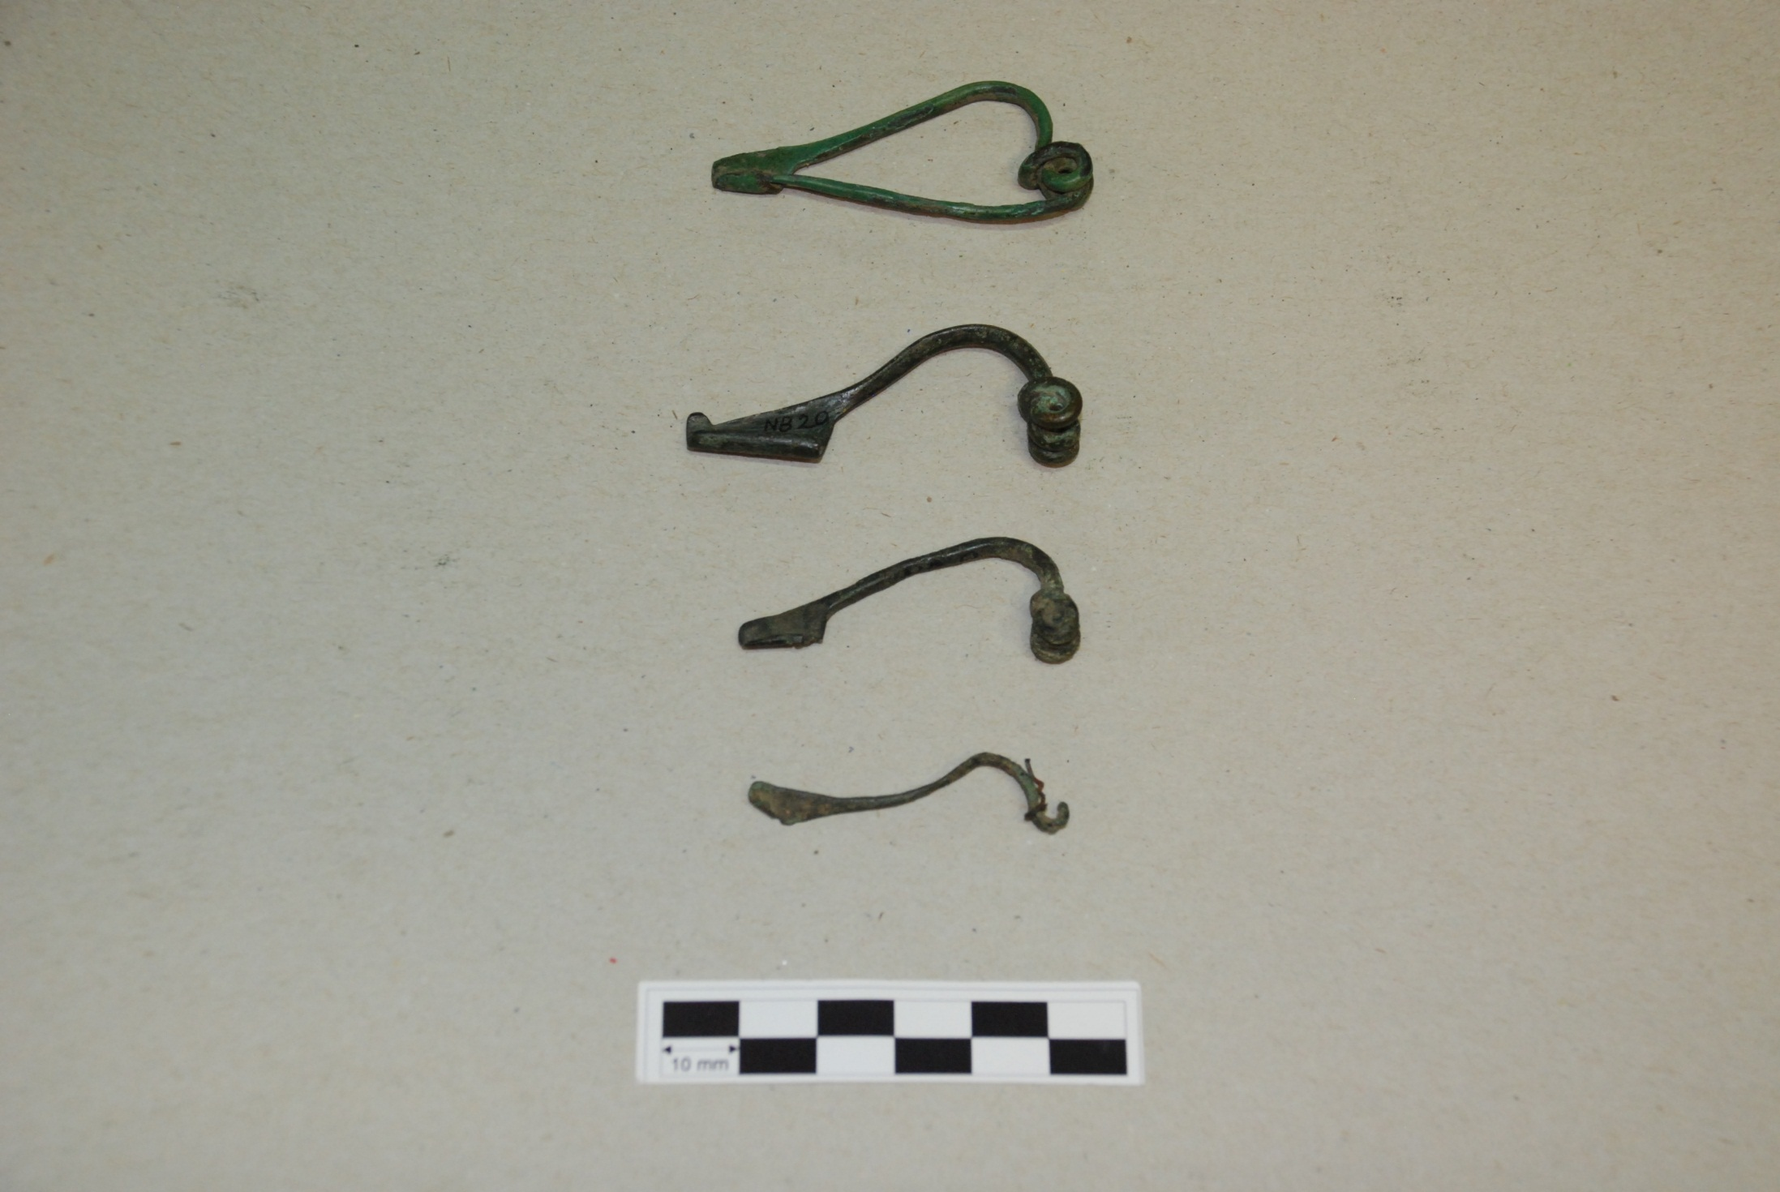
Eingliedrige Drahtfibeln («Soldatenfibeln») – Almgren 15

Slide 18
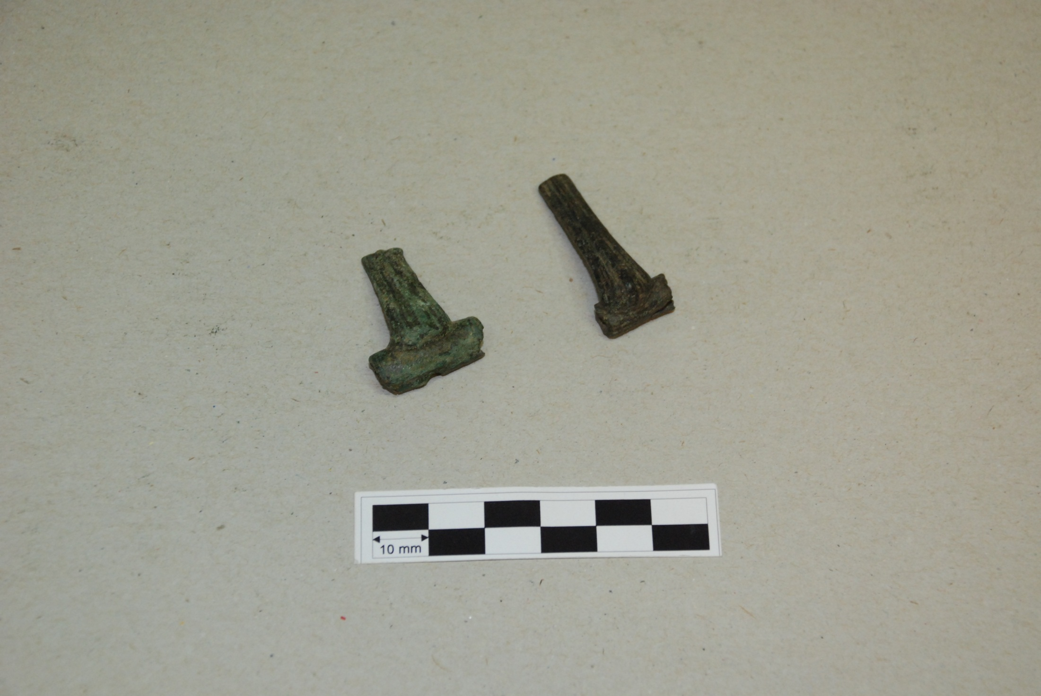
Nertomarus type

Slide 19
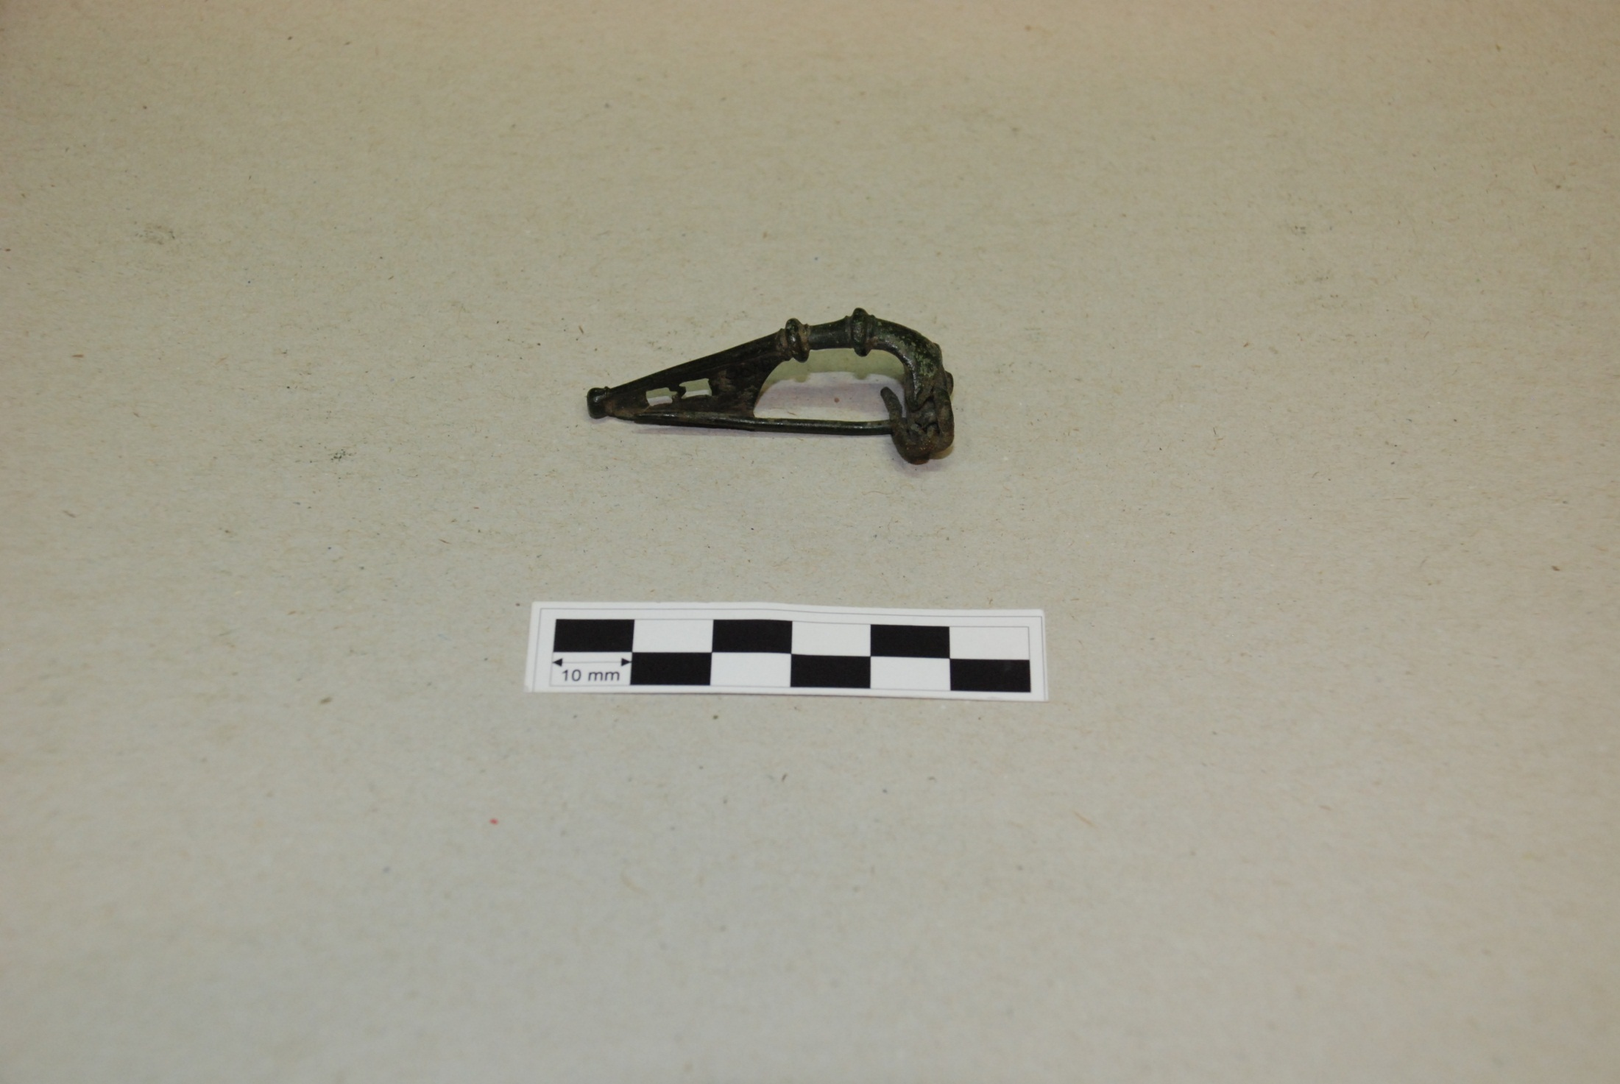
Doppelknopffibel

Slide 20
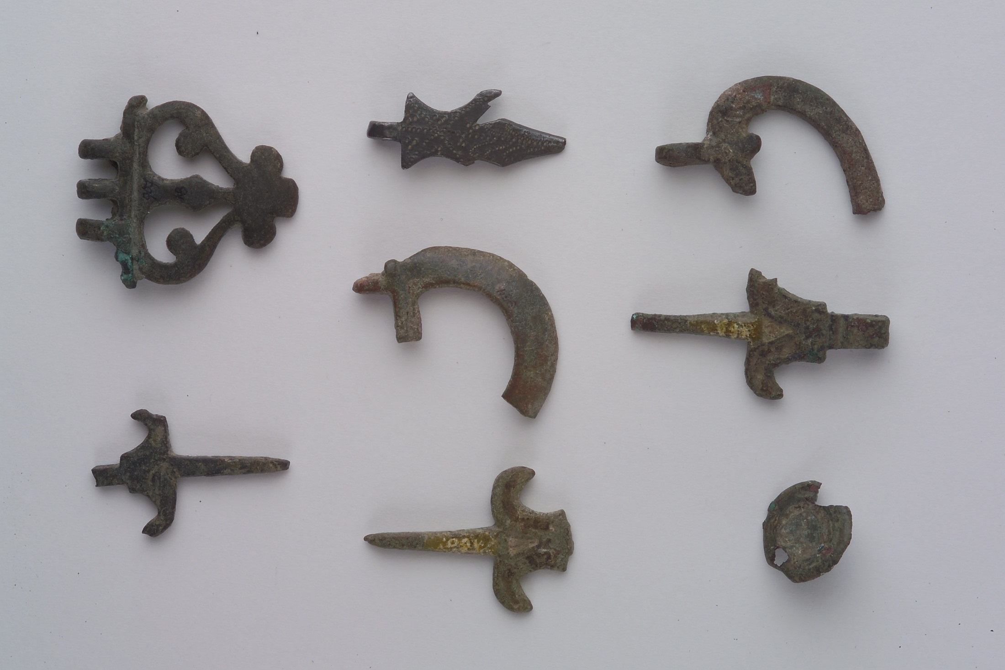

Slide 21
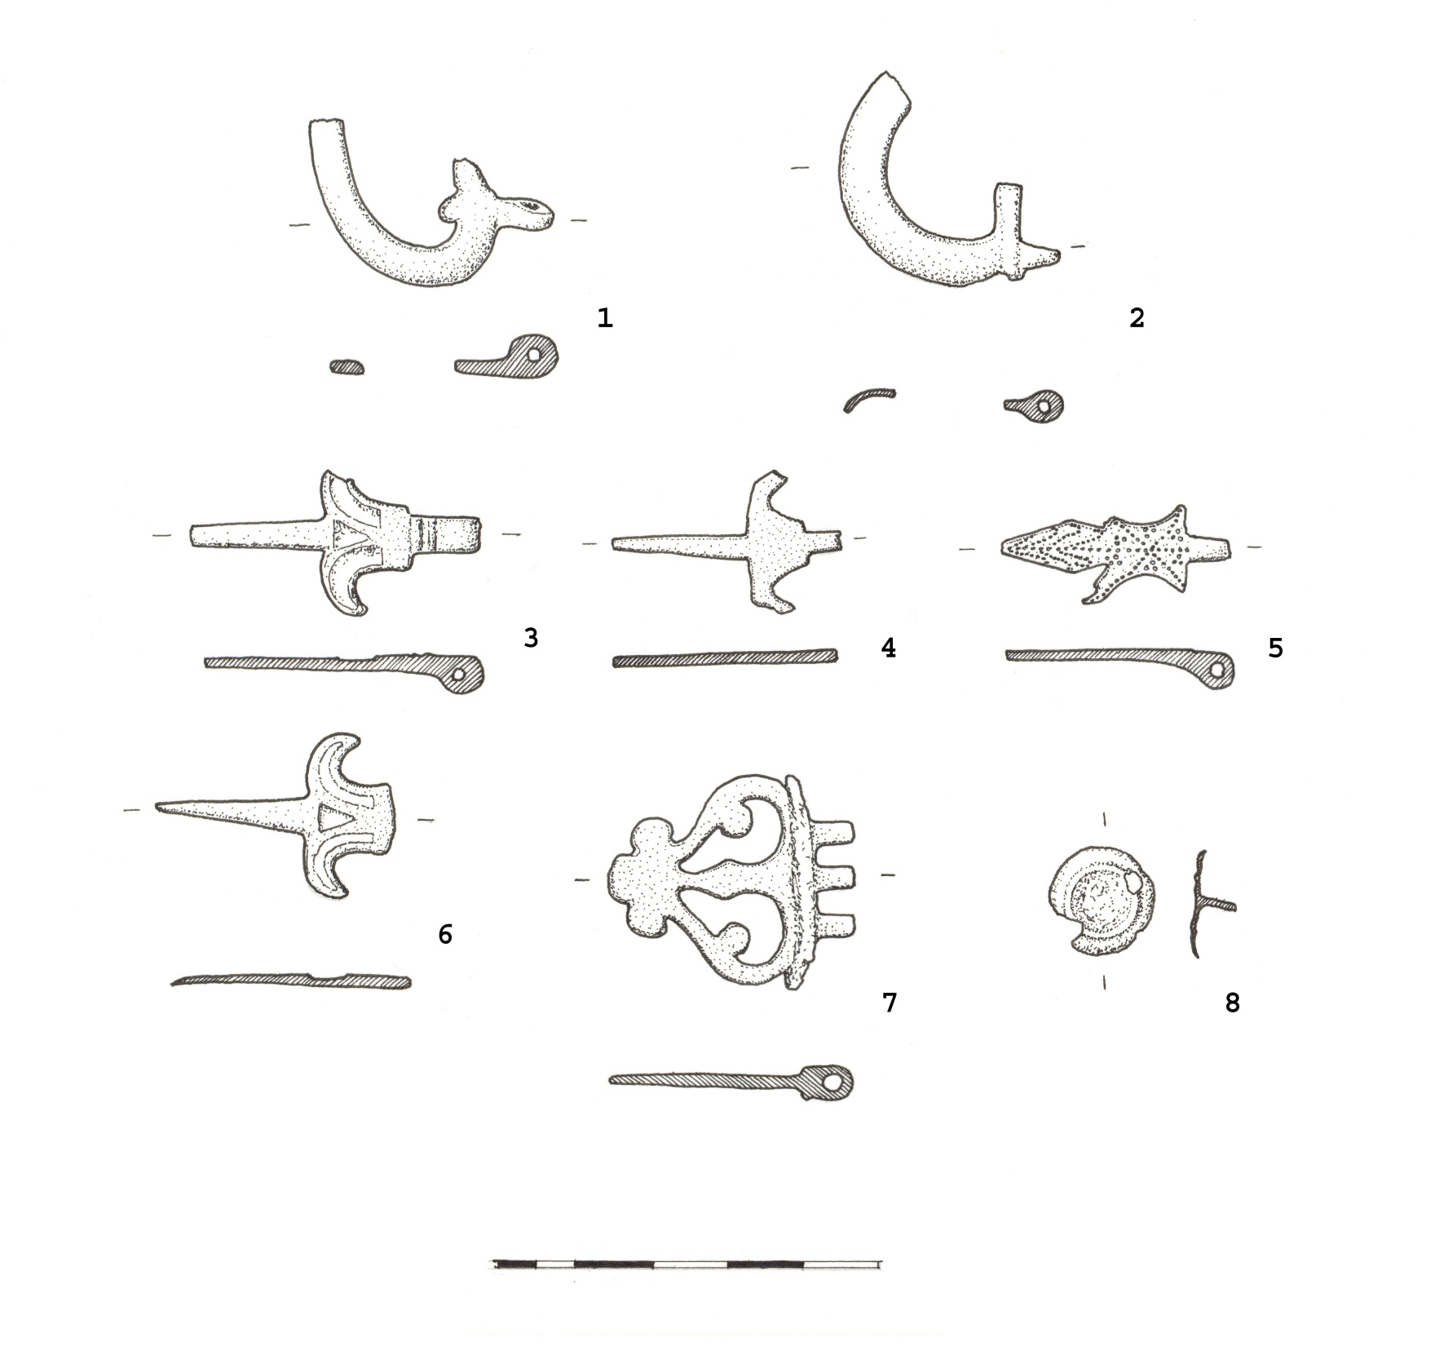

Slide 22
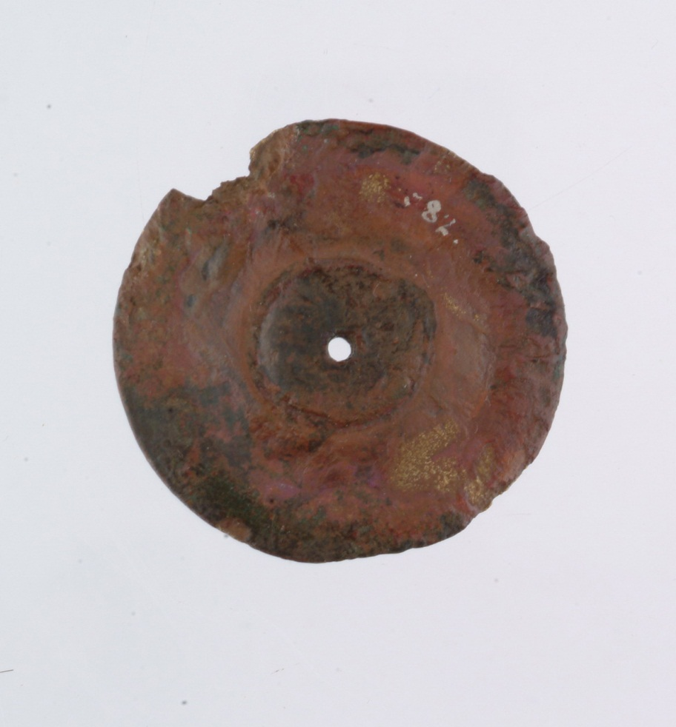
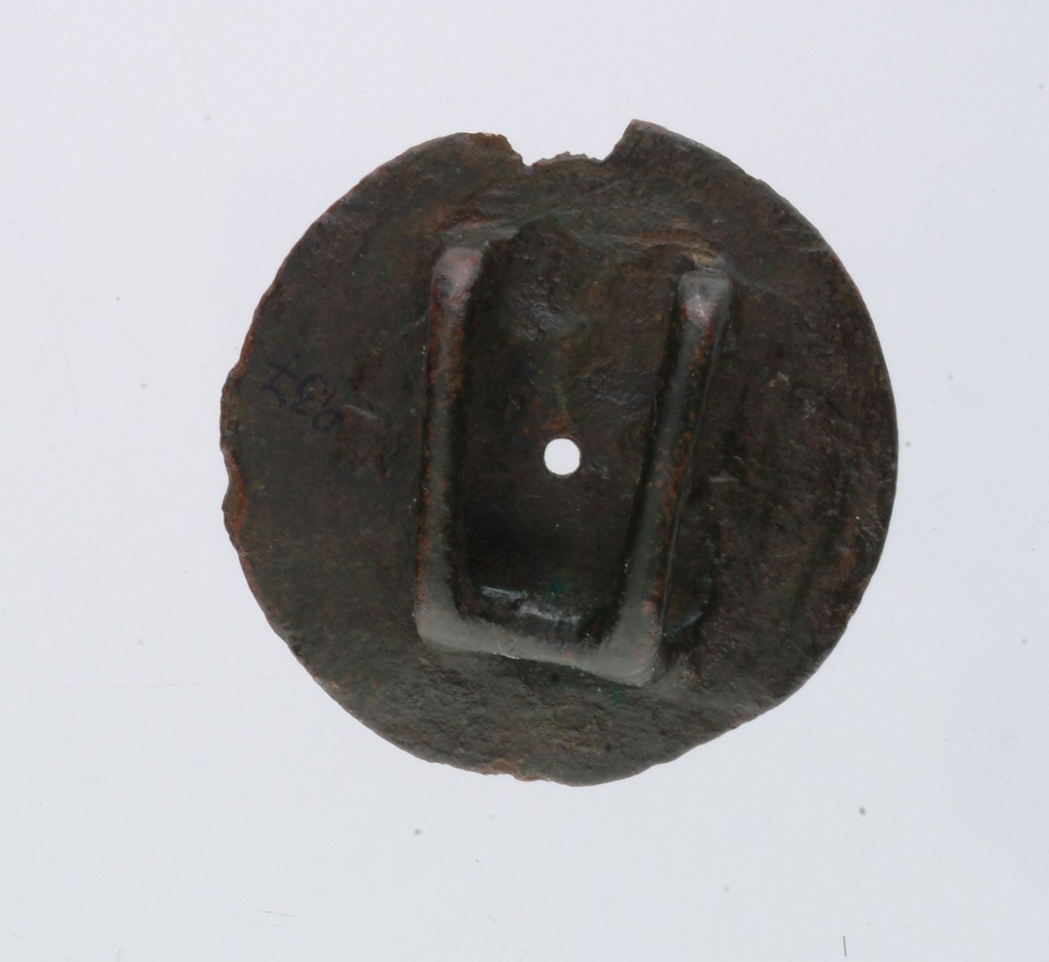
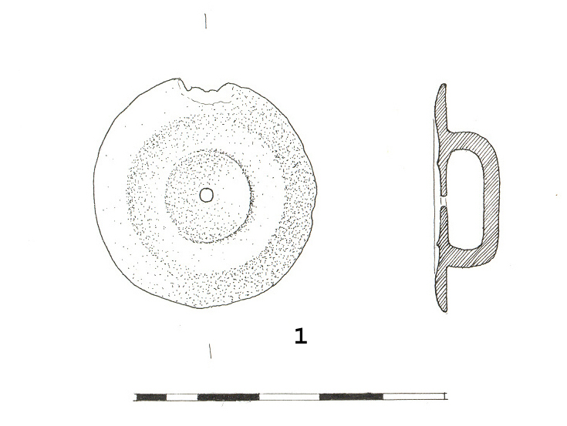
The small copper-alloy phalera (cat. 1) according to Bishops typology of Roman cavalry equipment, is akin to his functional type 2f while the front side of this phalera corresponds to Bishop’s decorative type 2a. This type of phalera was most probably associated with a pendant and served no functional purposes except as a pendant mount (Bishop, 1988: 94-95, 135-141). It can be roughly dated to the 1" century AD, probably starting from the Claudian time to the early 2nd century at the latest (Bishop & Coulston 1993:105; Rabeisen, 1990: 80, 84-85; Deschler-Erb, 1999: 59; Chapman, 2005: 132-133).

Slide 23
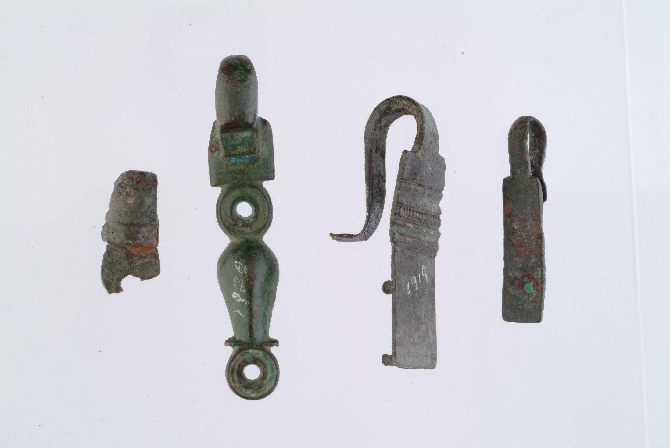

Slide 24
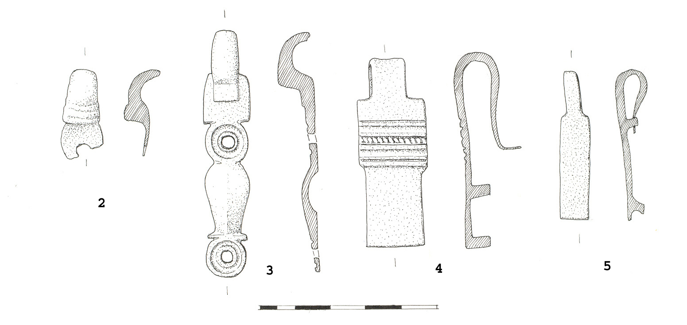
There are four, more or less well preserved junction loops among the harness fittings from Burgenae. The fragment (cat.2) probably belongs to Bishop’s type 1, i.e. the spectacle type, but the subtype cannot be determined. The types of the other three junction loops are far easier to determine. There is a nicely preserved junction loop of 2a type (cat.3), the largest specimen of rectangular shape with a broad decorated band at the upper end (cat. 4) is related to the type 5e, while the simple rectangular junction loop (cat. 5) could be determined as type 8h. (Bishop, 1988: 100). They can all be dated to the 1st and early 2nd century AD (Deschler-Erb, 1999: 61; Chapman, 2005: 133-136).

Slide 25
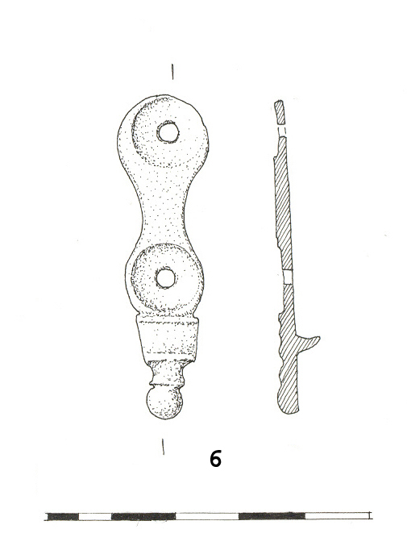
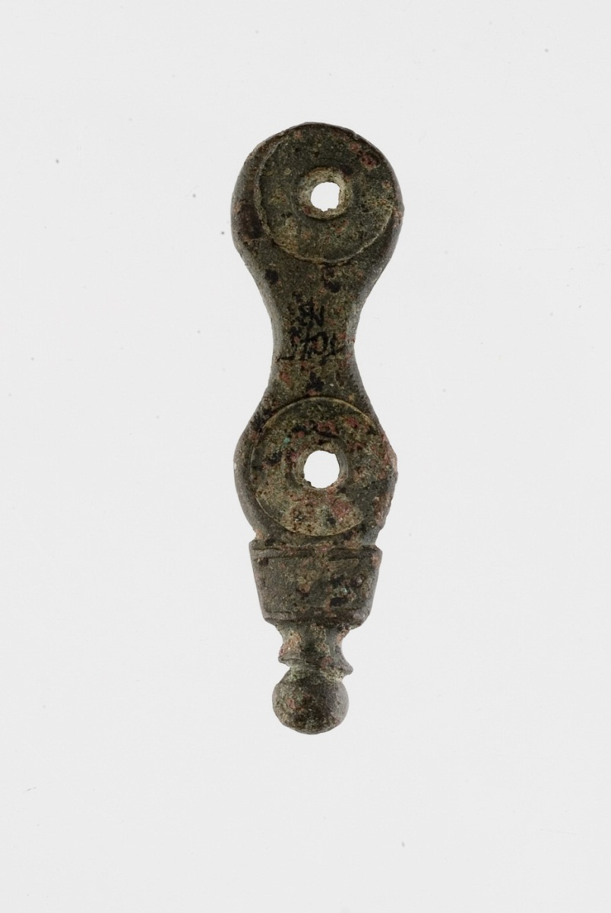
The copper alloy strap terminal (cat. 6) is also a very common item. This specimen corresponds to Bishop’s 1a type and can be dated to the 1st century AD (Bishop, 1988: 103, 109, 1 54-165; Deschler-Erb, 1 999: 62; Chapman , 2005: 136-137).

Slide 26
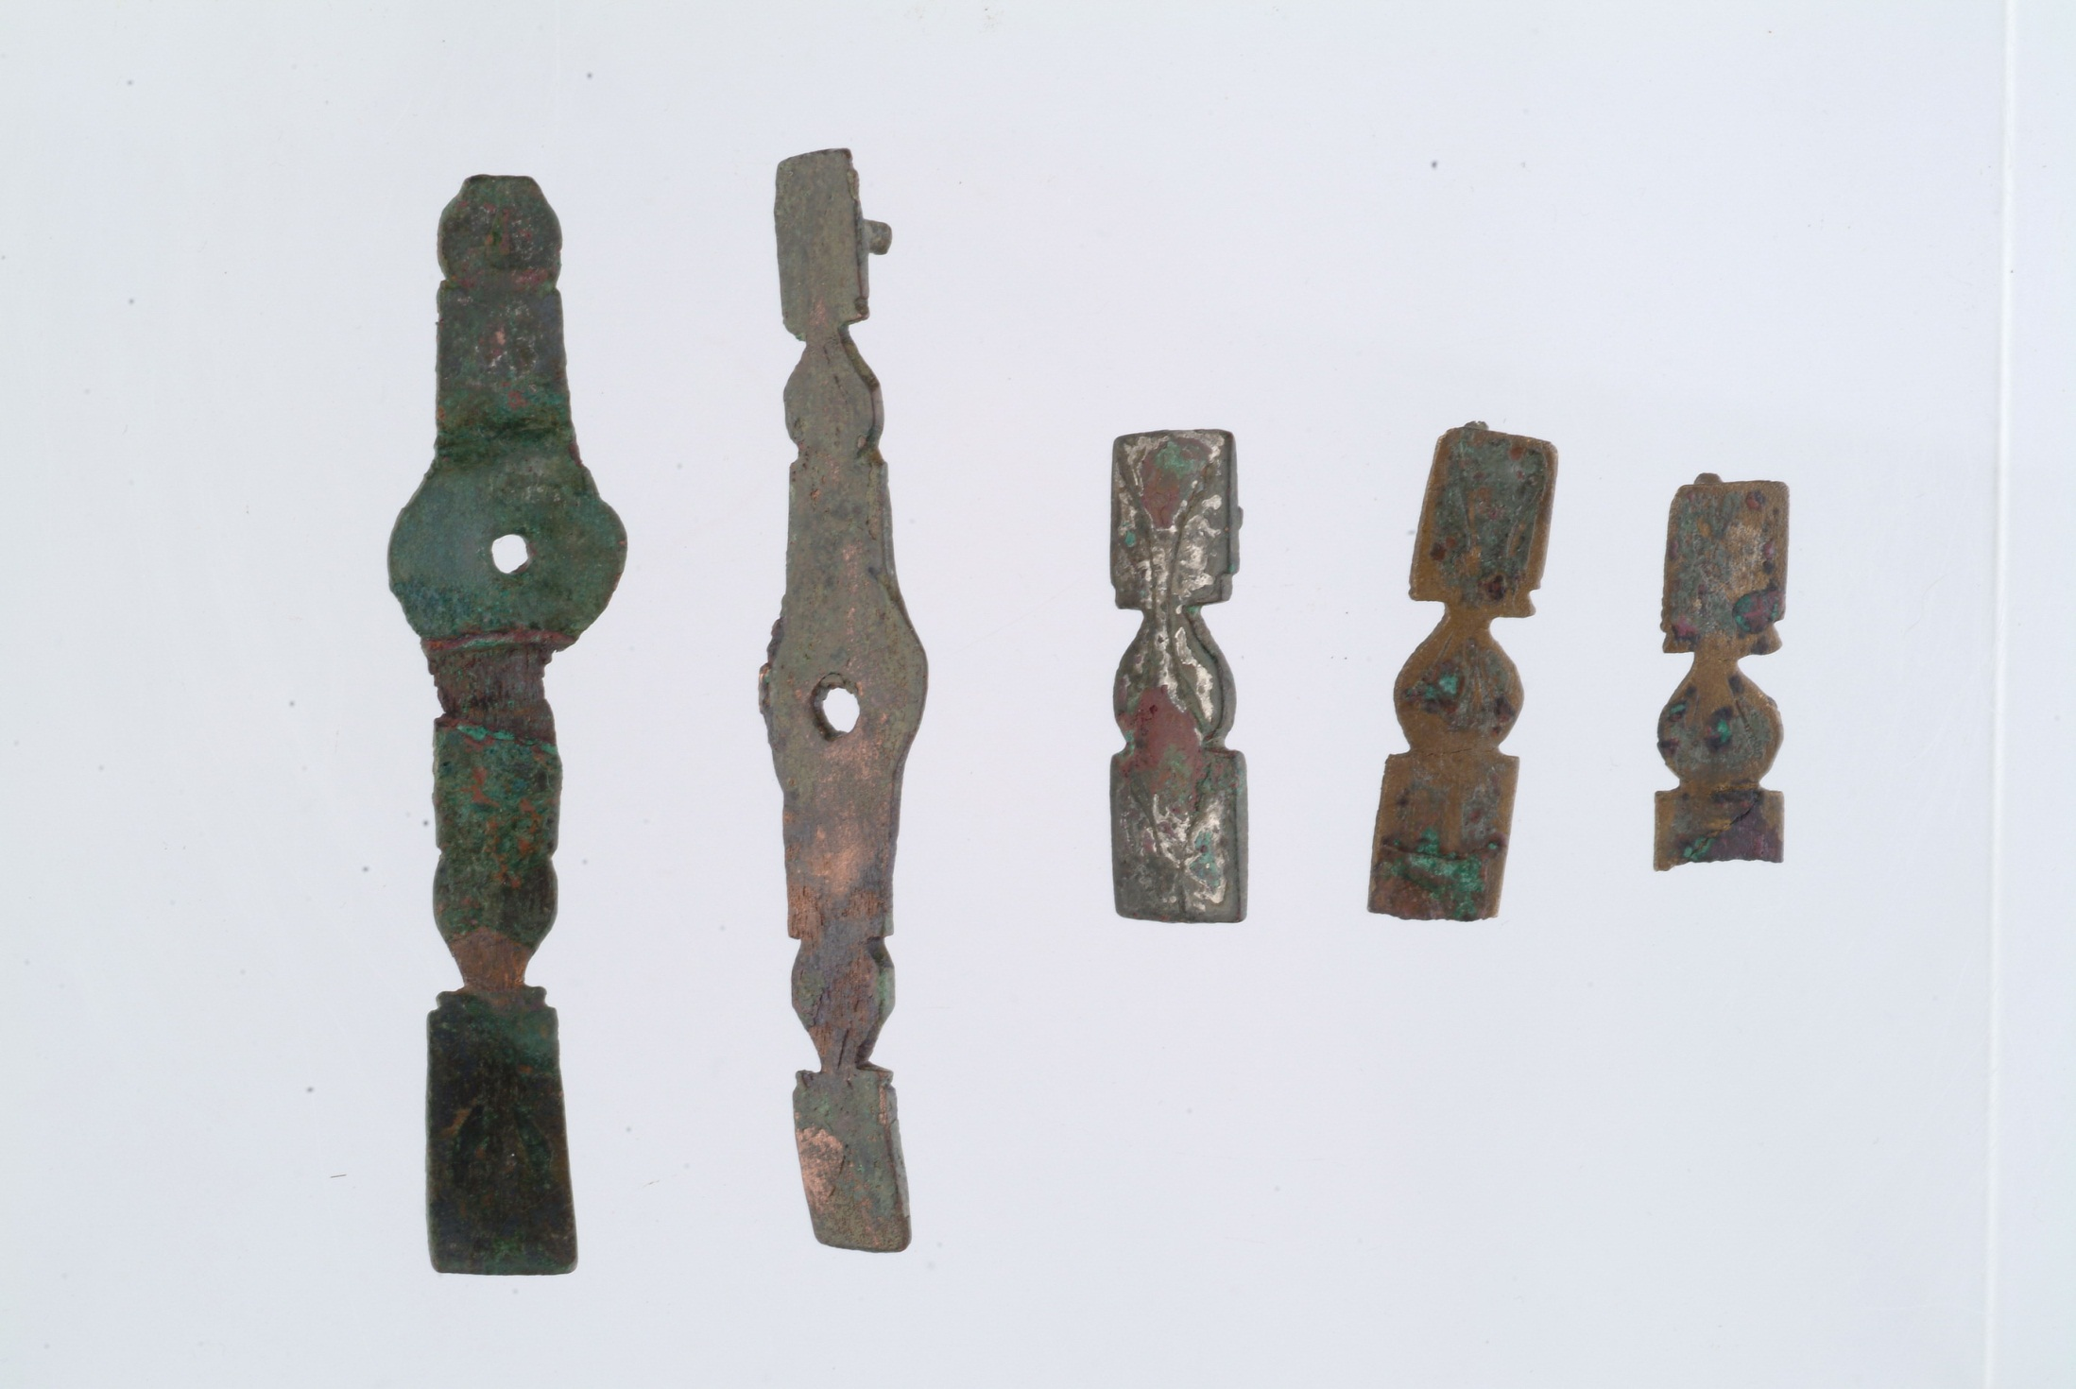

Slide 27
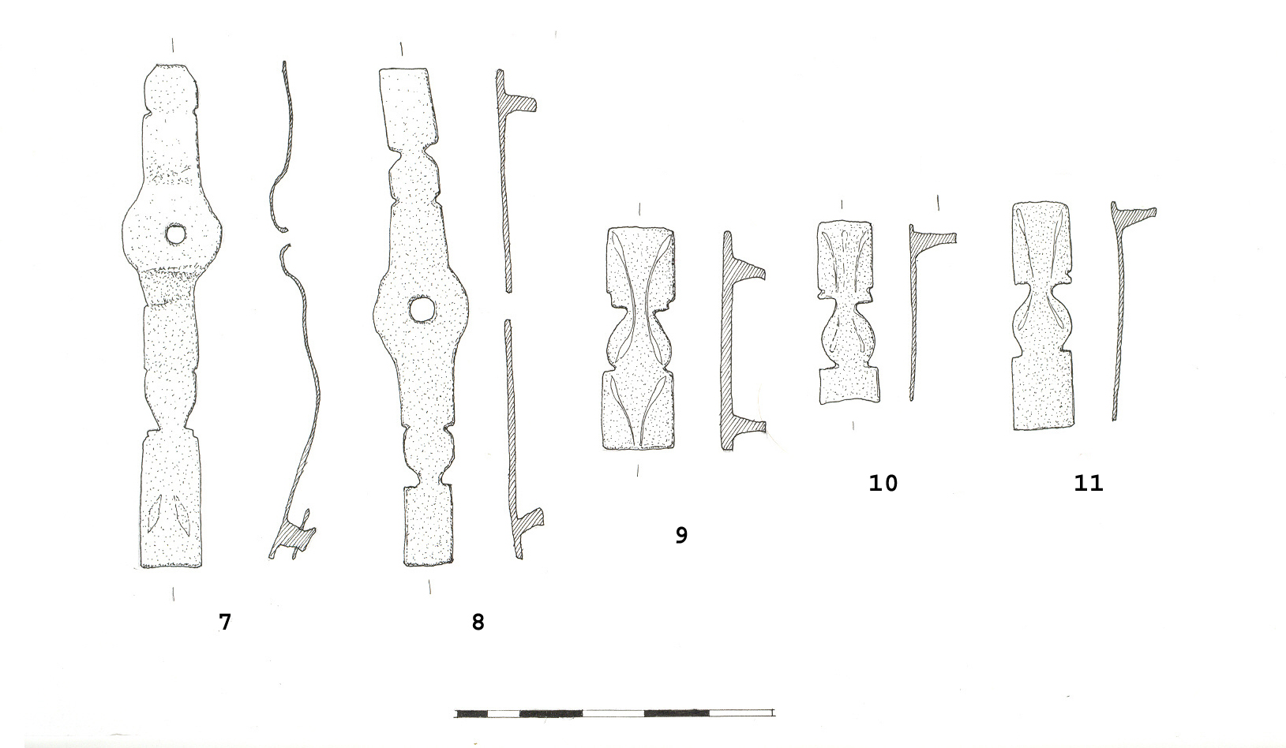
The strap mounts are fairly well represented in this small sample of harness fittings. The two larger ones seem to correspond to Bishop’s 6d type. Actually, the better-preserved one (cat. 8) definitely does, while the fragmented one (cat. 7) is certainly related. The latter one still bears traces of niello. The three smaller ones are related to Bishop’s 6b type. The best preserved one (cat. 9) shows clear traces of coating, most probably silvering and traces of niello, which might also be present on the other two (cat. 10 and 11). All of them can be dated to the 1st century AD (Ulbert, 1959: 94, T. 19, 1-3; Bishop,1988: 170-173; Deschler-Erb1999: 63) .

Slide 28
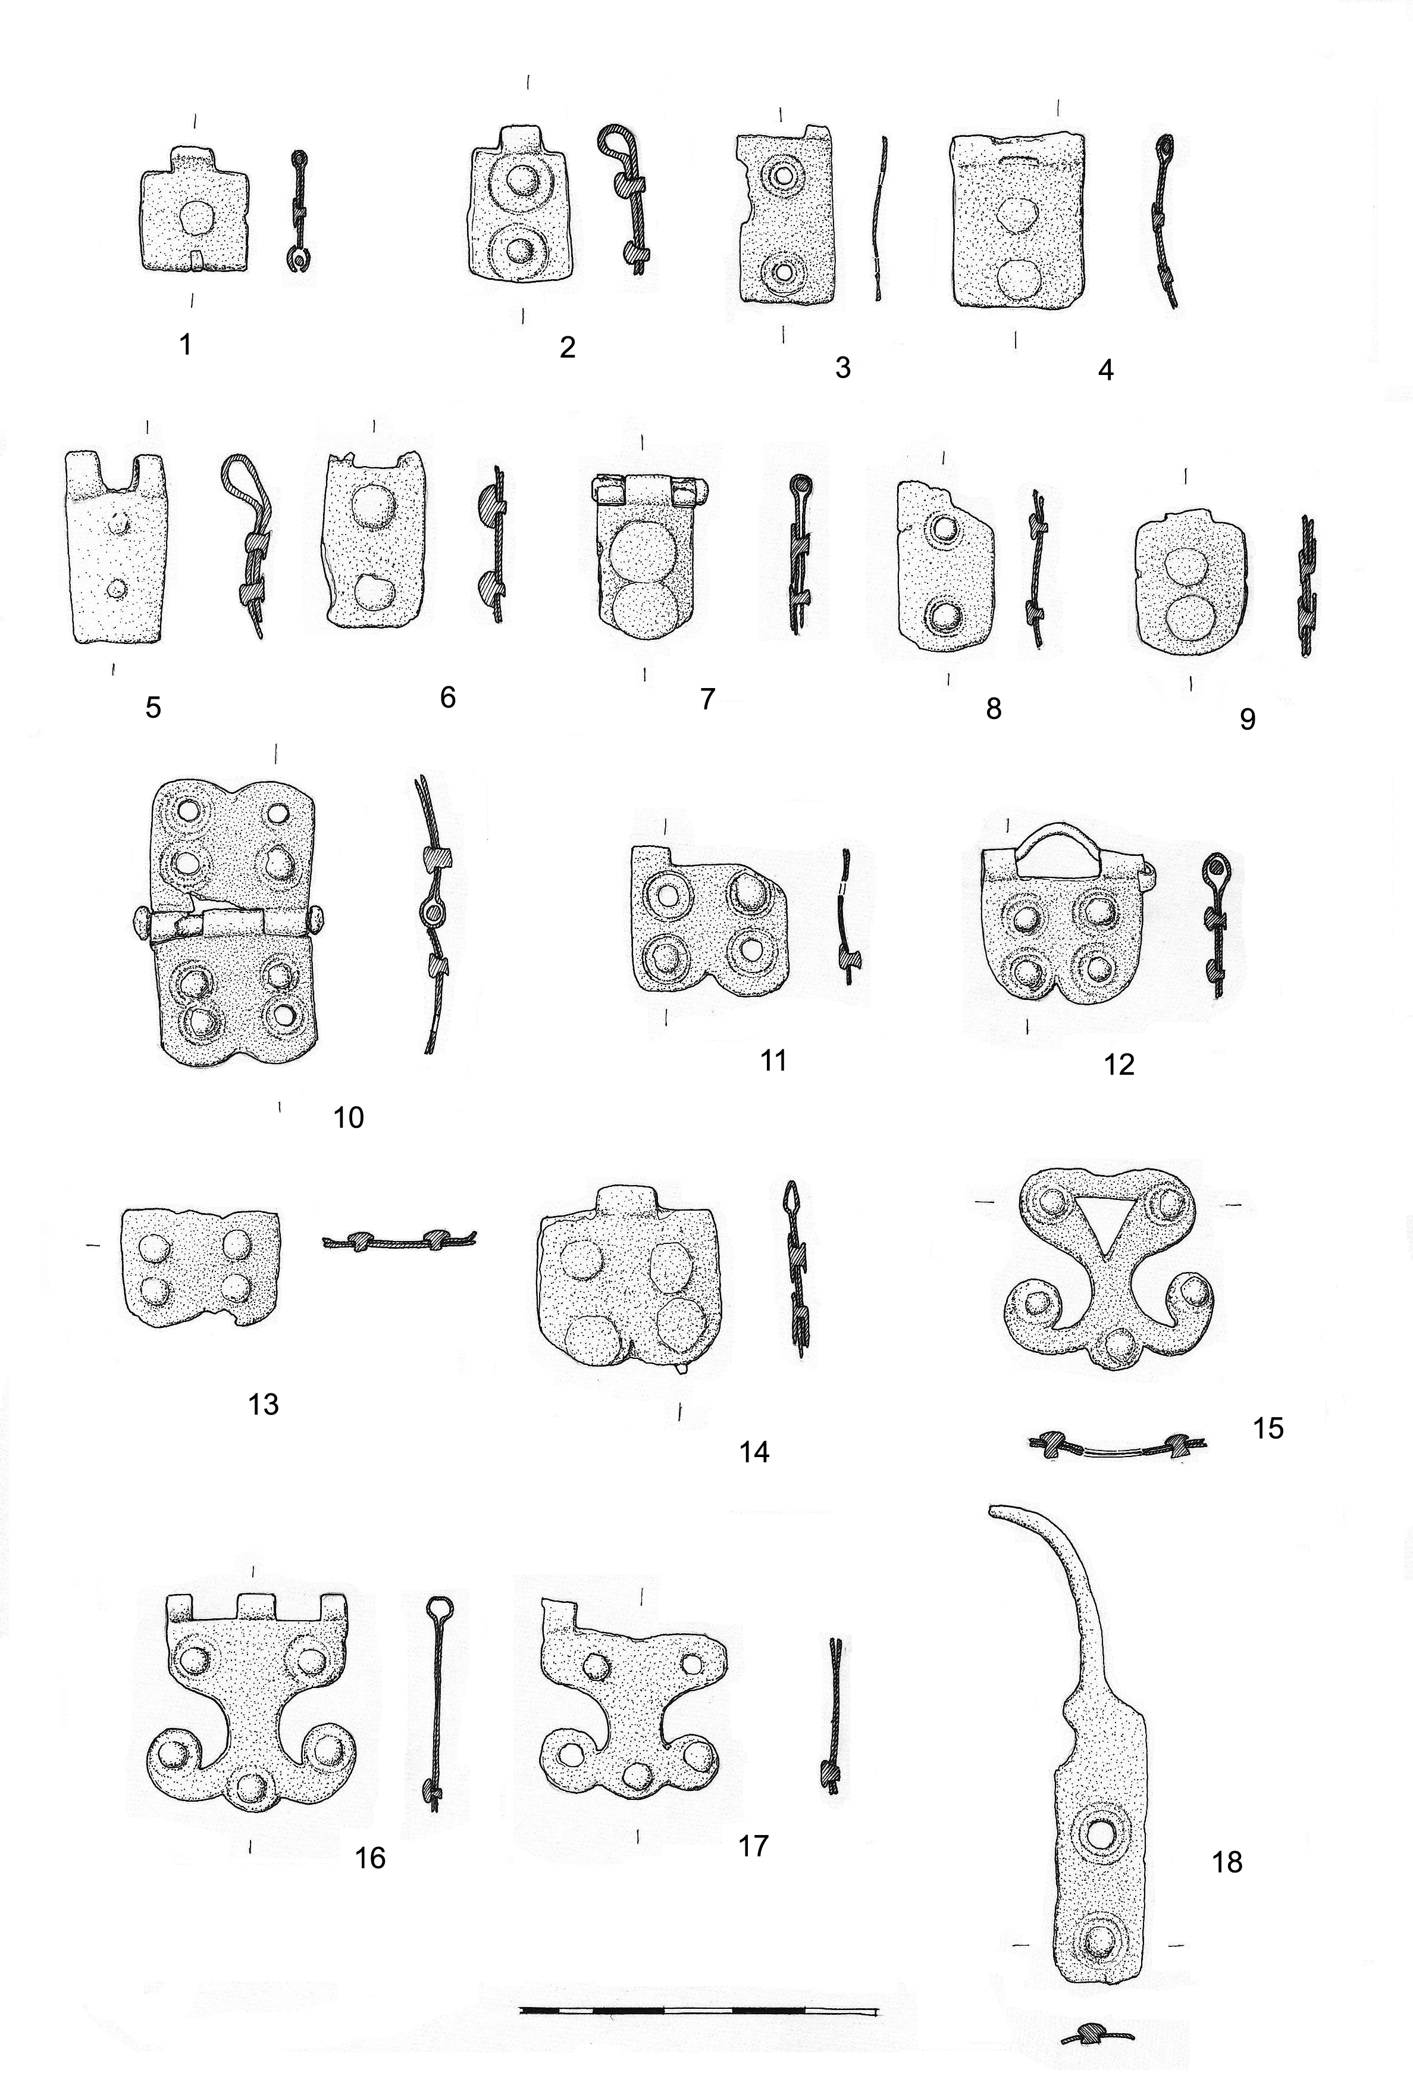
There are eight shoulder hinge fitments (10 – 17) among the finds from Burgenae, and while three of them belong to the Corbridge type cuirass (15 – 17),
just as the other pieces, five of them
(10 – 14) seem to be earlier in date. They are closely related to finds of fittings attributed to the Kalkriese type cuirass and can be described as sub-lobate type hinges with rounded scalloped ends, Thomas’ type F II.

Slide 29
HOPEFULLY, FUTURE RESEARCH, GEOPHYSICAL SURVEYING AND EXCAVATIONS WILL PROVIDE DEFINITE ANSWERS TO OUR DILEMMA...

Slide 30
This work has been fully supported by Croatian Science Foundation under the projects no. 1549: Cultural, economic, monetary and social transformations in view of the archaeological heritage of the Middle Danubian region,
279 B.C. – A.D. 582 and no. 4632: Roman funerary monuments from south-western Pannonia in their material, religious and social context

