Slide 1
THE POPULATION OF AQUAE
BALISSAE (PANNONIA SUPERIOR)
Branka Migotti
The Croatian Academy of Sciences and Arts,
Zagreb, Croatia

Slide 2
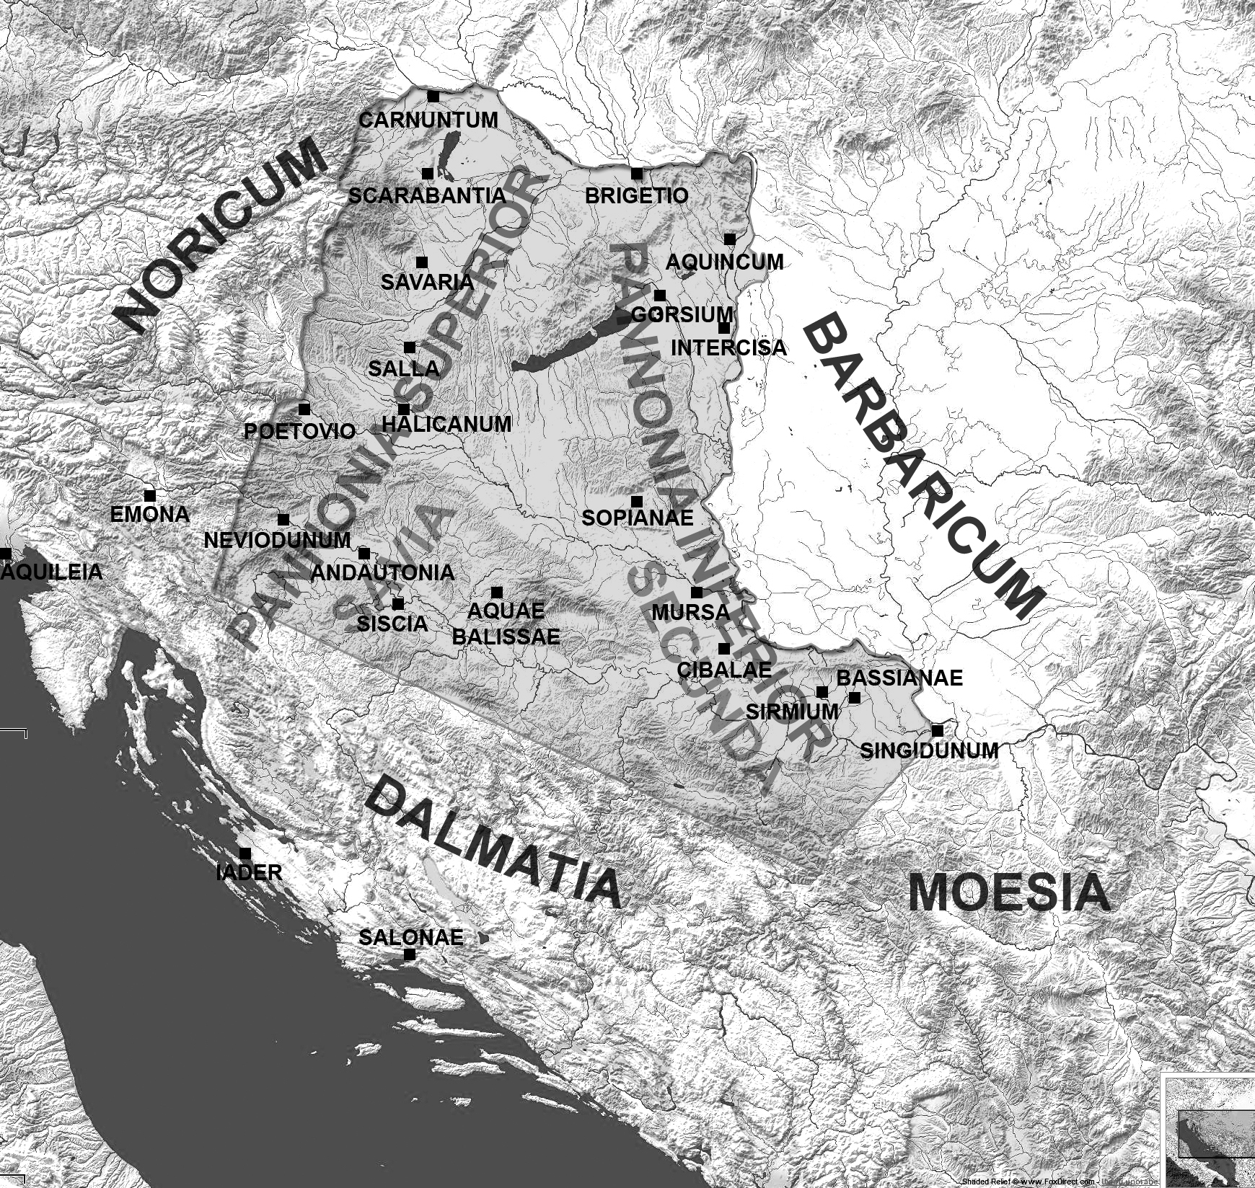
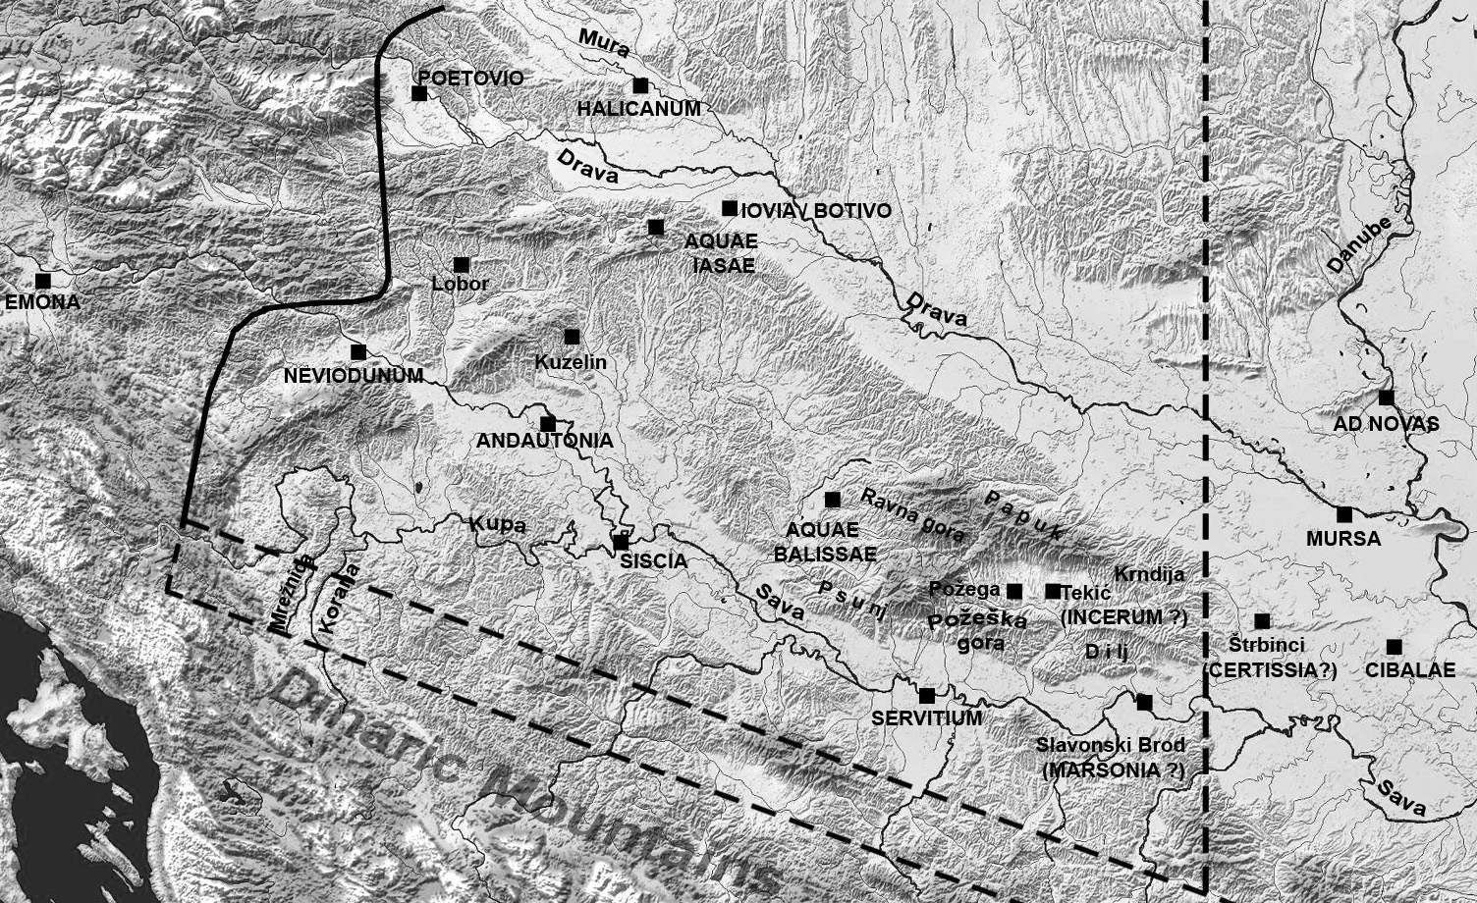
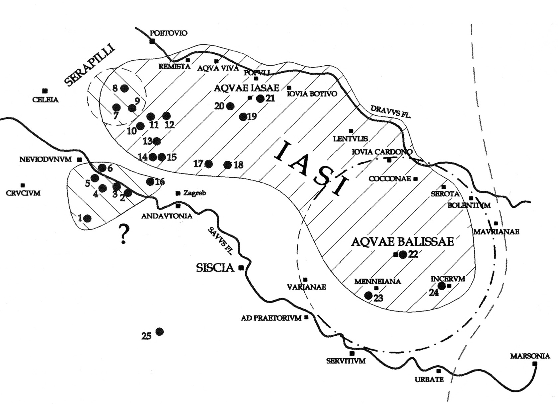
civitas Iasorum,
Aquae Balissae,
municipium Iasorum,
res publica Iasorum
territory of the Iasi
presumed territory of Aquae Balissae

Slide 3
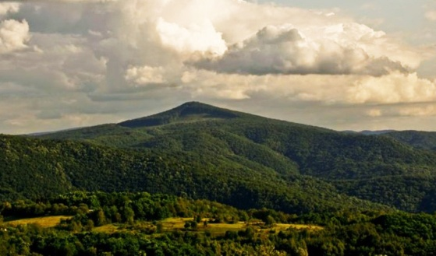
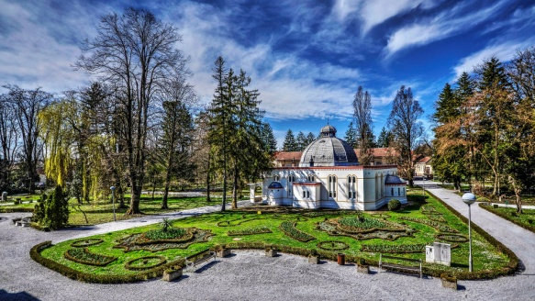
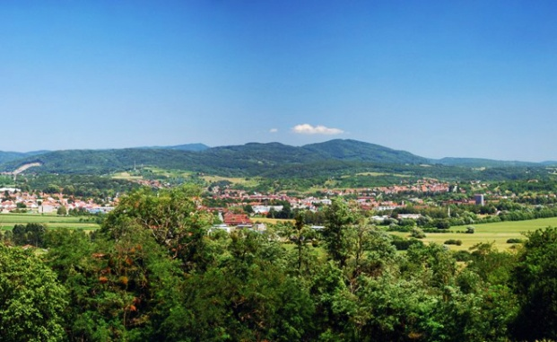
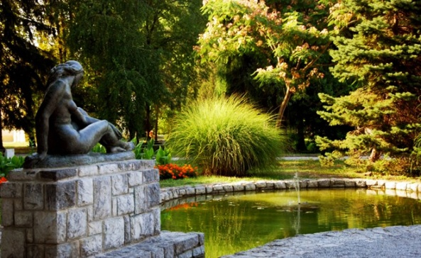
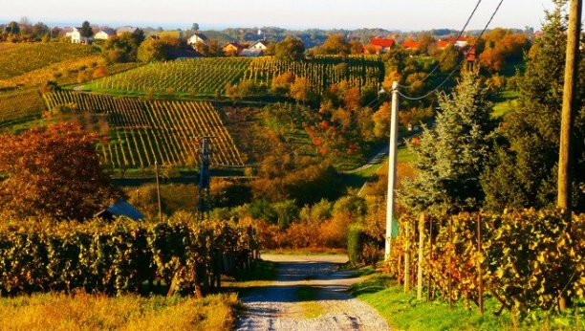
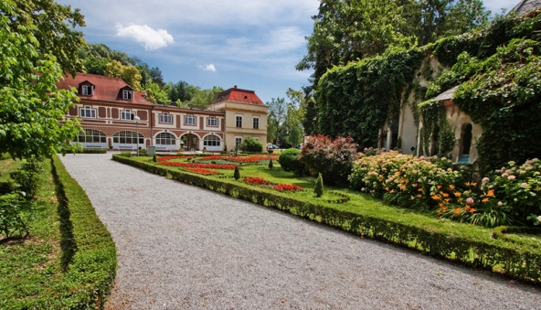
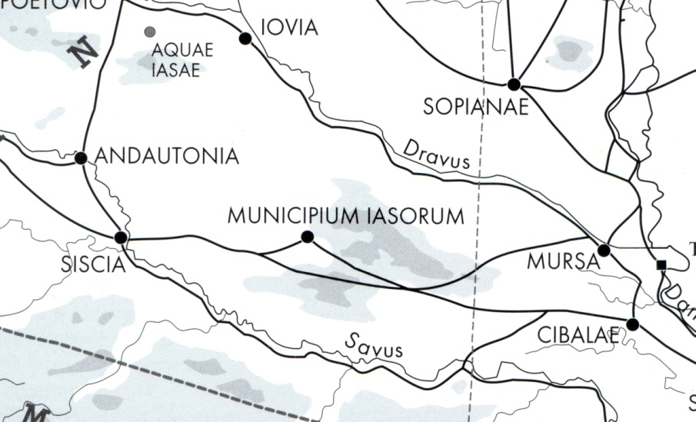
Aquae Balissae, modern-day Daruvar, north Croatia
Termal baths
Environment
ADMINISTRATION OVER TIME
military camp: until the Flavians
military prefect : “ “
princeps Iasorum : after the
Flavians
municipium Iasorum: 2nd c.
res publica Iasorum: 3rd c.
Roads

Slide 4
CROSS-SECTION OF THE POPULATION - EPIGRAPHIC EVIDENCE
- SOCIAL STATUS
- RELIGIOUS WORSHIP
- ETHNIC-GEOGRAPHICAL ORIGIN
22 MONUMENTS later 1st to the 4th c.
10 FUNERARY, 8 VOTIVE, 4 IMPERIAL HONORARY
19 INSCRIBED
- 14 BEARING REFERENCE TO SPECIFIC PEOPLE
COMPARISON: Aquae Balissae – Aquae Iasae

Slide 5
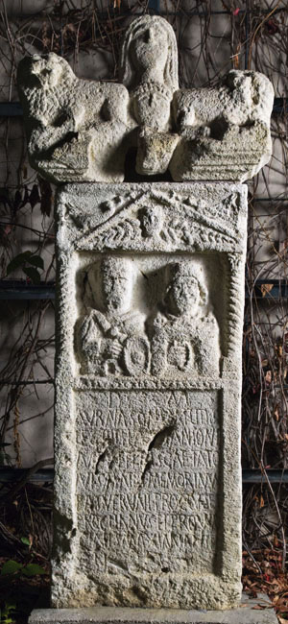
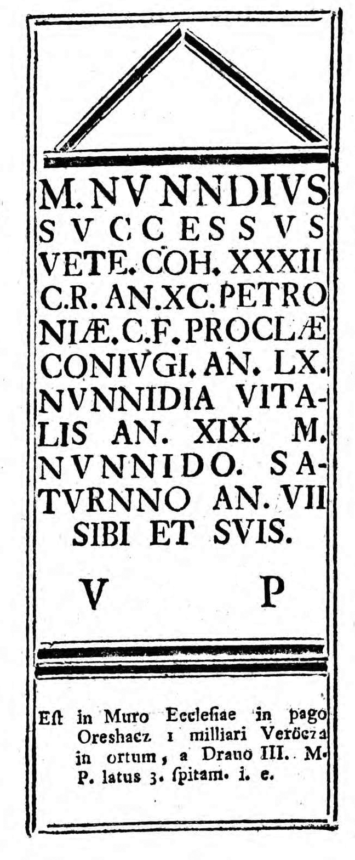
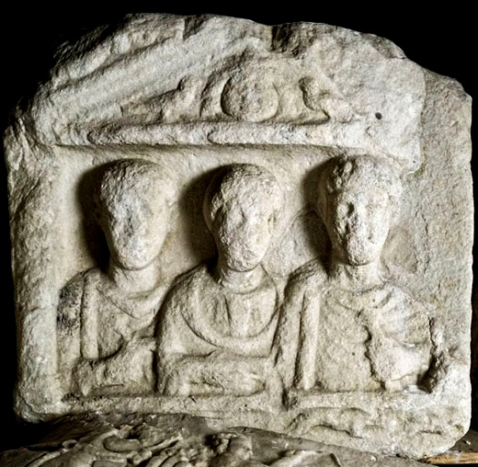
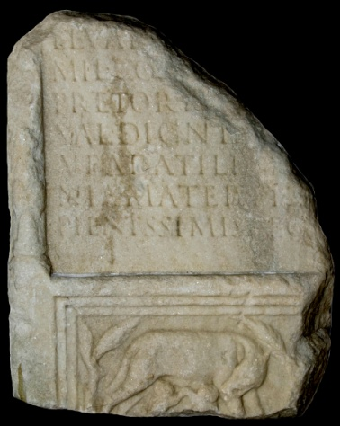
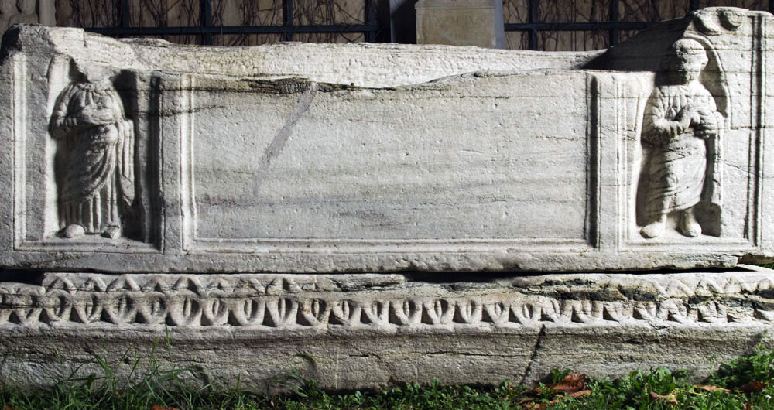
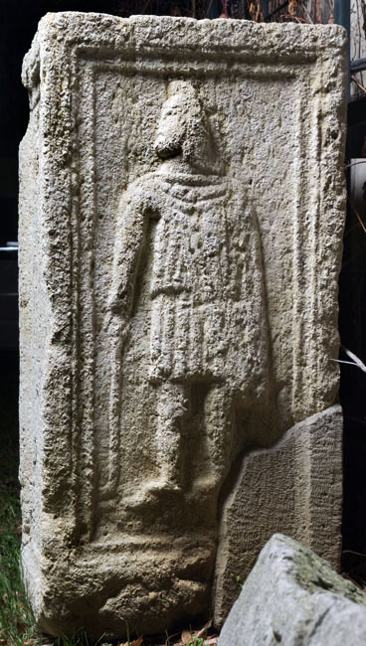
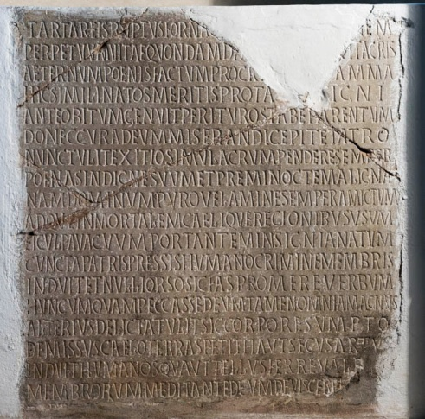
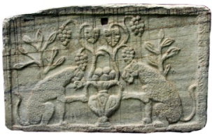
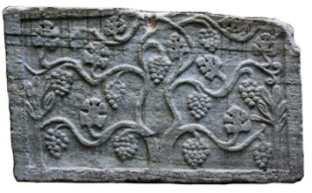
F U N E R A R Y M O N U M E N T S (11)
MILITARY (6 - one missing)
s t e l a e
sarcophagus
CIVILIAN (2, two missing)
inscribed slab
altar

Slide 6
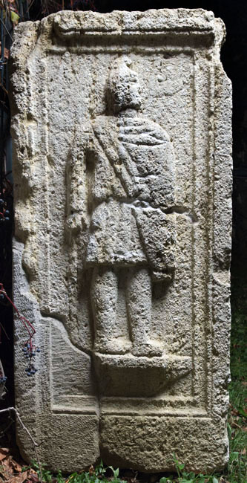
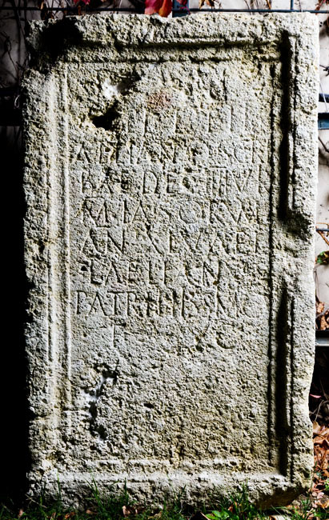
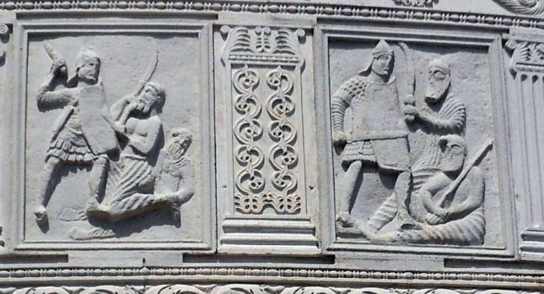
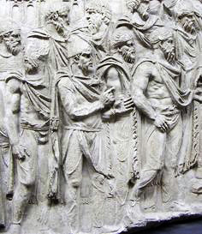
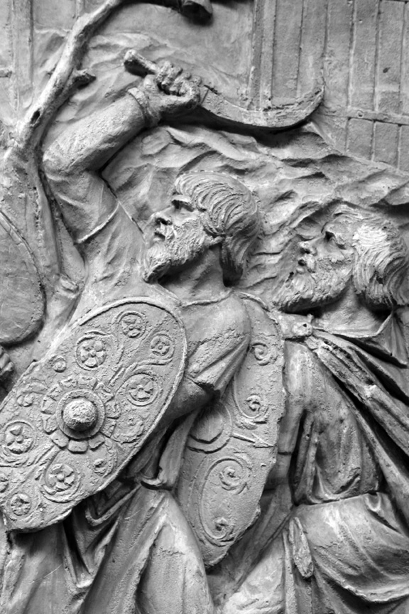
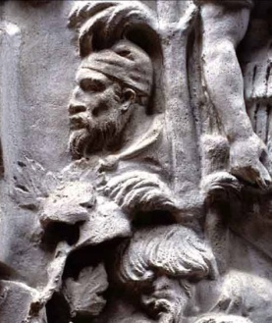
FUNERARY ALTAR TO PUBLIUS AELIUS AELIANUS FROM DARUVAR, mid-2nd c.
D(is) M(anibus)
P(ublio) Ael(io) P(ubli) fil(io)
Aeliano scri-
bae dec(urioni) IIIIvir(0)
m(unicipii) Iasorum
an(norum) XLV Ael(ius)
Laelianus
patri piissimo
f(aciendum) c(uravit)
genii, warriors, Attises
Tropaeum Traiani, Adamclissi
Trajan’s column, Rome

Slide 7
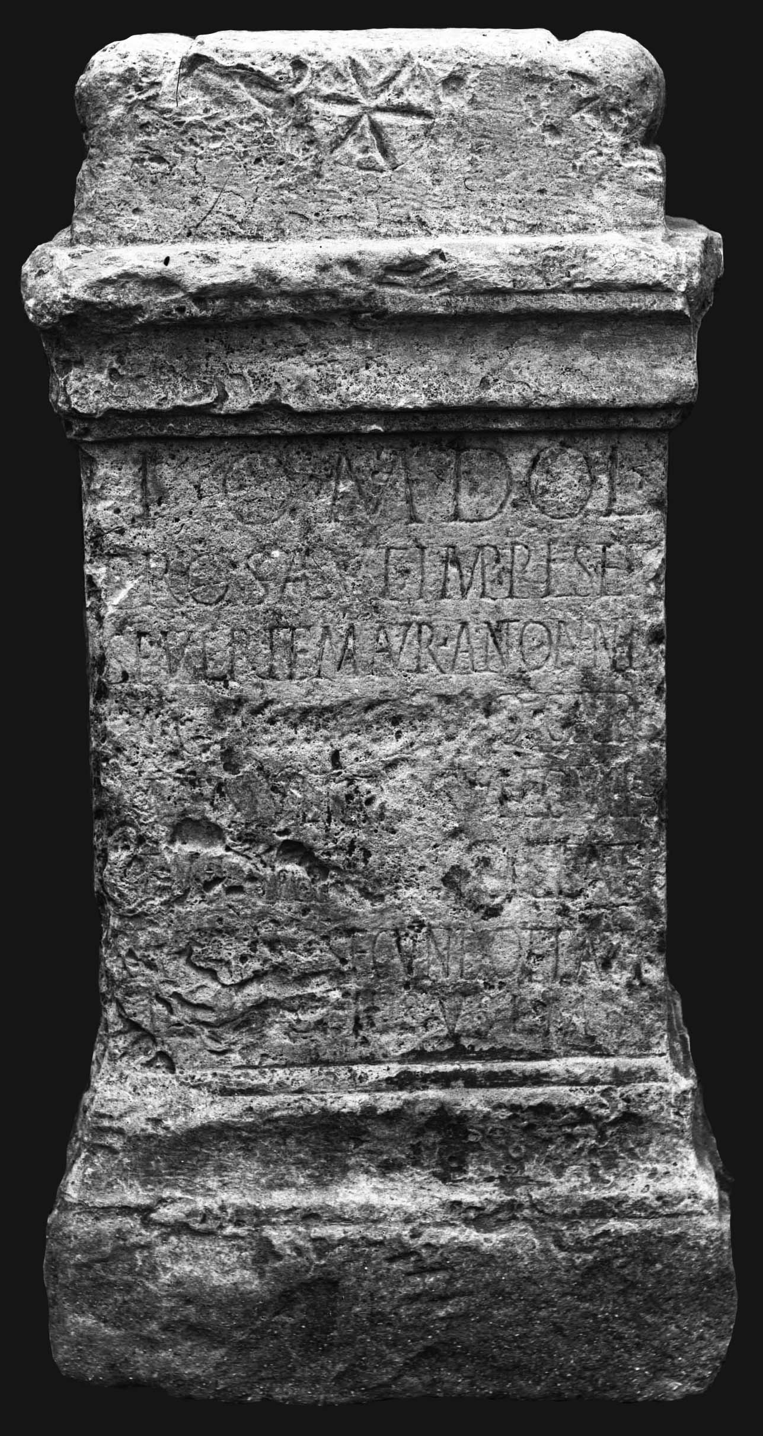
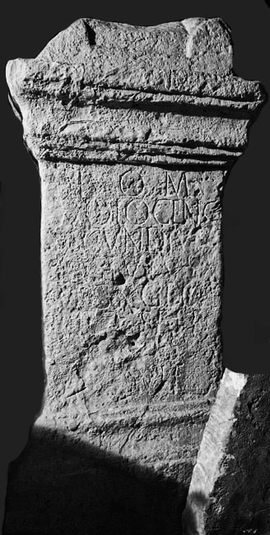
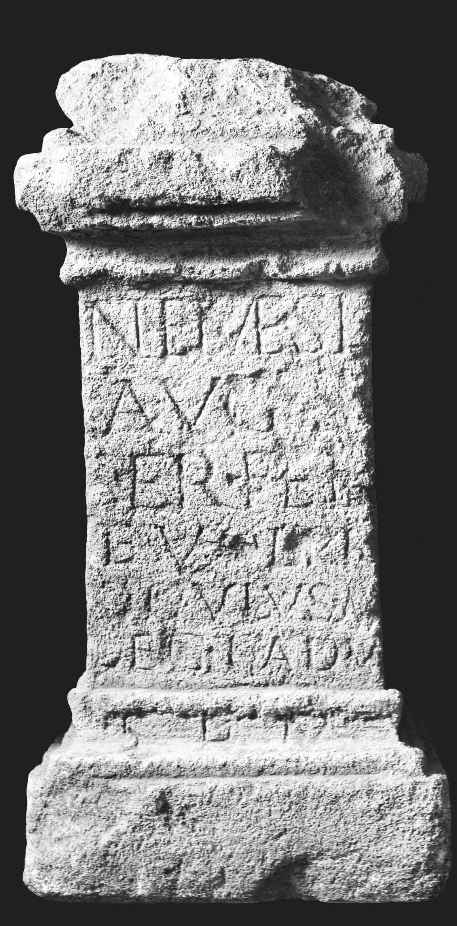
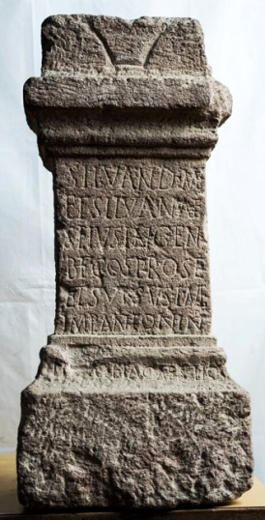
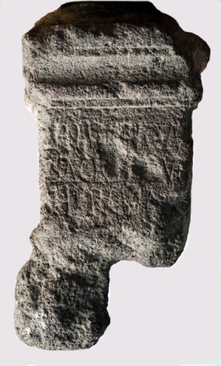
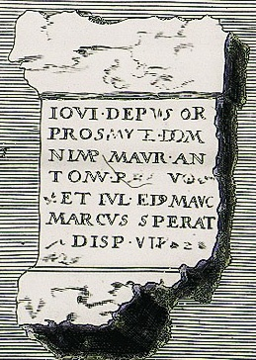
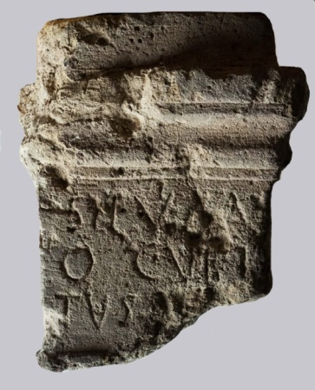
V O T I V E A L T A R S (8)
MILITARY (5)
one missing:
IOM
Silvanus Domesticus
and Silvana
Jupiter Dolichenus
Nemesis
CIVILIAN (2)
DISPENSATOR
Silvanus Magnus
Silvanus
Jupiter Depulsor

Slide 8
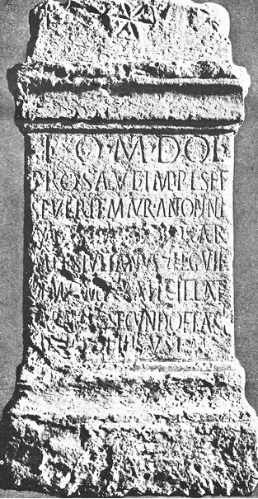
DARUVAR
Archaeological Museum in Zagreb
AD 209-211
I(ovi) O(ptimo) M(aximo) Dol(icheno)
pro salute Impp(eratorum) L(uci) Sept(imi)
Severi et M(arci) Aur(eli) Antonini
Augg(ustorum) [[---]] Q(uintus) Car-
meus Iulianus
(centurio) leg(ionis) VII
Gem(inae) cum Iul(ia) Att(i)cilla et
Carmaeis Secundo et Atti-
cilliano fili(i)s v(otum) s(olvit) l(ibens) m(erito)

Slide 9
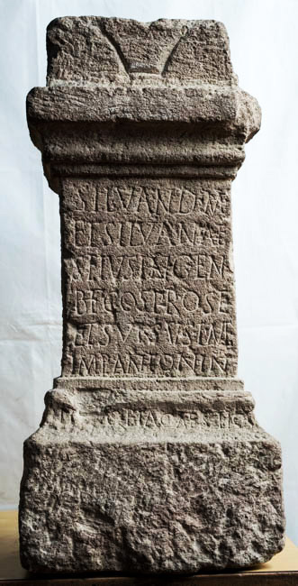
DARUVAR
Archaeological Museum in Zagreb
AD 208 (imperial consulships)
Silvan(o) D(o)m(estico)
et Silvanae
Seius Ingenuus
b(ene)f(iciarius) co(n)s(ularis) pro se
et suis v(otum) s(olvit) l(ibens) m(erito)
Imp(eratore) Antonin(o)
III [et] Geta Caes(are) II co(n)s(ulibus)
Silvanus Domesticus

Slide 10
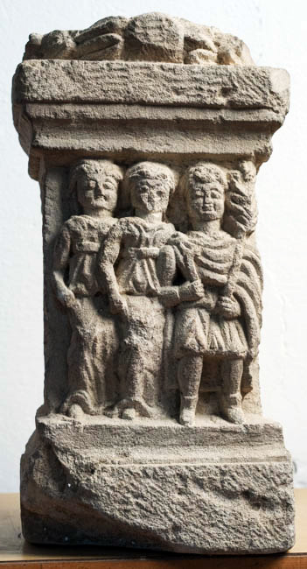
C O N C L U S I O N S
SOCIAL STATUS (17 monuments)
- one inconclusive (dispensator)
- civilians: 5
- military: 11 (2 veterans, 9 active soldiers)
RELIGIOUS WORSHIP (8/9 monuments)
- Jupiter: 4 (J. Optimus Maximus, J. Dolichenus, J. Depulsor)
- Silvanus: 3 (Silvanus, S. Magnus?, S. Domesticus, Silvanus
and Silvana)
- Nemesis: 1
ETHNIC-GEOGRAPHICAL ORIGIN (13 gentilicia, 35 cognomina)
- based on the onomastics; inconclusive
- cognomina in tandem with gentilicia mostly suggest a broad Celtic origin
GENTILICIA: Aelius, Aurelius, Carmeus, Casius, Flavius, Iulia, Nunnidius,
Petronia, Secundius, Sergius, Ulpius, Valerius
COGNOMINA: Adatilia, Aelianus, Atticilla, Atticillianus, Claudia,Cocceius,
Cupitus, Dignius, Exoratus, Felix, Fronto, Grecus, Herculanus,
Ingenuus, Iulianus, Laelianus, Marcus, Maximianu, Naso, Prisca,
Proculus, Proculianus, Provincialis, Quintus, Restutus,
Saturninus, Secundus, Sextus, Speratus, Scenus, Serenus,
Successus, Surus, Tato, Valerius, Vitalis

Slide 11
THANK YOU FOR YOUR
ATTENTION!

