Slide 1
ROMAN FUNERARY STONES OF SOUTH-WESTERN PANNONIA:
GEOLOGICAL ASPECT
Branka Migotti
The Croatian Academy of Sciences and Arts
Zagreb

Slide 2
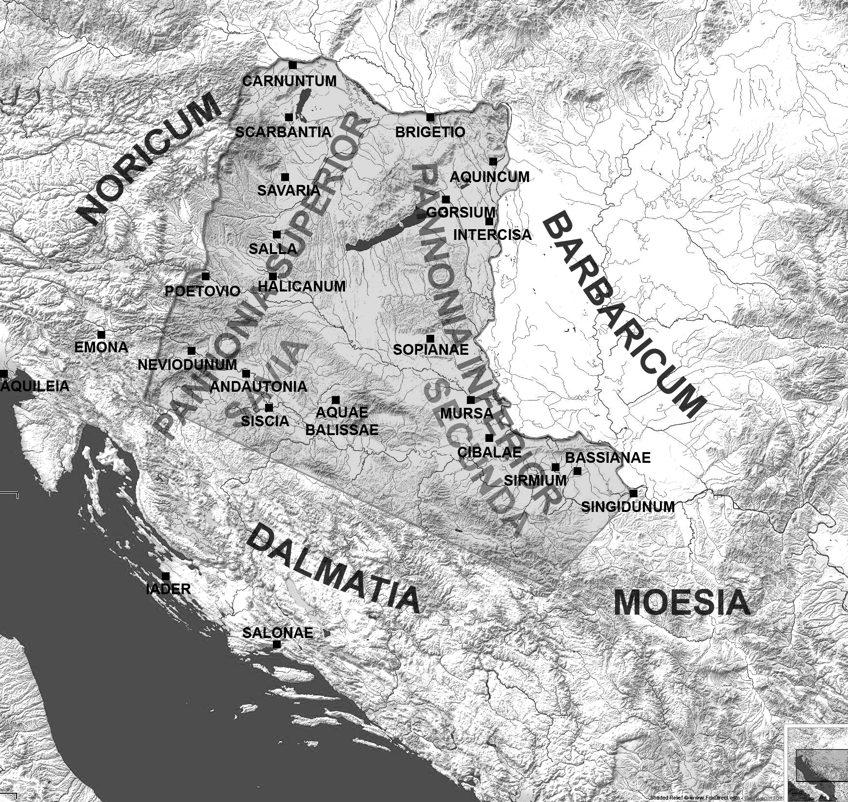
FUNERARY STONES OF SW PANNONIA IN THEIR MATERIAL, SOCIAL
AND RELIGIOUS CONTEXT (May 2015 – May 2018)
COLLABORATING INSTITUTIONS:
● The Archaeological Museum in
Zagreb
● The Slovenian Academy of
Sciences and Arts, Ljubljana
● The Faculty of Philosophy,
Ljubljana (Bojan Djurić)
TERRITORY:
ANDAUTONIA (Ščitarjevo / Zagreb)
SISCIA (Sisak)
AQUAE BALISSAE (Daruvar)

Slide 3
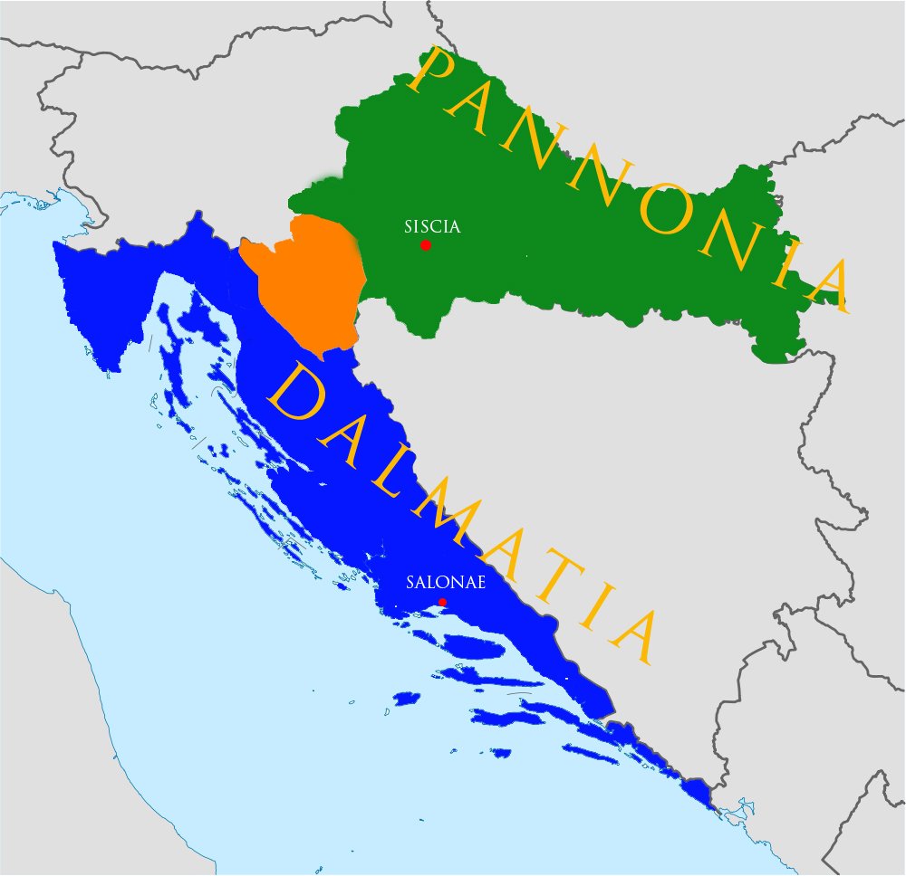
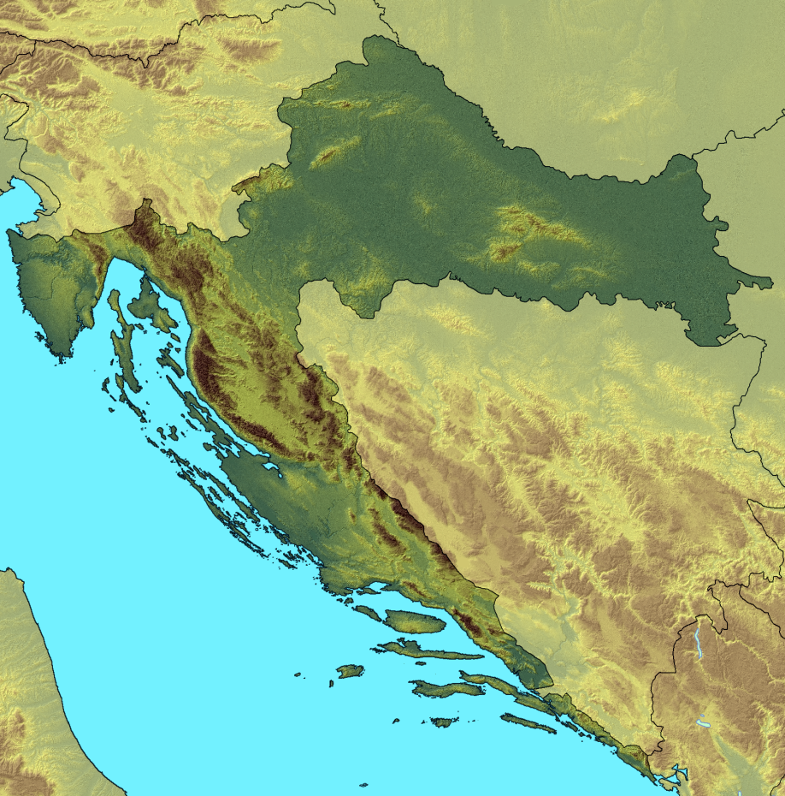
GEOARCHAEOLOGICAL RESEARCH IN CROATIA SO FAR
CHRONOLOGICAL
TRAJECTORY:

Slide 4
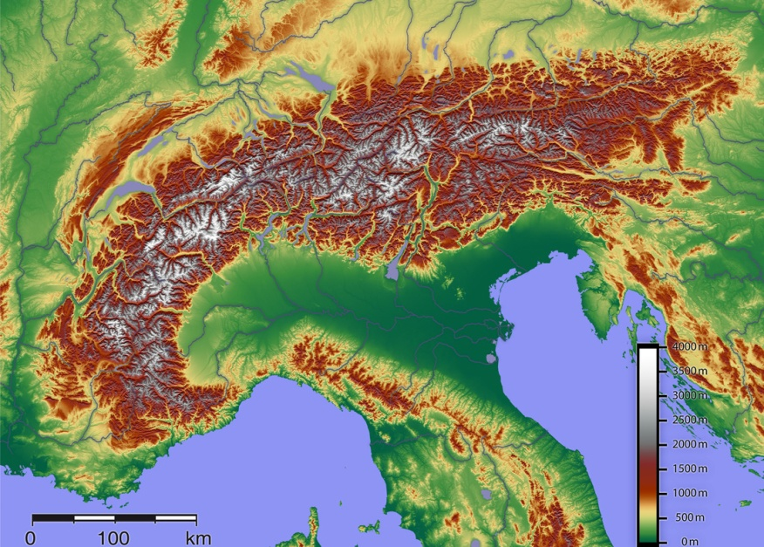
MARBLE
H. Müller (The Univ. of Natural Resources and Applied Life Sciences, Vienna) and B. Djurić:
The Museum of Slavonia, Osijek, 2004/5 The Archaeological Museum in Zagreb, 2008

Slide 5
H. MÜLLER, THE ARCHAEOLOGICAL MUSEUM IN ZAGREB, 2008
METHODS
C and O stable isotopes
Microscopic analysis of the thin section for minerals
Geochemical analysis for trace elements
60 SAMPLES
14 inconclusive in terms of the differentiation Gummern / Pohorje
2 unattributed
26.6% of the total of 60 inconclusive
14/3

Slide 6
W. PROCHASKA
Department of Applied Geological Sciences, University of Leoben
SW-Pannonian marble, characterization in 2017
29 / 25 samples
METHODS
● C and O isotope ratio
● trace element chemistry
● inclusion fluid chemistry
Müller:
● C and O stable isotopes
● microscopic analysis of the thin section for minerals
● geochemical analysis for trace elements
M. BELAK: accessory minerals

Slide 7
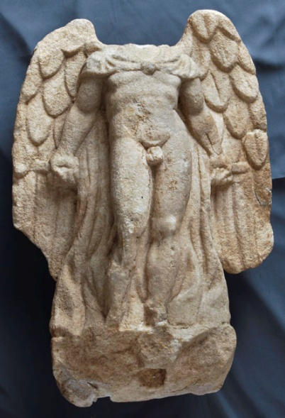
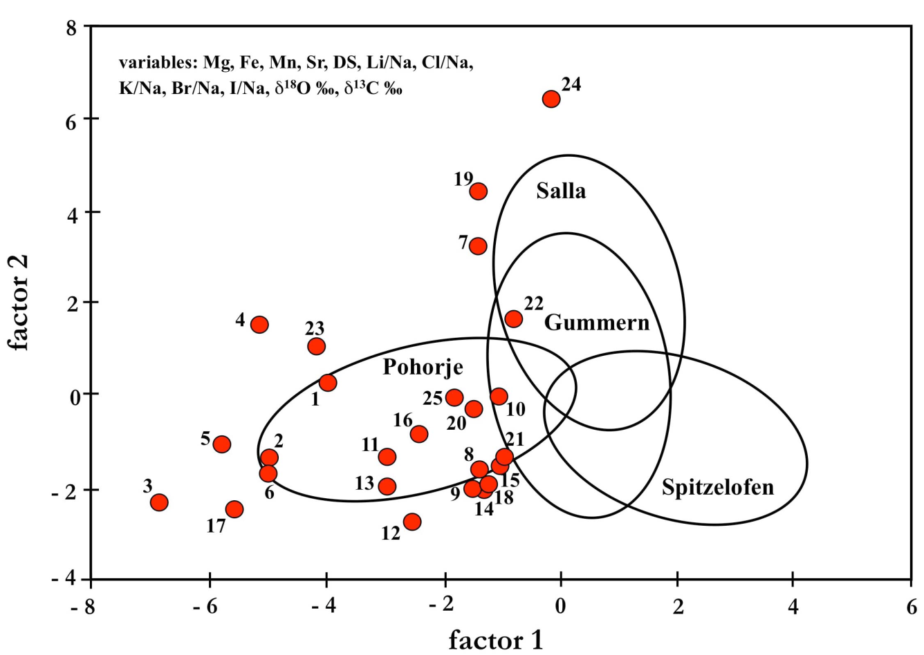
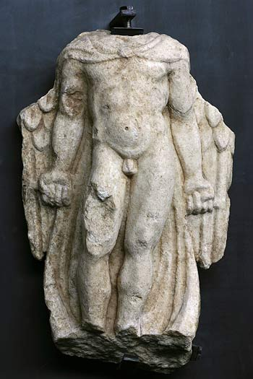
W. Prochaska, evaluation: multivariate discrimination analysis
Pohorje - Gummern
no. 22 (Gummern)
3 double-checked samples:
25 = Pohorje
19 and 24 = Salla
no. 24
Leibnitz / Flavia Solva (Salla)

Slide 9
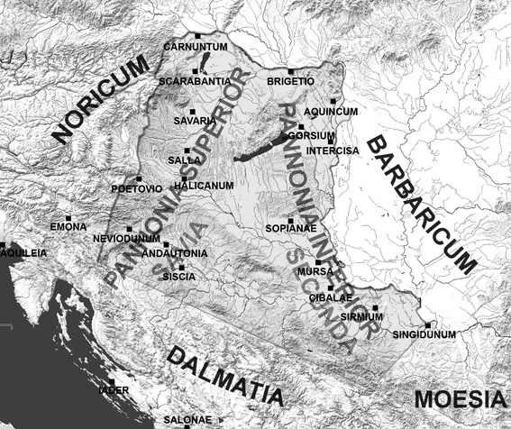
OTHER STONES – “the rule of the closest possible source”
Sisak, 3rd c..

Slide 10
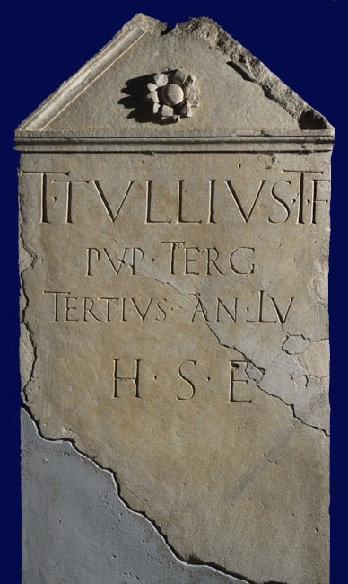
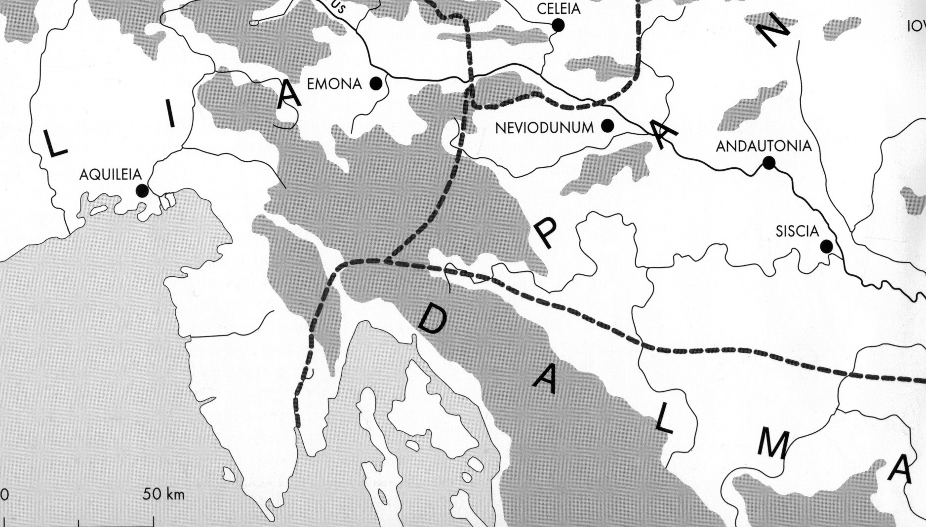
Sisak (Siscia), mid-1st c.
AURISINA

Slide 11
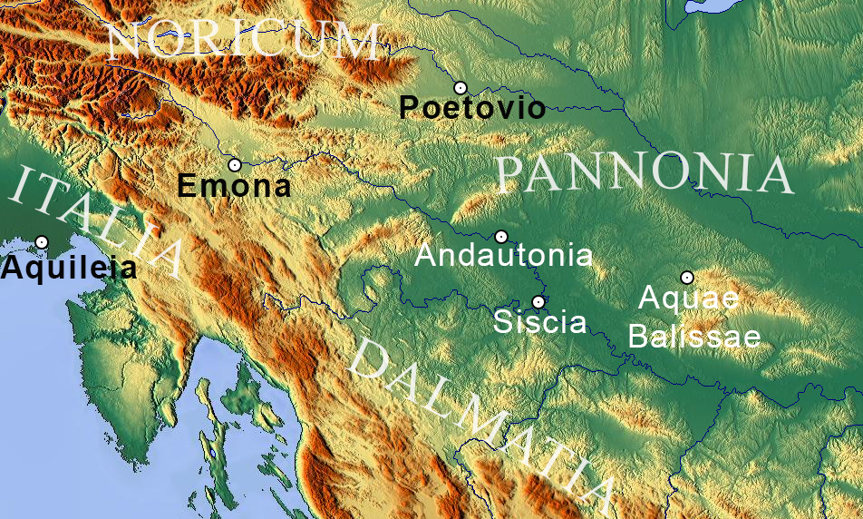
80 samples from NW Croatia (SW Pannonia)
METHODS:
macroscopy,
microscopy (polarizing light microscope, electron microscope)
X-ray diffractions
chemical analyses
CHARACTERIZATION OF STONES OTHER THAN MARBLE 2017

Slide 12
THANK YOU FOR YOUR ATTENTION!

